Slide 1

DROITS DES FEMMES
Marta H. - PROJET: Plurilinguisme

Slide 2
TABLE DES MATIÈRES
01
Women’s rights
04
Deutschland
02
History of Women’s rights
03
New Zealand
05
La France
06
Journée internationale
des femmes

Slide 3
Women’s rights
the fundamental human rights that were enshrined by the United Nations for every human being on the planet nearly 70 years ago
include: right to live free from violence, slavery, and discrimination; to be educated; to own property; to vote; to earn a fair and equal wage

Slide 4
Today’s famous saying
“Women’s rights are human rights.”

Slide 5
History of women’s rights
1848 → the first women’s rights convention; E. C. Stanton and L. Mott congregated a few hundred people in New York at their nation’s first women’s rights convention where they demanded civil, social, political and religious rights for women in a Declaration of Sentiments and Resolutions (idea is derisioned, movement is born)
1911 → the first International Women’s Day which amassed more than one million people across Europe for women’s suffrage and labour rights
1945 → the UN was born and it layed foundation for women’s rights
1970 → the first UN Decade for Women and the first world conference on women in Mexico escalates global discourse on women’s rights
more than a century since the women’s suffrage movement began and decades of vigorous activism later, women in a vast number of the world’s countries can vote by the 1980s

Slide 6
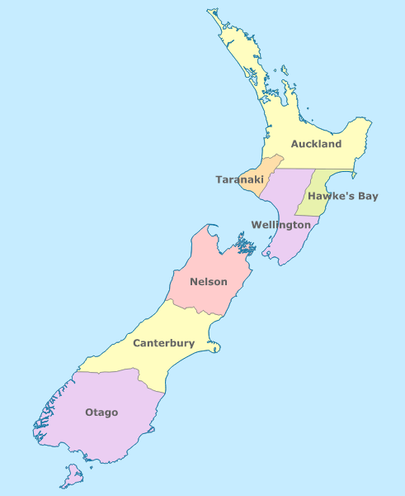
New Zealand
19 September 1893 → Governor Glasgow signed the Electoral Bill and New Zealand became the first self-governing country to grant the vote to all adult women

Slide 7
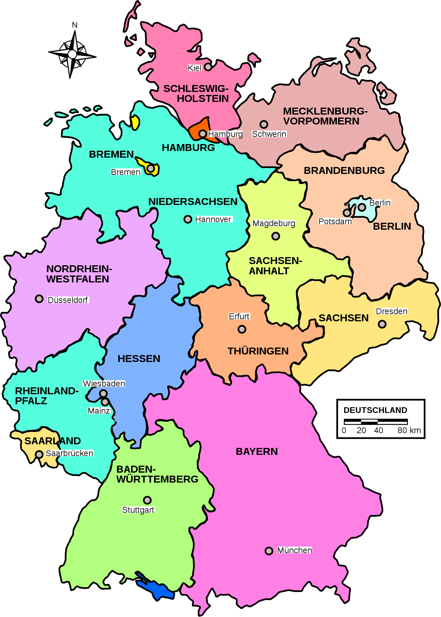
Deutschland
30. November 1918 → das neue deutsche Gesetz, das Männernund Frauen ab 20 Jahren das direkte und allgemeine Wahlrecht einräumt

Slide 8
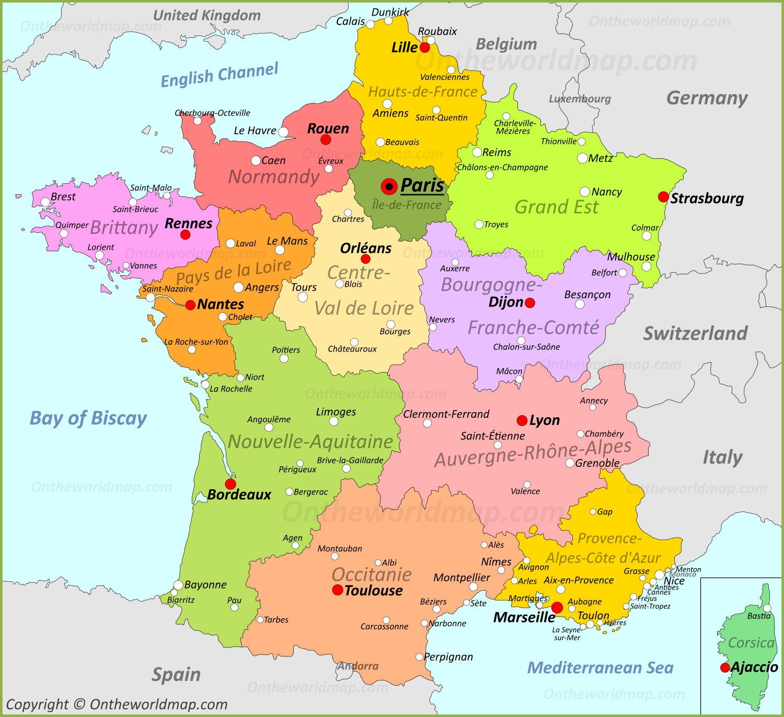
La France
le 21 avril → la mesure a été signée pour le suffrage des femmes sous un gouvernement provisoire dirigé par le général Charles de Gaulle

Slide 9
Journée internationale des femmes
une journée mondiale qui célèbre lesréalisations sociales, économiques, culturelles et politiques des femmes
elle est célébrée le 8 mars

Slide 10
La bibliographie
“Timeline: Women of the World, Unite!” UN Women | Timeline, https://interactive.unwomen.org/multimedia/timeline/womenunite/en/index.html?gclid=CjwKCAiAheacBhB8EiwAItVO29ner2DBbXpPR64BDNNsWZXh6TIeMOH35qtfR6Wo6u0EBNBTO_oh1xoCT2kQAvD_BwE#/1980. Accessed 11 December, 2022.
“Information about Women's Human Rights.” Global Fund for Women, https://www.globalfundforwomen.org/womens-human-rights/. Accessed 11 December, 2022.
“About International Women's Day.” International Women's Day, https://www.internationalwomensday.com/about. Accessed 11 December, 2022.
Archives.govt.nz, https://www.archives.govt.nz/discover-our-stories/womens-suffragepetition#:~:text=Te%20Petihana%20Whakamana%20P%C5%8Dti%20W%C4%81hine,The%20Women's%20Suffrage%20Petition&text=When%20Governor%20Glasgow%20signed%20the,won%20the%20right%20to%20vote. Accessed 11 December, 2022.
Breuer, Rayna. “How German Women Obtained the Right to Vote 100 Years Ago – Dw – 11/30/2018.” Dw.com, Deutsche Welle, 30 Nov. 2018, https://www.dw.com/en/how-german-women-obtained-the-right-to-vote-100-years-ago/a-46256939. Accessed 11 December, 2022.
24, FRANCE. “France Marks 70 Years of Women's Voting Rights.” France 24, France 24, 21 Apr. 2014, https://www.france24.com/en/20140421-france-womens-voting-right-anniversary. Accessed 11 December, 2022.

Slide 11
Merci de votre attention!

