Slide 1
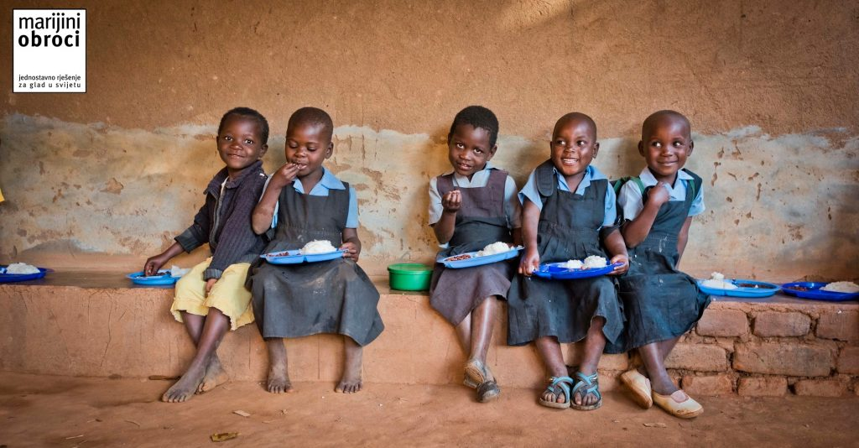
Mary’s Meals
Lucija Glavičić Marović and Jan Veljača

Slide 2
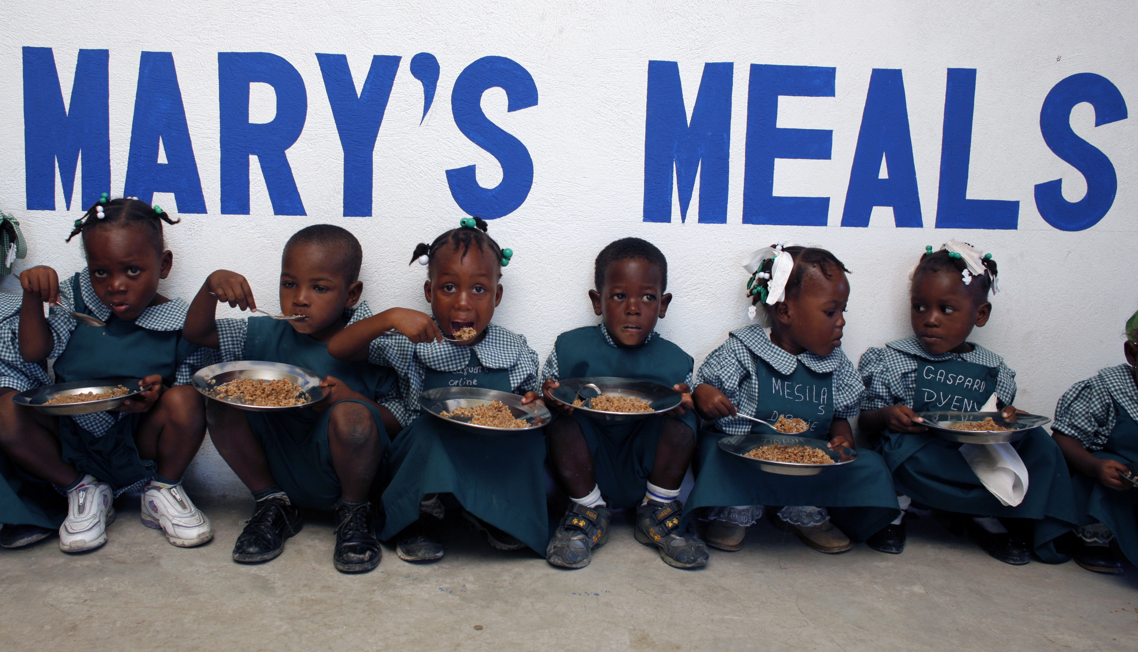
About
Charity which sets up school feeding programmes in some of the world’s poorest places
Named after Mary, mother of Jesus
Feed more than 1 million children daily
Benin, Ecuador, Ethiopia, Haiti, Kenya

Slide 3
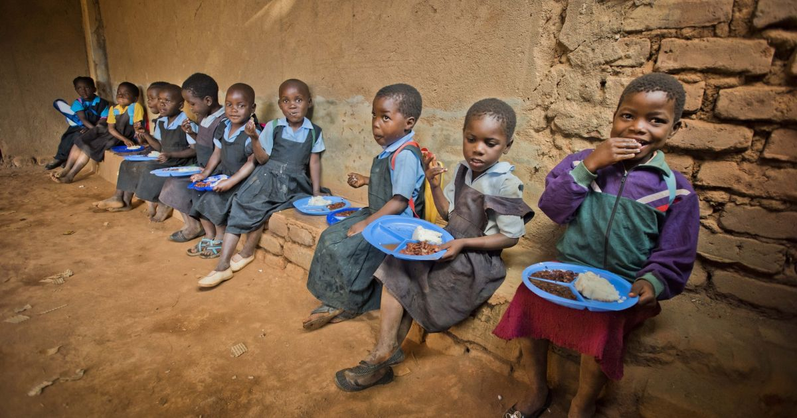
A child who has the energy to attend and concentrate during lessons can achieve the unthinkable
School feeding programmes are recognised as a cost-effective way to deal with poverty by addressing the immediate needs of hungry children and contributing to the long-term development of their communities

Slide 4
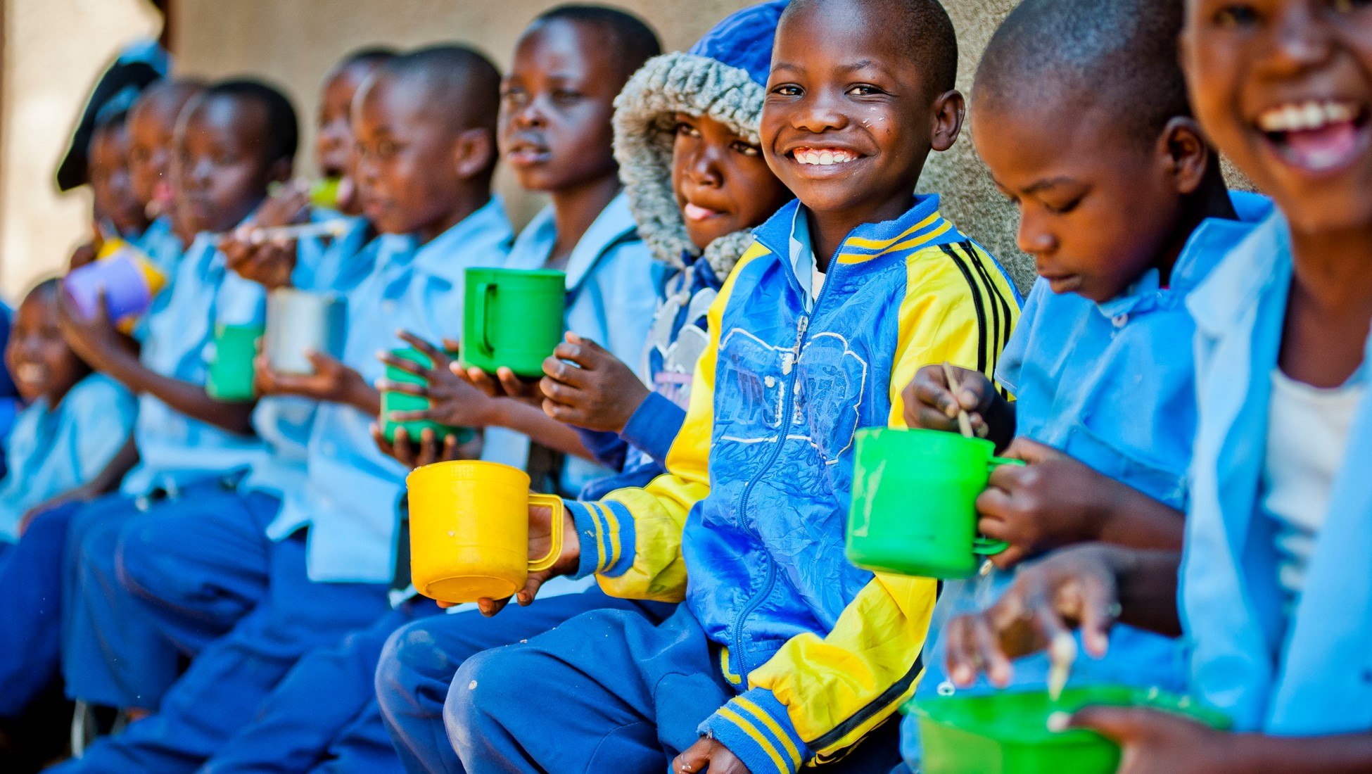
“We firmly believe that every child in the world deserves an education and enough to eat and we have seen the difference that daily meals in a place of learning can make to vulnerable children and whole communities.”
Mary’s Meals, 2022.

Slide 5
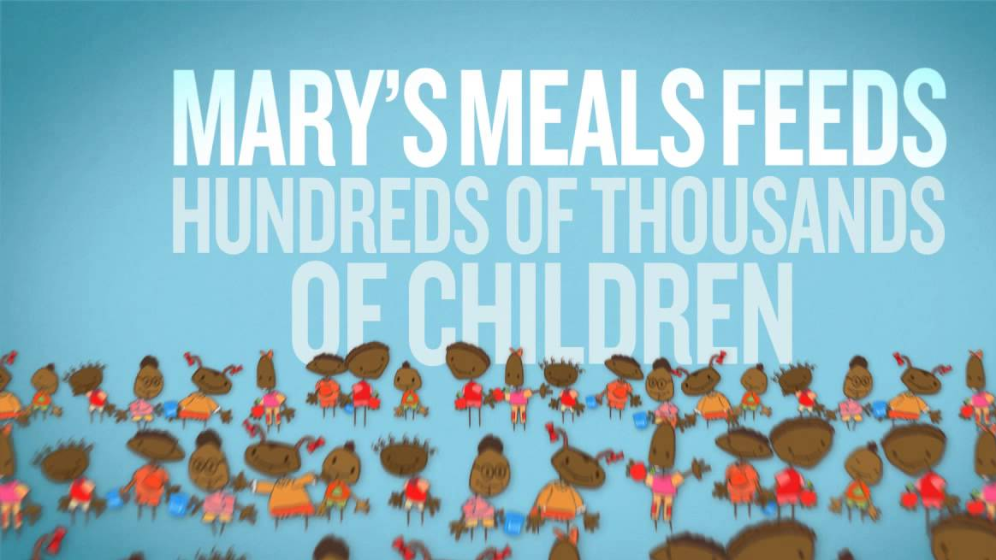
Resources
Juetten, Mary. “Dinner, Anyone? the Freshly Story.” Forbes, Forbes Magazine, 15 Oct. 2020, https://www.forbes.com/sites/maryjuetten/2020/10/15/dinner-anyone-the-freshly-story/.
“Mary's Meals Provides Food for One Million Children.” BBC News, BBC, 19 May 2015, https://www.bbc.com/news/uk-scotland-32806247.
“Our Impact.” Mary's Meals, https://www.marysmeals.org/what-we-do/our-impact.

