Slide 1
Dekica za
snove
CAS (Service)

Slide 2
What is it?
‘Dekica za snove’ is an initiative by the organization ‘Smiješak za sve’ in which students from high schools and middle schools read intriguing stories to children in kindergarten.
FB of organization:
https://www.smijesakzasve.hr/projekti
facebook.com/smijesak.zagreb/

Slide 3
What DID WE DO ON THE EVENT?
On September, students from IB DP XV. gimnazija, Zagreb and ‘Smiješak za sve’ collaborated to read stories to children.

Slide 4
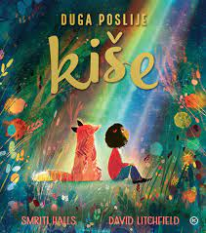
Hana e.
I read ‘Duga poslije kiše’ and the learner outcome which I related to the most is ‘Challenge and skills’: I faced a challenge reading in front of people out loud which i overcame by reading said story.

Slide 5

JANA č.
I read a story “Zaljubljeni krokodil” from Luko Paljetak’s collection “Miševi i mačke naglavačke”. During this CAS experience, I was able to “identify my own strengths and develop areas for growth, because I was able to experience how it is to read in public and recognize how I could improve my performance.

Slide 6

Victor K.
During my attendance at “Dekica za sve” project, I read a children’s book named “Mali majmun u velikoj brizi”. What’s most important to me is further developing & stabilizing the CAS Learning Outcomes (LO). Thanks to this project, I was able to develop LO 5 which involves understanding the significance of working collaboratively as well as demonstrating my skills (which I learned during my personal Creativity & Service - expressive reading)
Overall, I am satisfied with this project since I really enjoyed participating and further developed one, but important, Learning Outcome.

Slide 7
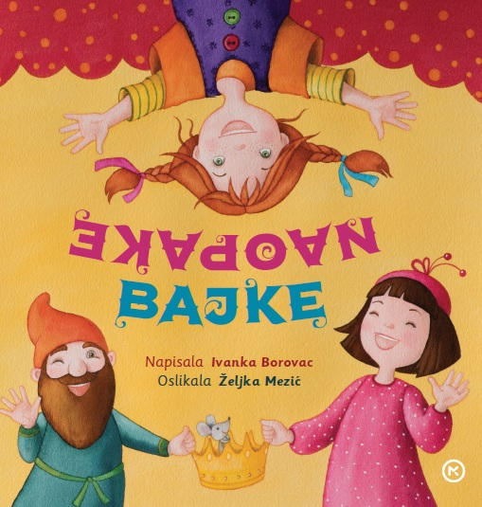
Lara L.
At “Dekica za sve”, I read a story called “Mala sirena s otoka Hvara” from Ivanka Borovac’s book of short stories for kids called “Naopake bajke”. As for the CAS learning outcomes, I feel like I demonstrated the skills and recognized the benefits of working collaboratively. I read the story expressively and therefore engaged other people to listen to me. Also, I think that I talk for everyone when I say that this was an interesting new experience and I am happy I did it with my school friends. We worked together towards embracing a new challenge.

Slide 8
Klara J.
At the “Dekica za snove” event I read two stories from the previously mentioned “Miševi i mačke naglavačke” by Luko Paljetak. “Jedna je mačka mnogo jela” and “Jedna je mačka mnogo pila”. This was an interesting experience in which i believe to have developed the CAS learning outcomes. The outcome this experience developed the most is working collaboratively with others. I had to listen actively and adjust my reading to the target audience which I believe are parts of this outcome.

Slide 9

Ema R.
During “Dekica za sve” event I read a story “Ljubavni pogled”, from a book “Ispričat ću ti priču” written by Jorge Bucay. Regarding the CAS learning outcomes, the ones I think I developed the most were the ability to work collaboratively with others and developing areas for personal growth. I had to listen actively while others were reading and engage in the project by deciding on the story I wanted to read in front of everyone. The content of the chosen story, as well as the intonation while reading, had to be suitable for my audience. The experience also allowed me to reflect on my reading skills and find ways for improvement.

Slide 10

Filip k.
At “Dekica za snove“, i read the popular Croatian story “Grga Čvarak“. regarding the CAS learning outcomes, I think i developed working collaboratively with others the most. There was a lot of us reading and we had to plan our activities. Some of us read the same books, so it was interesting to see how different people approach the same text. Also, i improved my reading and public speaking skills and hence learnt something useful from it. I am satisfied with how the event was organised and what we did, as it was both fun and useful, as we all learnt something.

