Slide 1
Gostomel Animal shelter needs your help!

Slide 2
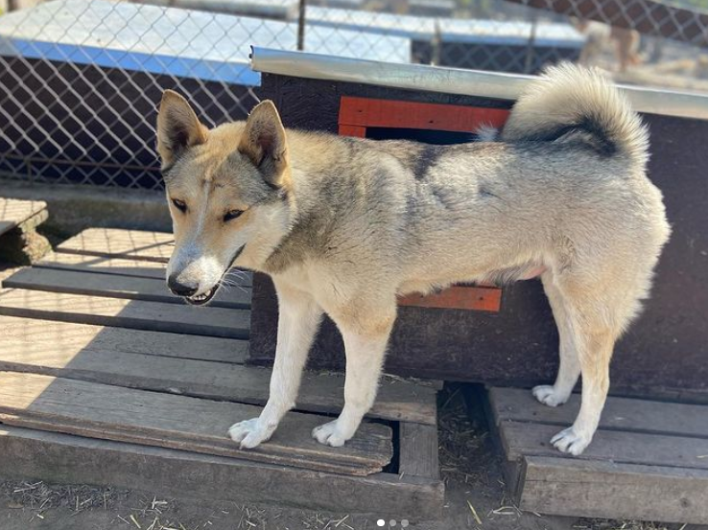
About Gostomel animal shelter
On February 24, 2022, Russia has invaded Ukraine and launched their attacks on large cities such as Kyiv, Kharkiv and many more
They have damaged homes, public institutions and other institutions including Gostomel animal shelter
Gostomel animal shelter is located just 8km away from Kyiv where major bombings took place
Four staff members and over 700 animals have suffered major consequences from damage to the physical property to death of some animals
The overall damage is estimated to be over 30,000$

Slide 3
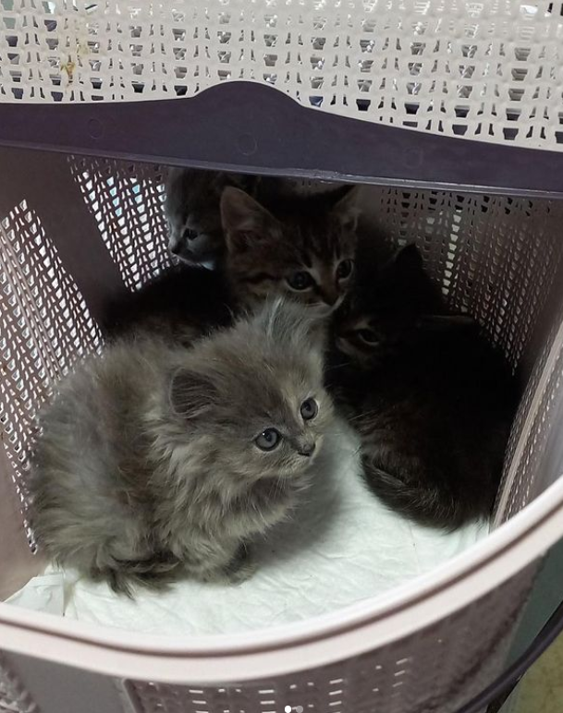
Future
Now that some things start to clear out we are capable to communicate and help the Gostomel Animal shelter
Through collaboration between AISZ and XV. Gymnasium we are raising funds to help the shelter recover and save lives of innocent pets
Without our help recovery of facilities in shelter will be impossible, but even basic necessary supplies will soon start to run out and animals will start to die from lack of medicine and starvation

Slide 4
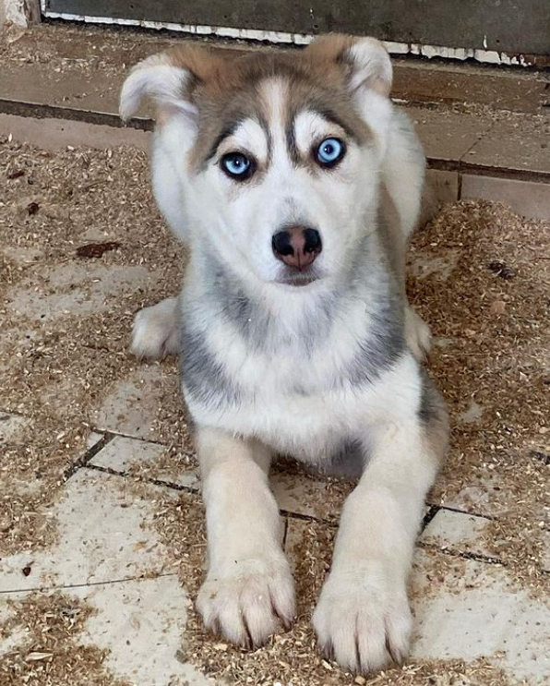
How can we help?
Main areas in which donated money will be invested:
- buy food, medication, electricity generators, etc
- rebuild parts of the shelter

Slide 5
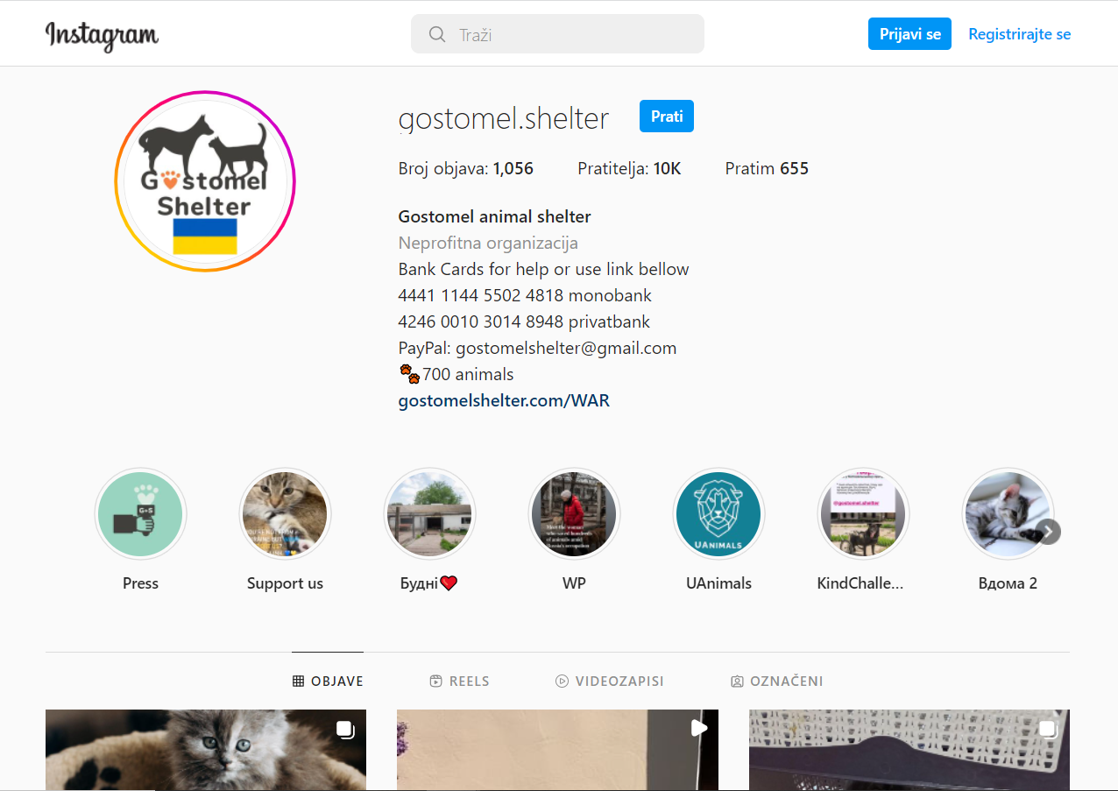
Animal Shelter Instagram
If somebody wishes to go to their Instagram and see the situation
This is the link: https://www.instagram.com/gostomel.shelter/

Slide 6
Resources:
“Login • Instagram.” Www.instagram.com, www.instagram.com/p/CdlBraJNV8s/. Accessed 18 May 2022.

