Slide 1
PERSONAL PROJECT 2021/2022
ALL YOU NEED TO KNOW ABOUT PERSONAL PROJECT

Slide 2
WHAT IS PERSONAL PROJECT?
an independent, individual project to be completed in MYP5
IB requirement for all MYP students in year 5
should be based around the topic that motivates you
should show the development of the ATL skills, attitudes and knowledge acquired in the MYP

Slide 3
WHAT DOES THE PP INCLUDE?
A report
A product
Excellent time-management
skills

Slide 4
SETTING A GOAL
The goal consists of 2 interrelated parts-a product and a learning goal
PRODUCT- what you want to create
LEARNING GOAL -what you want to learn
It may come from:
a global context that you find particularly compelling
a service as action experience that you would like to build on
a unit of inquiry that you would like to explore further
or it may be based on an interest or hobby outside the school

Slide 5
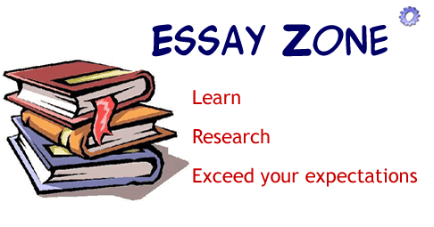
A PRODUCT OR OUTCOME
an original work of art –painting,sculpture,short story,
novel, film,play, etc.)
an awareness-raising campaign
a video/computer game,website
learning to play a new piece of music/instrument
improvning athletic performance
an essay (literary,scientific,etc.)

Slide 6
PERSONAL PROJECT OBJECTIVES
Objective A: Planning
You shoud be able to:
state a learning goal for the project and explain how a personal interest led to that goal
state an intended product and develop appropriate success criteria for the product
present a clear, detailed plan for achieving the product and its associated success criteria
Objective B: Applying skills
explain how the ATL skill(s) was/were applied to help achieve their learning goal
explain how the ATL skill(s) was/were applied to help achieve their product
Objective C: Reflecting
explain the impact of the project on themselves or their learning
evaluate the product based on the success criteria.

Slide 7
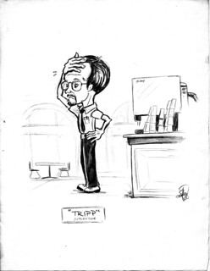
THE SUPERVISOR
Each student is assigned a supervisor who should:
provide guidance
provide timetable with deadlines
provide the assessment criteria
give advice on how to keep and use the
process journal
emphasize the importance of personal
analysis and reflection
provide formative feedback
(oral and written)
ensure requirements for academic honesty

Slide 8
GATHERING EVIDENCE
Evidence to document the process is:
gathered throughout the project to document its development
an evolving record of intents, processes, accomplishments
a collection of initial thoughts and developments, brainstorming, possible lines of inquiry and further questions raised
a record of interactions with sources, for example, teachers, supervisors, external contributor
a record of selected, annotated and/or edited research and to maintain a bibliography
a collection of useful information, for example, quotations, pictures, ideas, photographs
a means of exploring ideas and solutions
a place for evaluating work
completed reflection on learning devised by the student in a format that suits his or her needs
a record of reflections and formative feedback received
The evidence needs to be shared/showed to the supervisor in meetings!!!
It is NOT a diary!!!

Slide 9
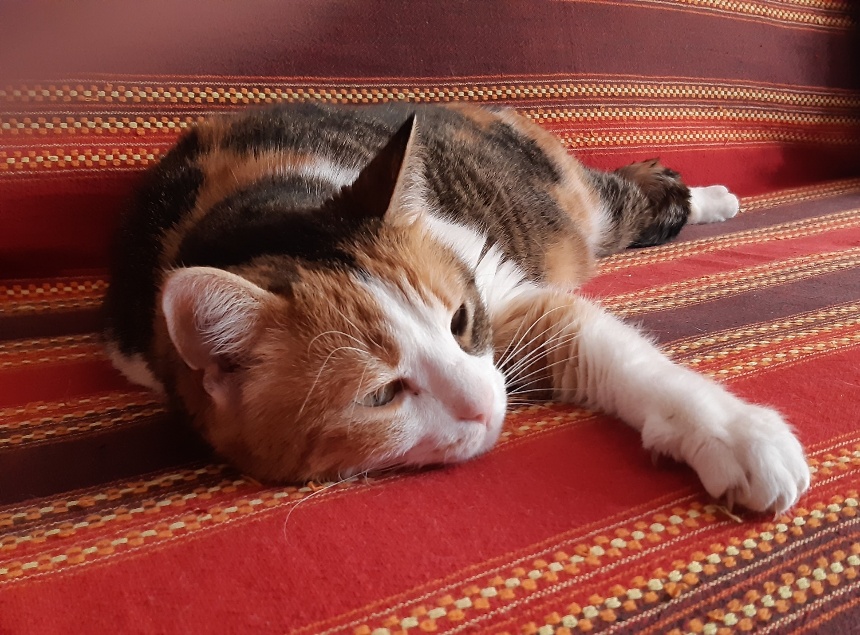

Slide 10
ACTION PLAN
Create a step-by-step ACTION PLAN for achieveing the goal and the chosen product which should include:
success criteria for the product
necessary steps or actions required to meet those criteria
establish a foundation to explain whether or not the goal was achieved in the report.
involves research, also related to the learning goal , which could be included as part of the action plan.

Slide 11
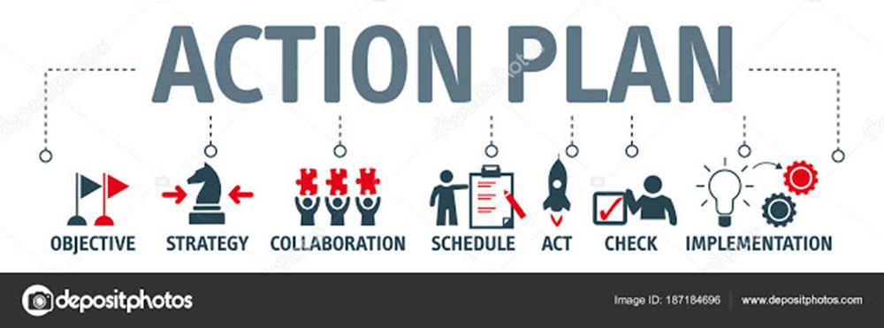
ACTION PLAN- samples

Slide 12
ATL SKILLS evidence may include:
visual thinking diagrams
bulleted lists
charts
short paragraphs
notes
timelines
action plans
annotated illustrations
annotated research
artefacts from inspirational visits to museums, performances, galleries
pictures, photographs, sketches
up to 30 seconds of visual or audio material
screenshots of a blog or website
self- and peer-assessment feedback.

Slide 13
S.M.A.R.T. Goals- how to achieve them

Slide 14
ATL SKILLS AND EVALUATION OF PRODUCT
When providing evidence of ATL skills you will have to:
select pieces of evidence to demonstrate the ATL skills that have had the most impact on your project
one piece of evidence must support the analysis of how ATL skill(s) were applied to extend the learning goal, and another must support the analysis of how ATL skill(s) were applied to achieve the product
use the success criteria to evaluate the extent to which the product goal was achieved.
evaluation is foundation for explaining the impact of the project
can help when selecting the evidence of the ATL skills to include in the report

Slide 15
REPORTING THE PERSONAL PROJECT
Should be presented in identifiable sections:
Planning
Applying skills
Reflecting
everything relevant to the process and the development of the PP has to be evidenced
the ability to communicate clearly and concisely is essential to demonstrate the elements of the report
PP work must be your own
you must use Academic honesty form when submitting the PP
if you plagiarise someone else’s work you will fail

Slide 16
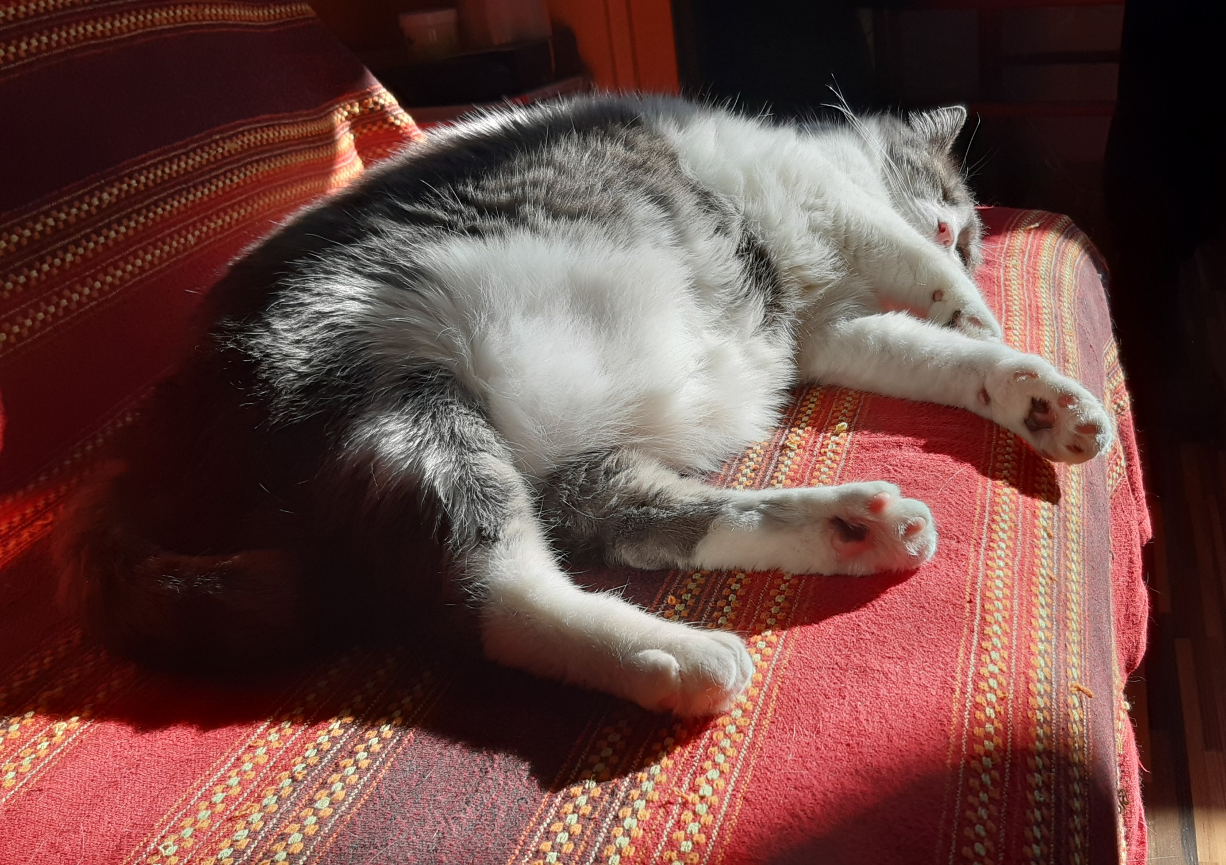

Slide 17
PHASE 1 May, June 2021
choose a topic and submit the topic to Ms Kos, MYP coordinator by 13:00 , Tuesday 1 June, 2021
a supervisor will be assigned
the list of topics, students and supervisors will be posted on the MYP notice board next to the MYP Coordinator's office on Monday , 7 June 2021
(after 12:00)
By 18 June, 2021 a meeting with the supervisor MUST be held/organized and topic, goals and action plan discussed

Slide 18
PHASE 2 June-September 2021
make weekly, step-by-step action plan to follow during the summer and beyond (including the success criteria for the product)
resesarch the topic during the summer
select, evaluate and acknowledge information
keep all the relevant info, research, evaluation of sources,screen shots of relevant pages and links in your PP journal (ATL skills )
meet with the supervisor in September 2021 as soon as possible

Slide 19
PHASE 3 October 2021
Provide further detailed action plan
Work on product-show evidence of it to supervisor
Regular meetings with supervisor-show progress
Use PP journal –keep notes and entries-show/share with the supervisor
PHASE 4 November,December 2021
Work on product
Use process journal-keep notes of meetings, development of product, photos, sketches,interviews,etc.
Regular meetings with supervisor
In November-PP presentations – in front of teachers and students

Slide 20
PHASE 5 January 2022
Complete product and report,including evidence and achieveing the 2 goals
Submit first draft of the report to the superviosor
Continue meetings with the supervisor
Submit/share the process journal notes/entries
PHASE 6 February 2022
First draft with feedback returned to student (1stweek of February)
By the end of February – submit both hard copy and digital version
Final draft of the report
Product
Completed academic honesty form
Bibliography/sources ( a separate document)
Personal project coversheet
Turnitin similarity report

Slide 21
PP festival 14 March 2022
Presentation /exhibition/showcase
of all PPs at the School day festival
(depending on the epidemiological
situation)
Parents, MYP4 students,other teachers are all invited

Slide 22
KEEPING
IF YOU FAIL TO FOLLOW/ KEEP THE DEADLINES THERE WILL BE POINTS TAKEN OFF THE PP
NO PERSONAL PROJECT
( FINAL DRAFT) WILL BE ACCEPTED AFTER THE DETERMINED DEADLINE !!!!!!!!

Slide 23
THANK YOU FOR LISTENING !!!
Acknowledgement : This PPT is adapted from the new IB Personal Project guide for use from September 2021, previously published PP guides and PPTs of XV. gimnazija

