Slide 1

PP DOS and DON’TS
Clara Kašić Ridvan Kučuk

Slide 2
DOS
Chose a topic you are extremely intersted in
Manage your time
Make lots of journal extracts
Have as many meetings with your supervisor as possible
Communicate with other students
Make a first draft
Use a variety of different sources

Slide 3
CHOOSE A TOPIC OF INTEREST
Do not chose a topic based on your goal supervisor’s field of work
Think critically before choosing
Choose something which you really want to learn about
At the same time, try making it as challenging as possible
It should have some impact on your community or you as a person

Slide 4
MANAGE YOUR TIME
Start as soon as possible
Create detailed plans for organizing yourself and your time
Follow deadlines
Do It (if you want to avoid stress)

Slide 5
MAKE LOTS OF JOURNAL EXTRACTS
Whenever you think about your PP note it down in your journal
Your journal is not a diary (include tables, graphs, charts, pictures…)
Try making your extracts fit in one page

Slide 6
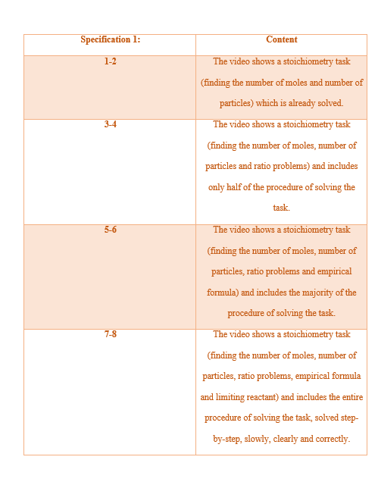
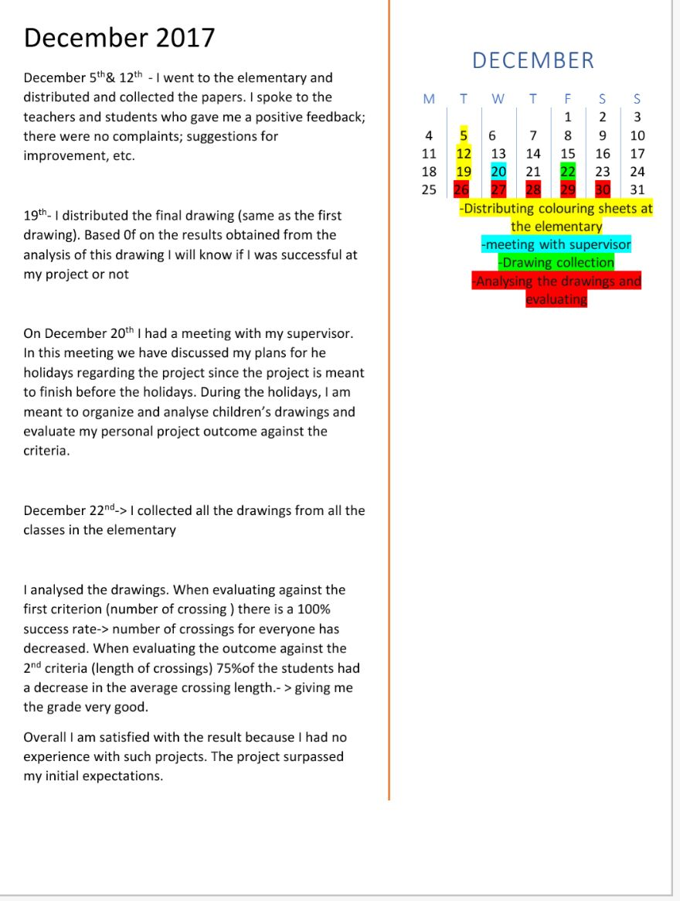

Slide 7
HAVE AS MANY MEETINGS WITH YOUR SUPERVISOR
For better understanding of your personal project speak to your supervisor as much as you can
Your supervisor is your primary source of information
You are supposed to organize the meetings, not your supervisor

Slide 8
USE A VARIETY OF SOURCES
Websites
Interviews
Videos
Books
Newspaper

Slide 9
DON’TS
Procrastinate
Focus too much on your product
Start too late
Don’t copy from other people (turnitin is watching you)
FORGET TO CITE SOURCES

Slide 10
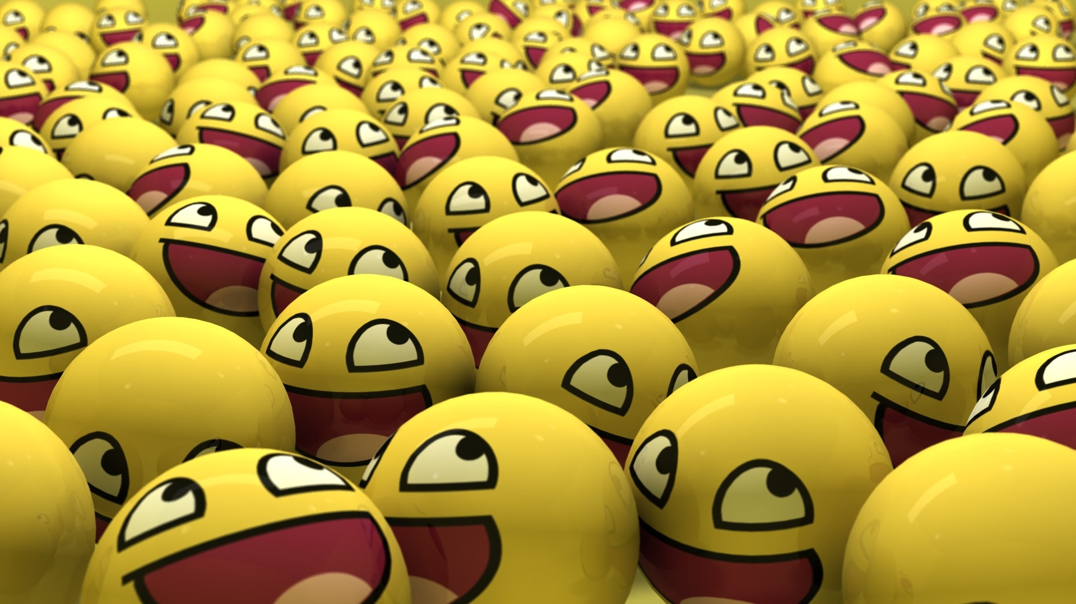
DON’T FORGET TO HAVE FUN!!!

