Slide 1
School Choir
Leader: Ozana Bijelonjić

Slide 2
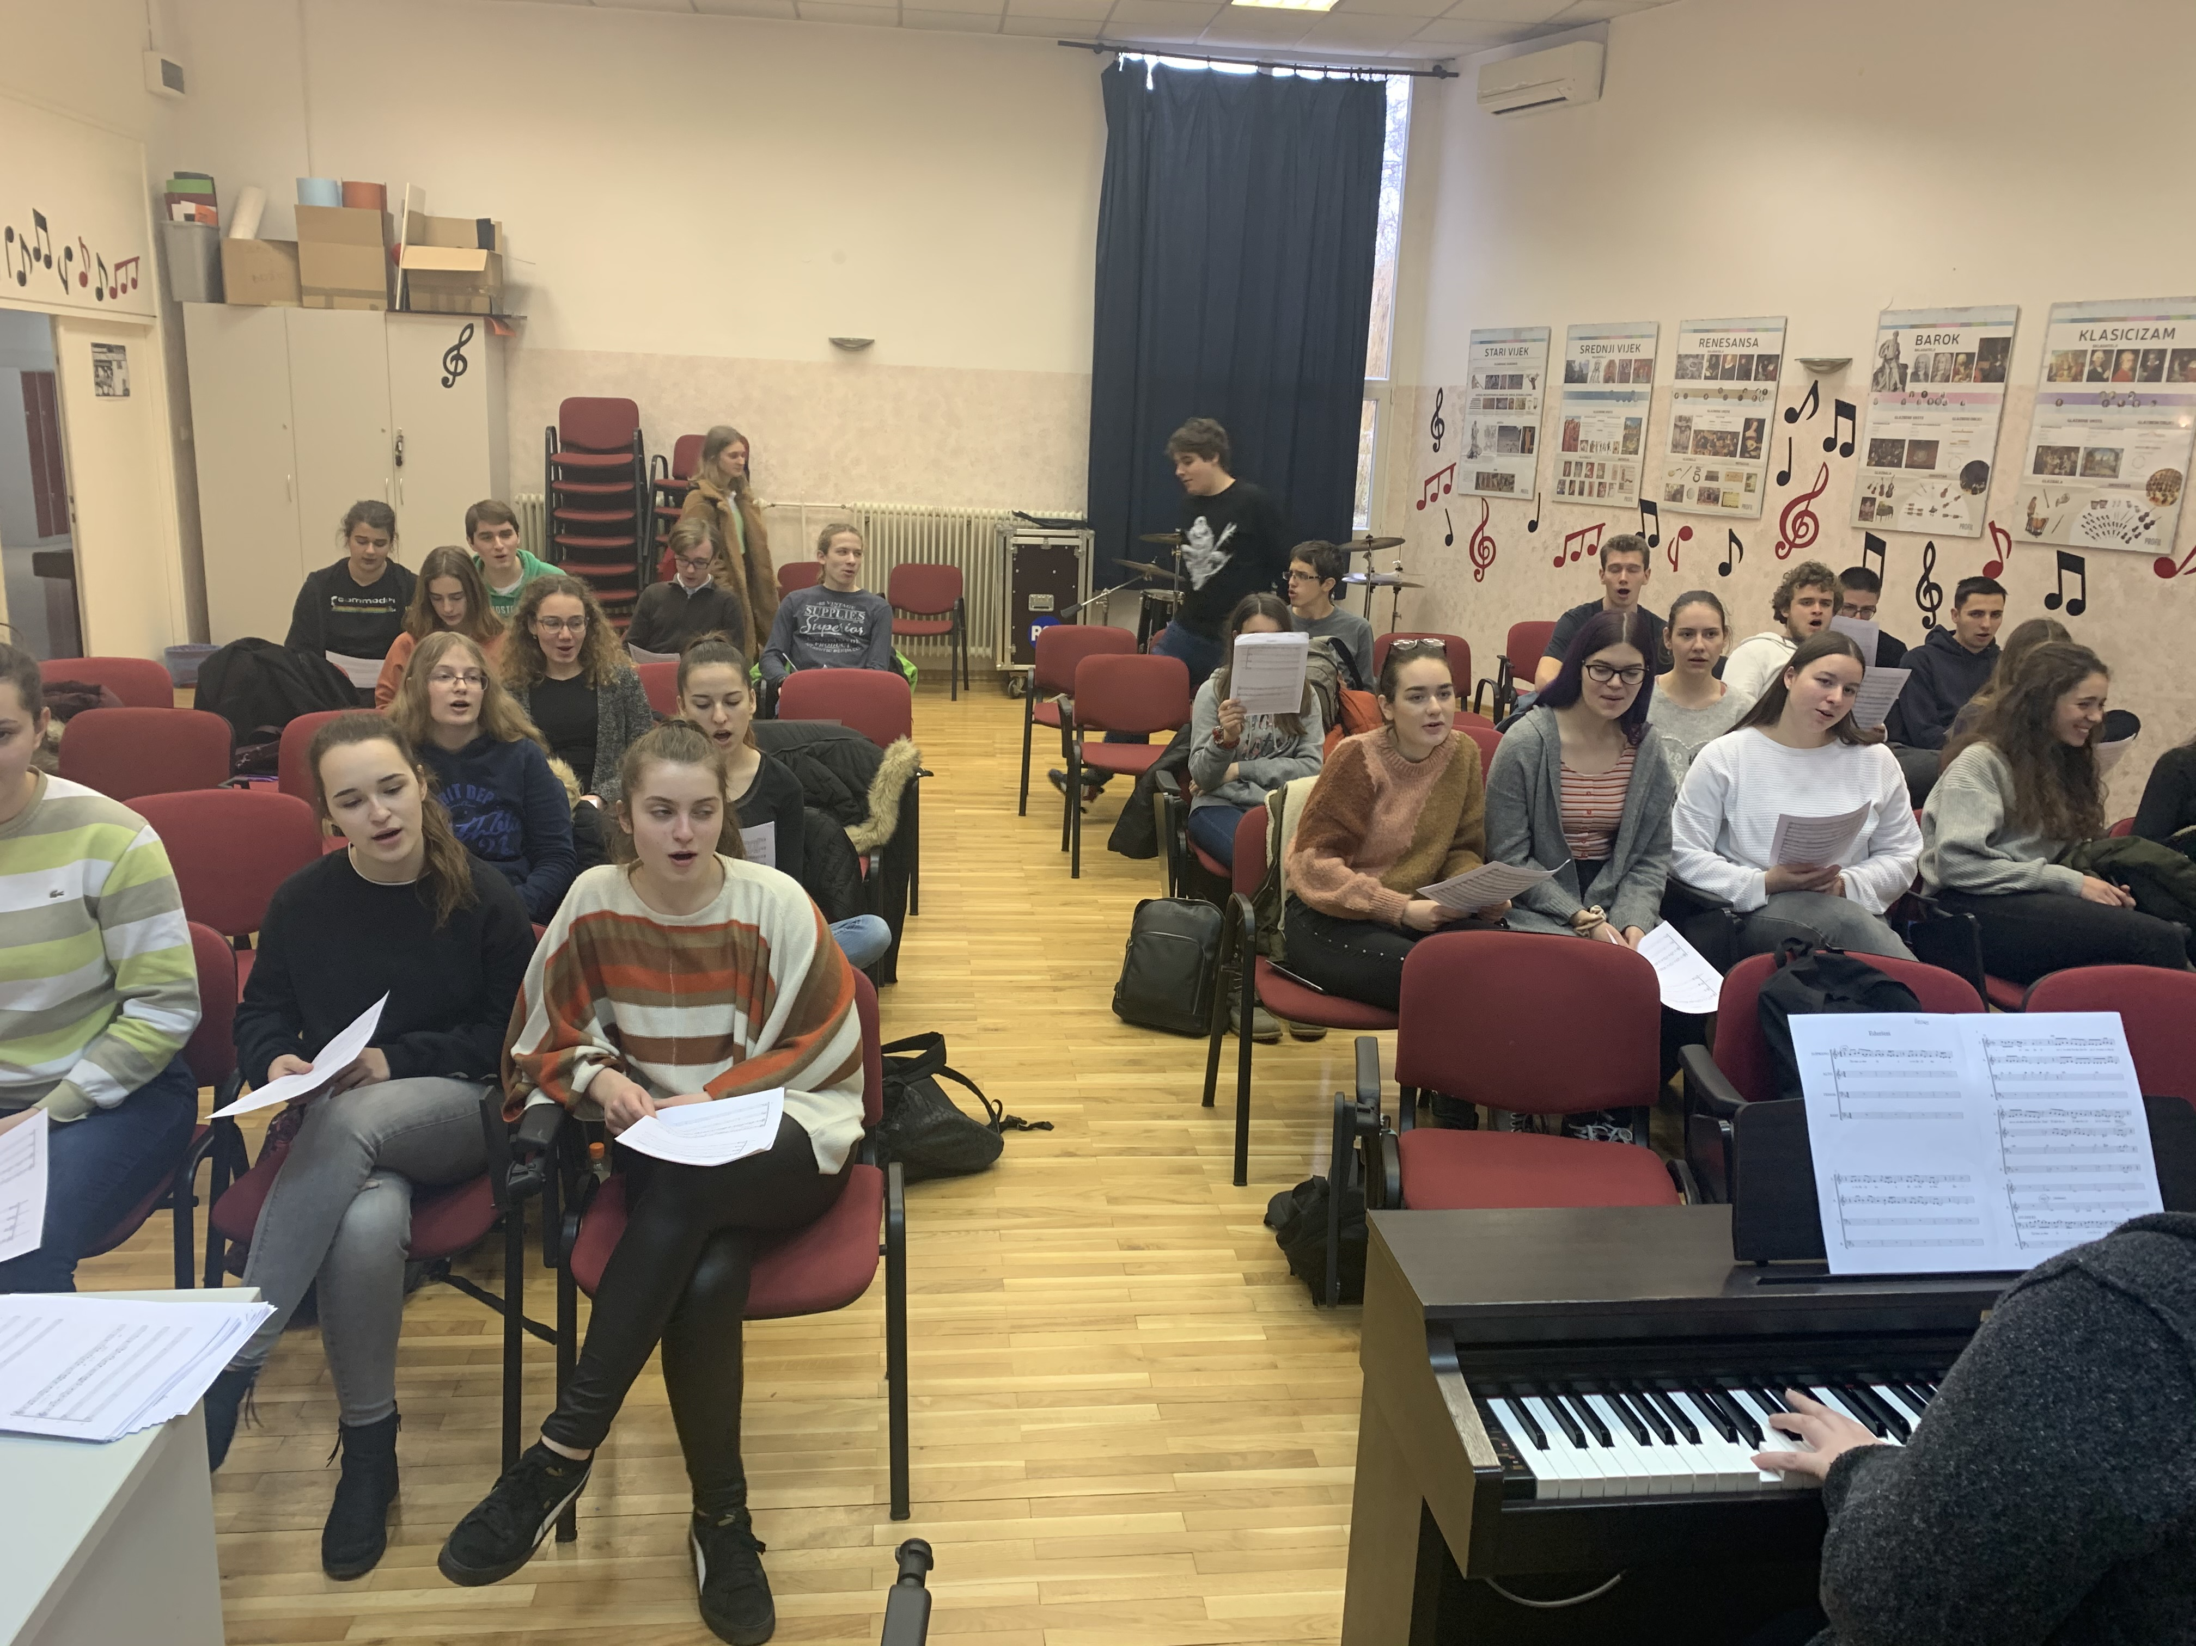
What did we do?
Sing various songs
At the moment we are singing Ederlezi, by Goran Bregović
Playing some instruments

