Slide 1
Pop-Rock Group – IB band
Lara Šimić, 3N
CAS activity

Slide 2
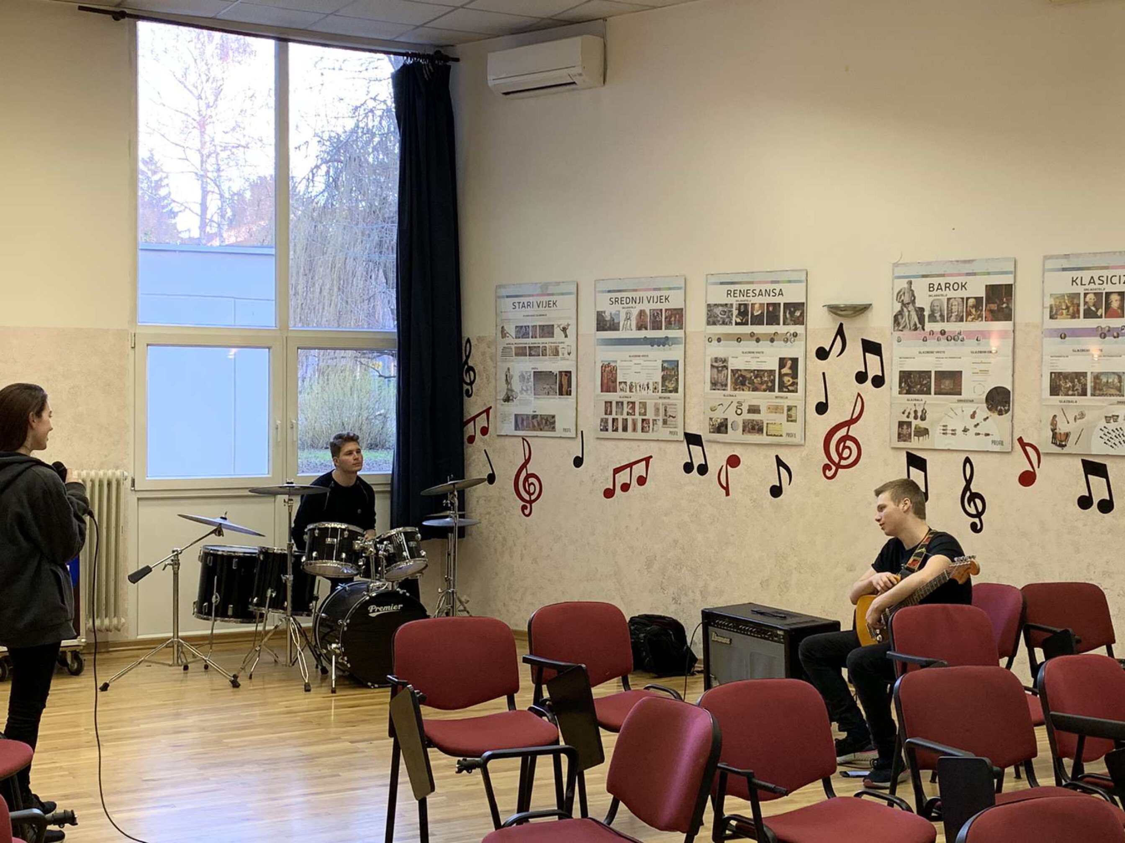
CAS activities
Pop – Rock group is a part of
creativity IB CAS experiences
It is led by Ms. Jadranka Ivaniš YaYa

Slide 3
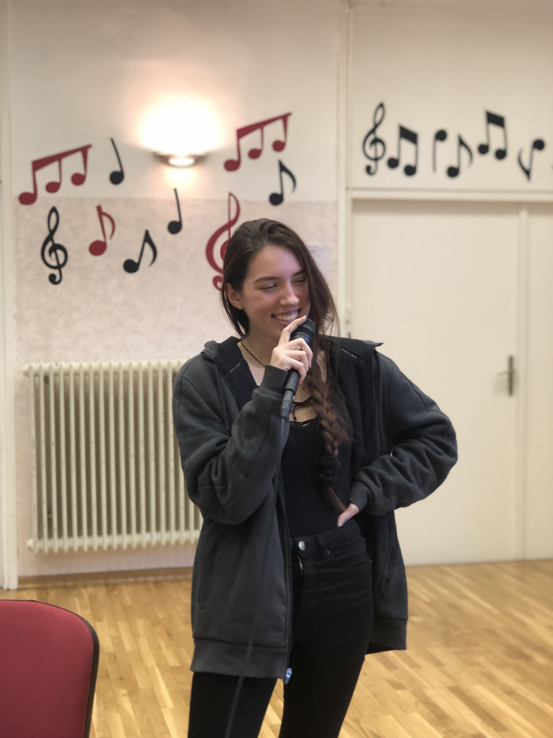
The Band
The IB band consists of a singer

Slide 4
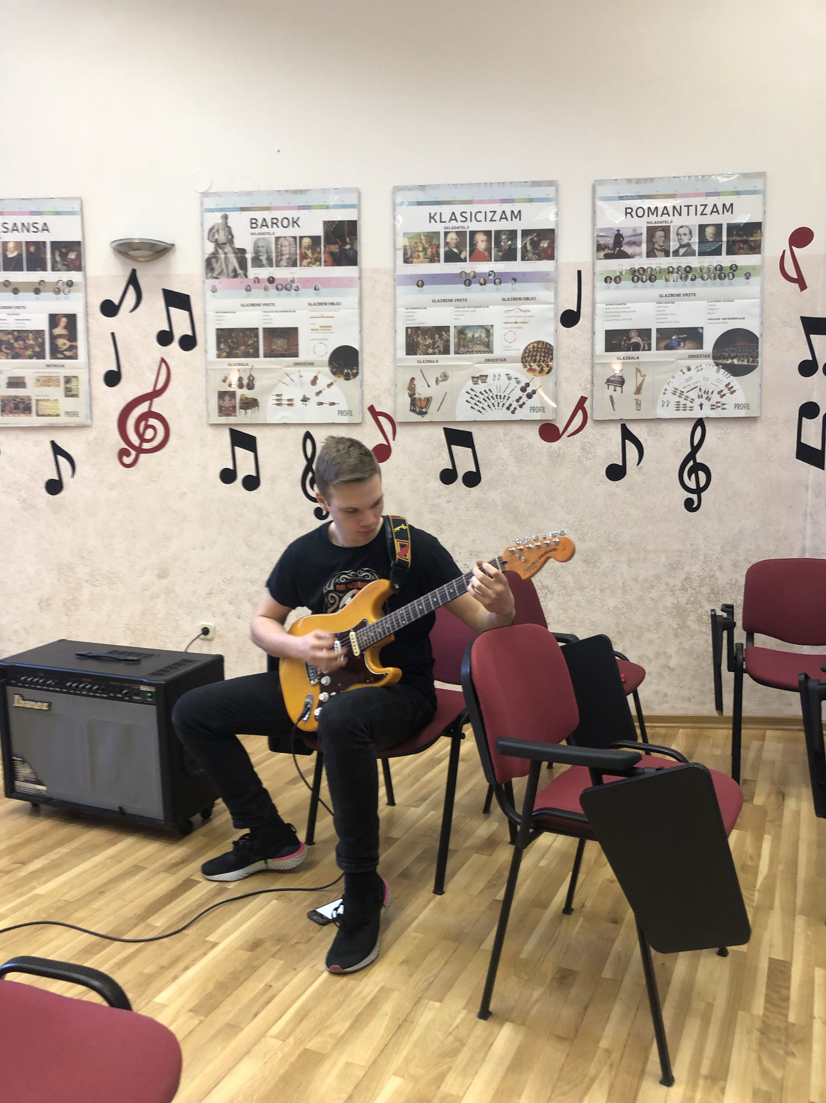
A guitarist

Slide 5
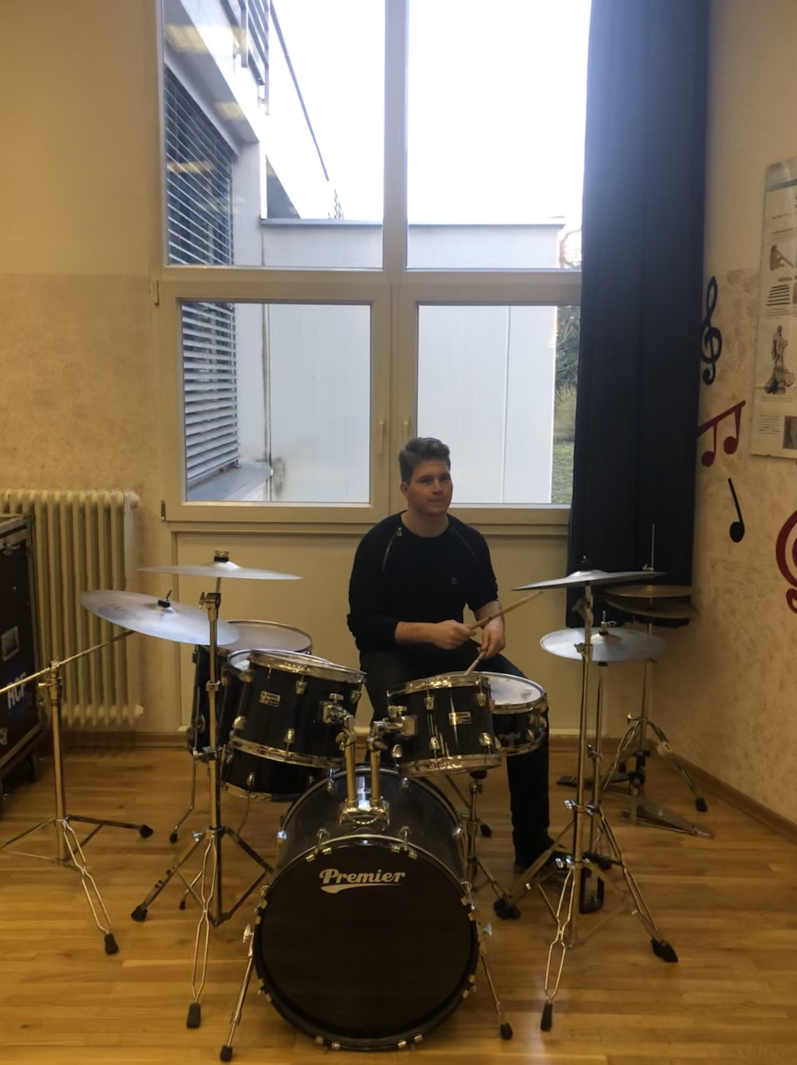
A drummer

Slide 6
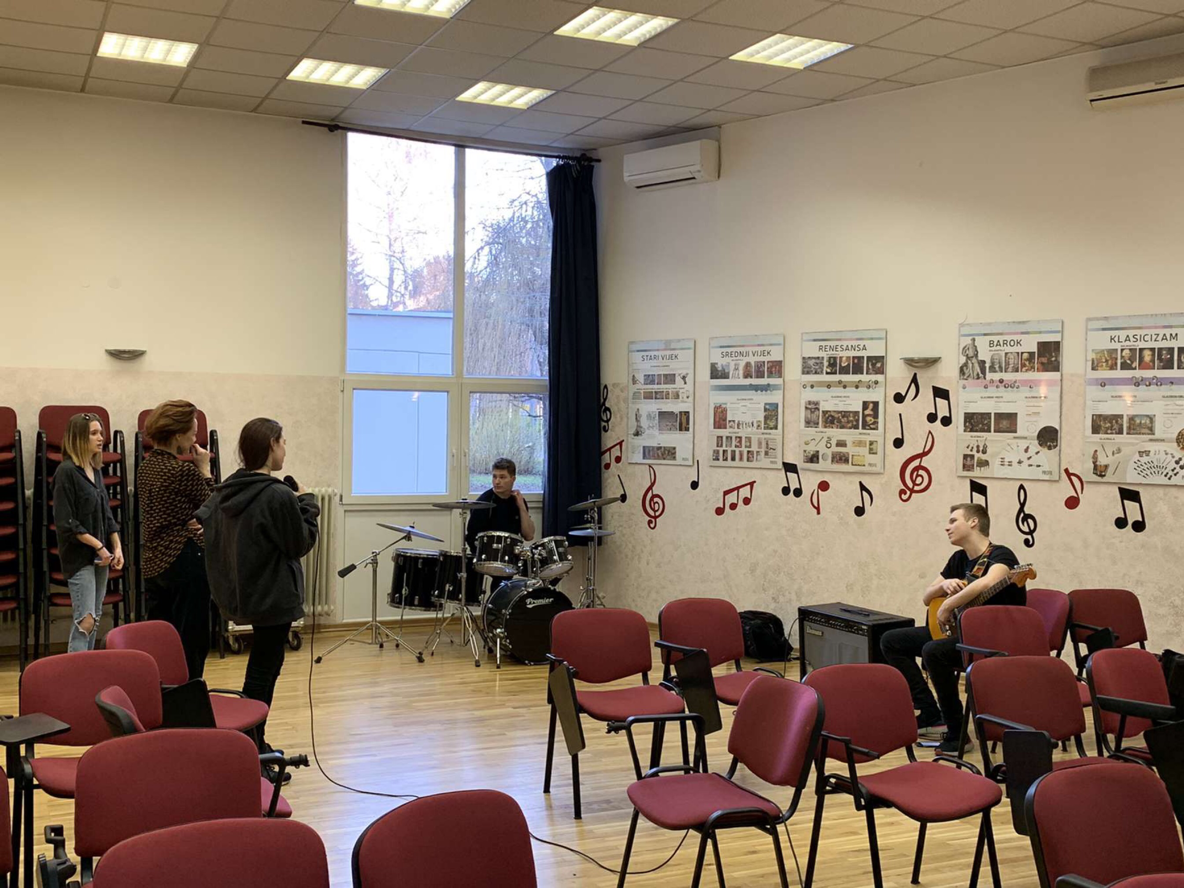
Violinist
Bassist

