Slide 1
CAS Activity: Model United Nations

Slide 2
They are preparing for presenting at international assemblies

Slide 3
Debating about relationships between countries

Slide 4
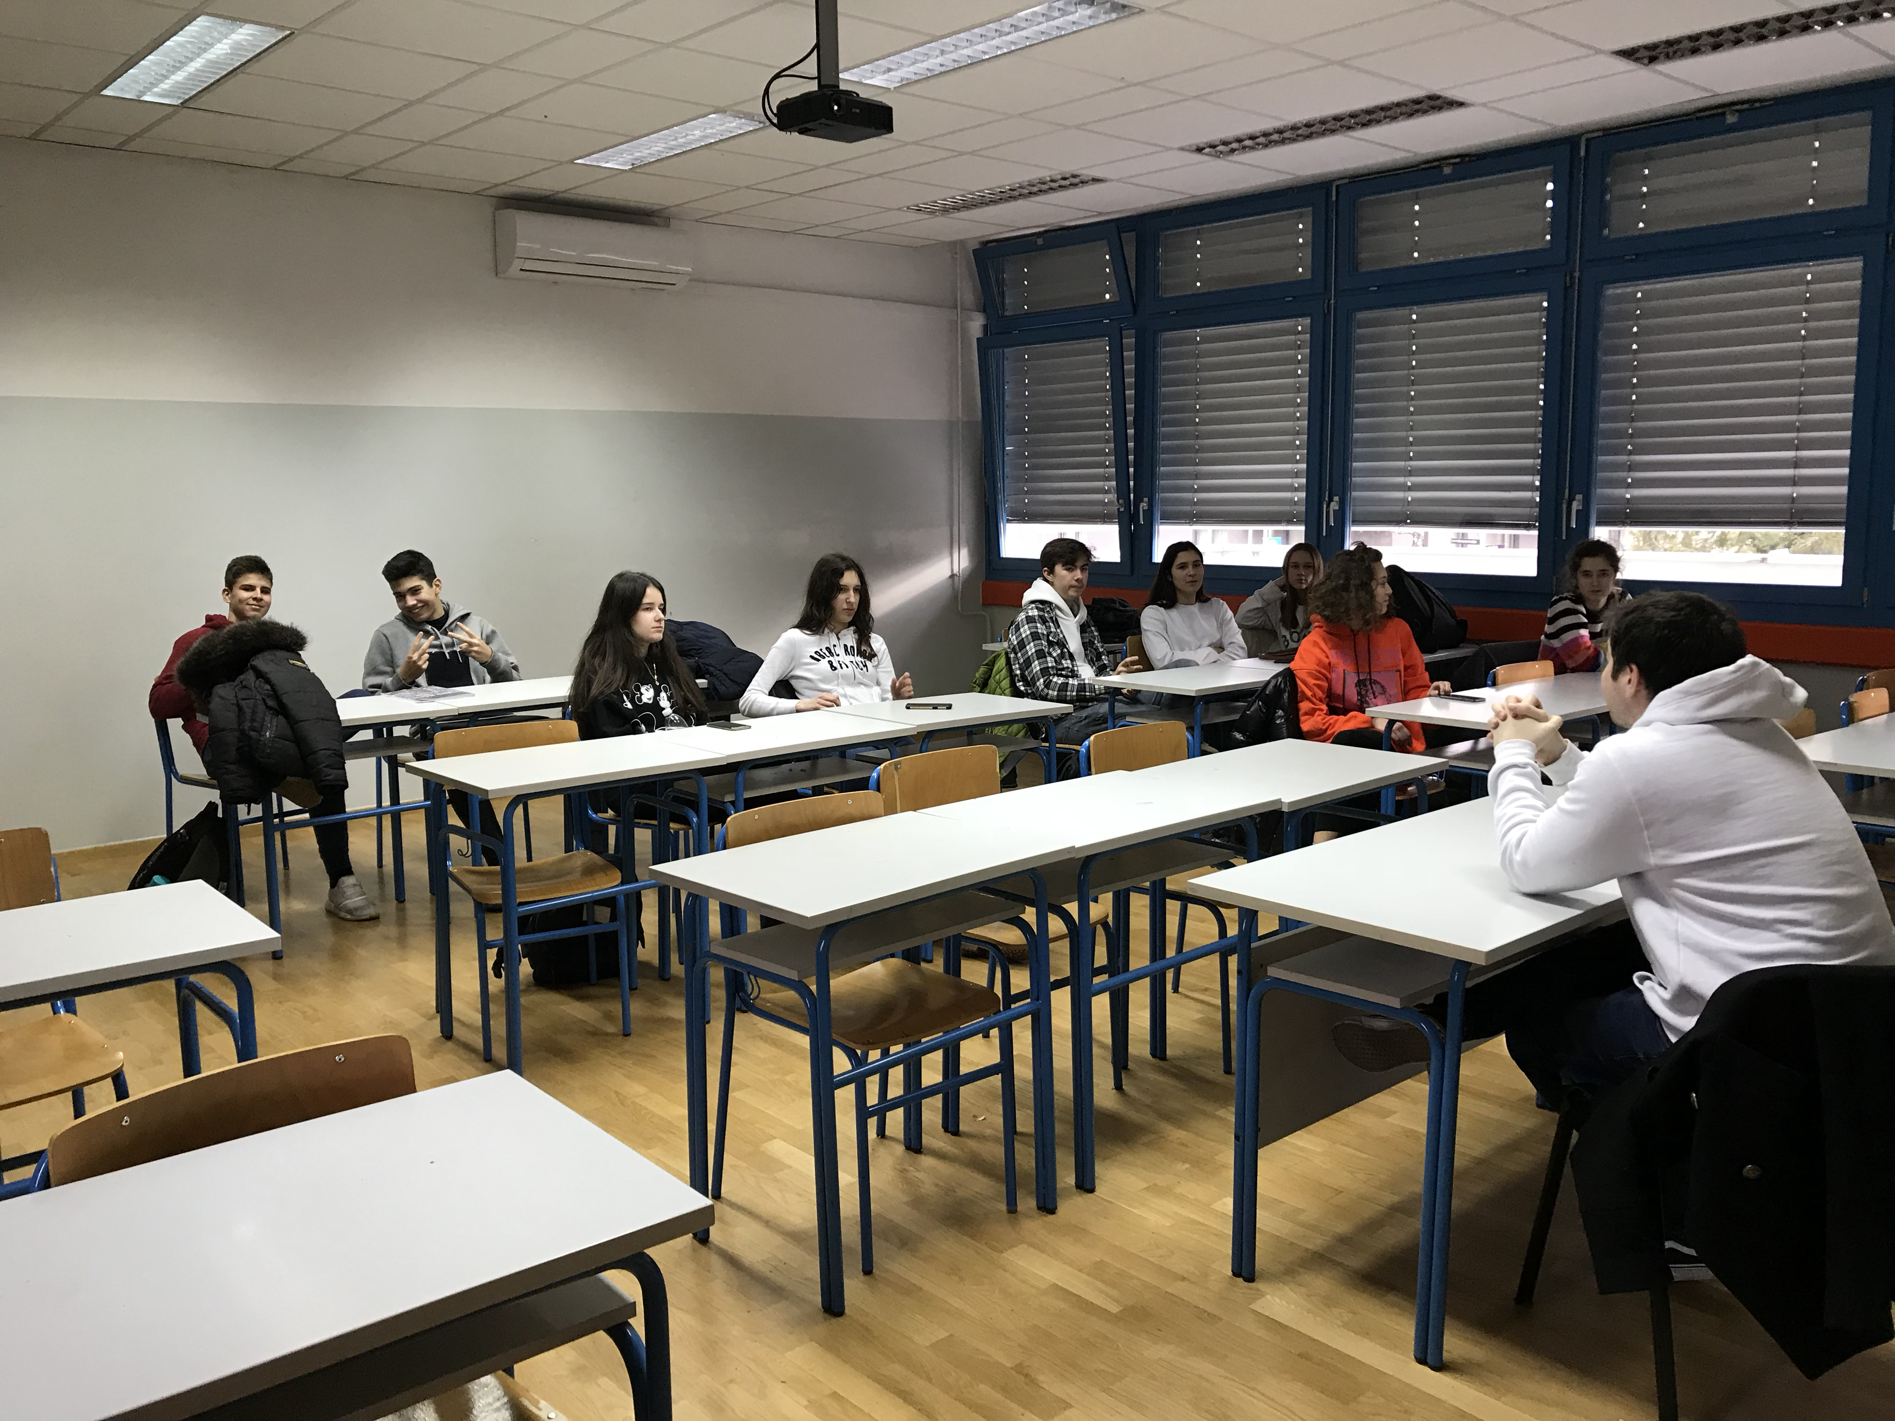
Presenting political issues in the world

