Slide 1
Film group
Leader: Karlo Špoljar

Slide 2
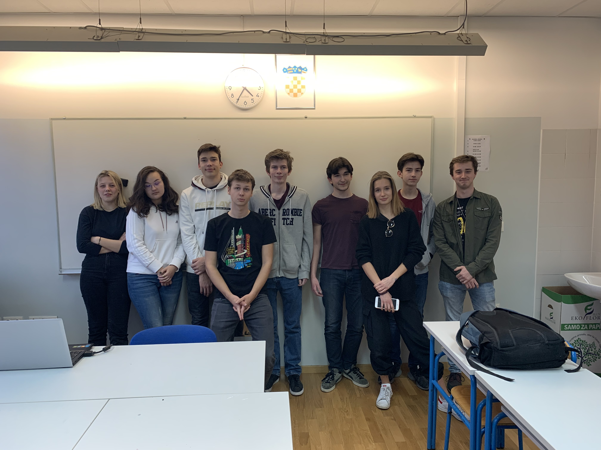
What did we do?
Started filming our movie
Analyzed other films
Learned film theory, such as film frames

