Slide 1
MUZEJ REALNOSTI
Museum of Illusions
By Marko

Slide 2
About exhibition
Museum of Illusions (Muzej iluzija) was converted into Museum of Reality (Muzej realnosti)
For the third year in a row organized by UNICEF
From 11th to 13th December 2017
Opportunity for an interactive journey through the earliest childhood and upsetting lives of millions of endangered children around the world
Experiences that will not leave you neutral
Free of charge
Notes:
Insert a map of your country.

Slide 3
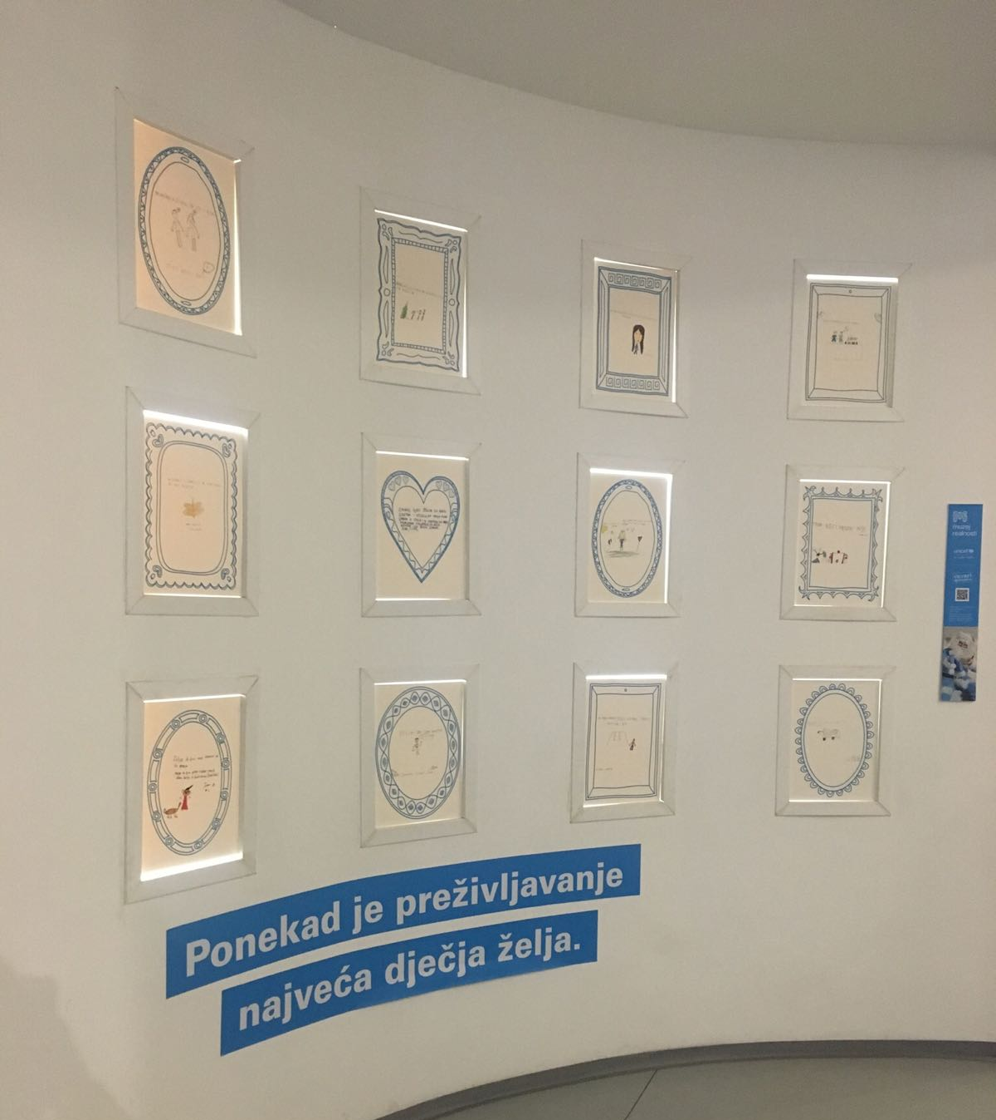
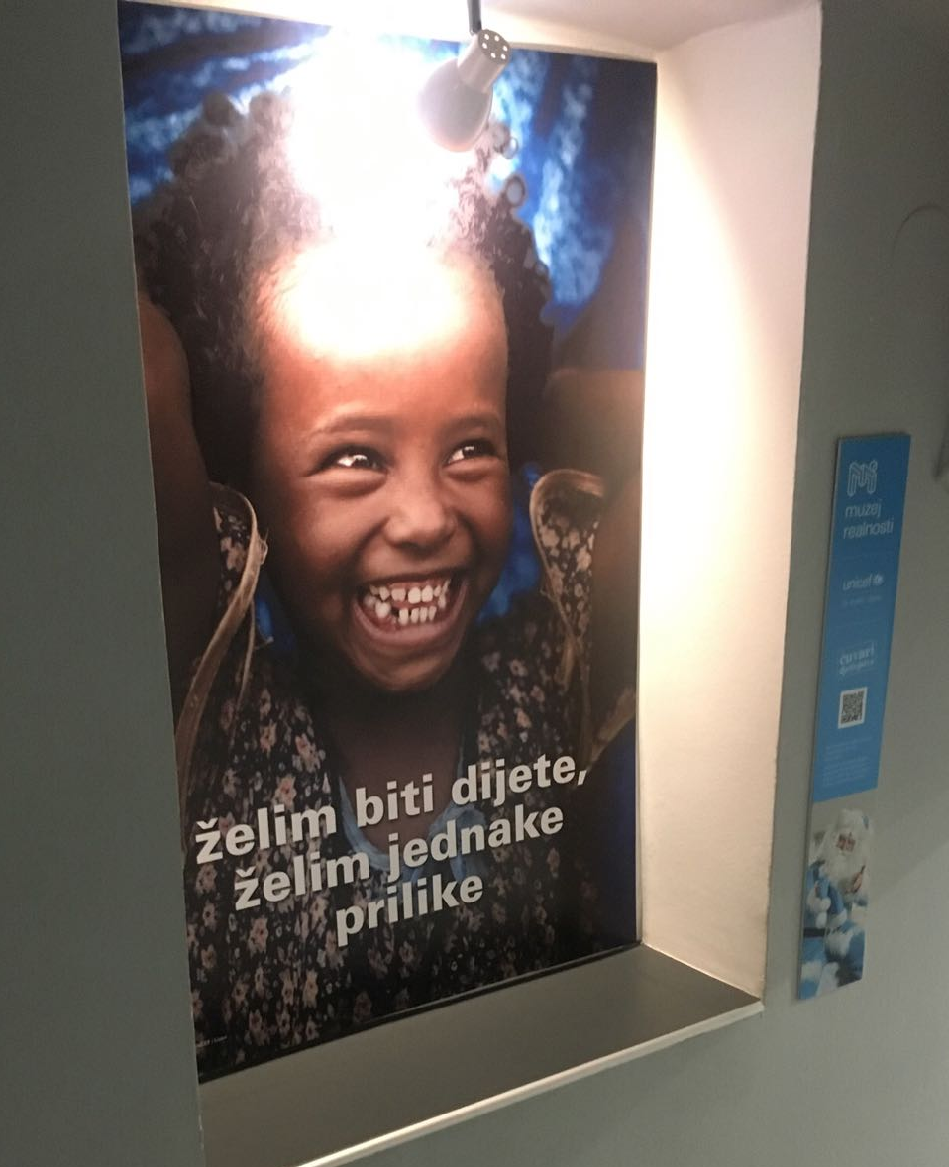

Slide 4
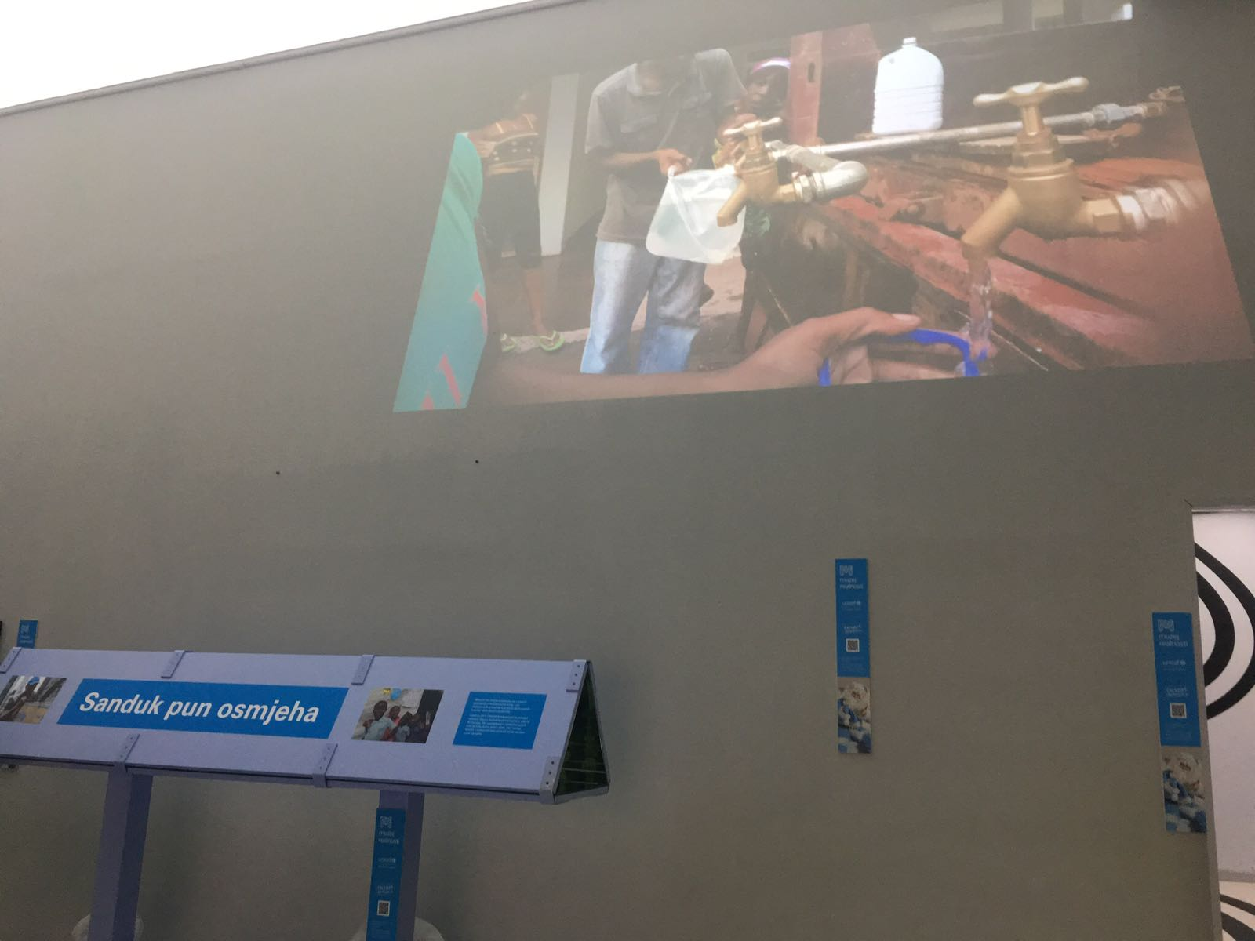
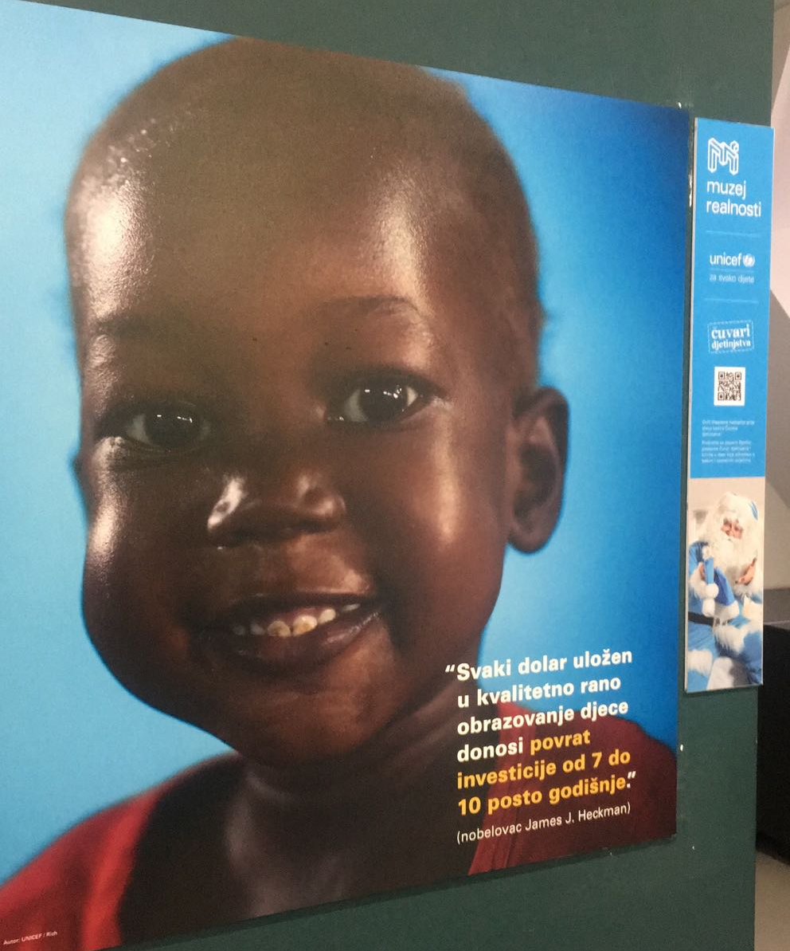

Slide 5
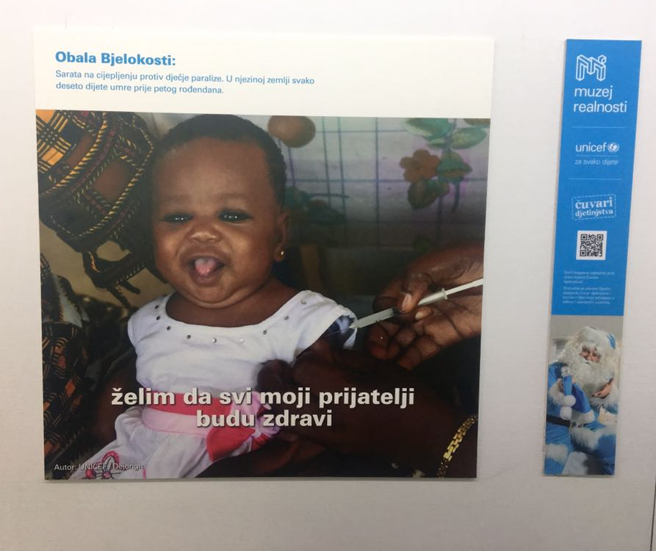
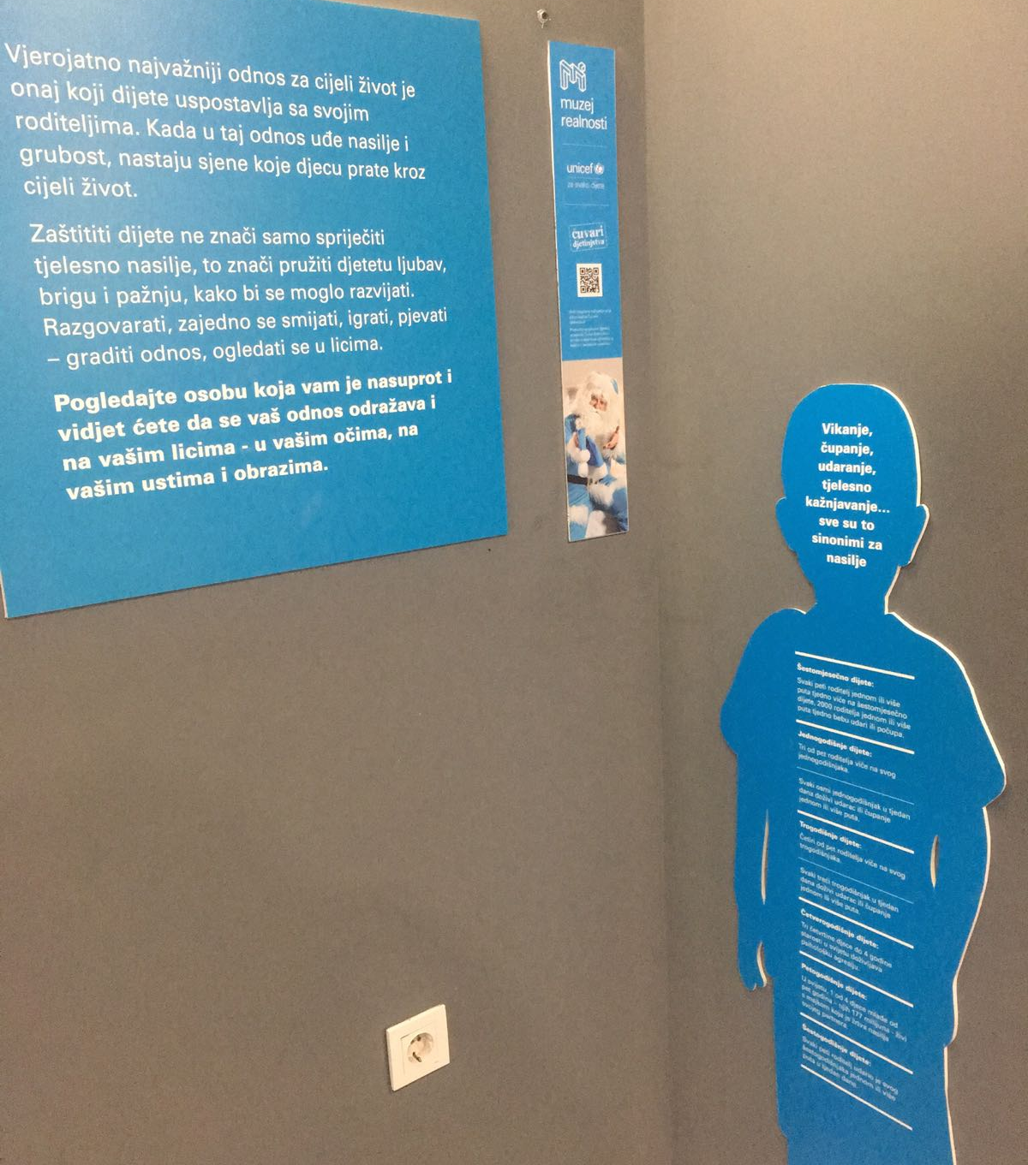

Slide 6
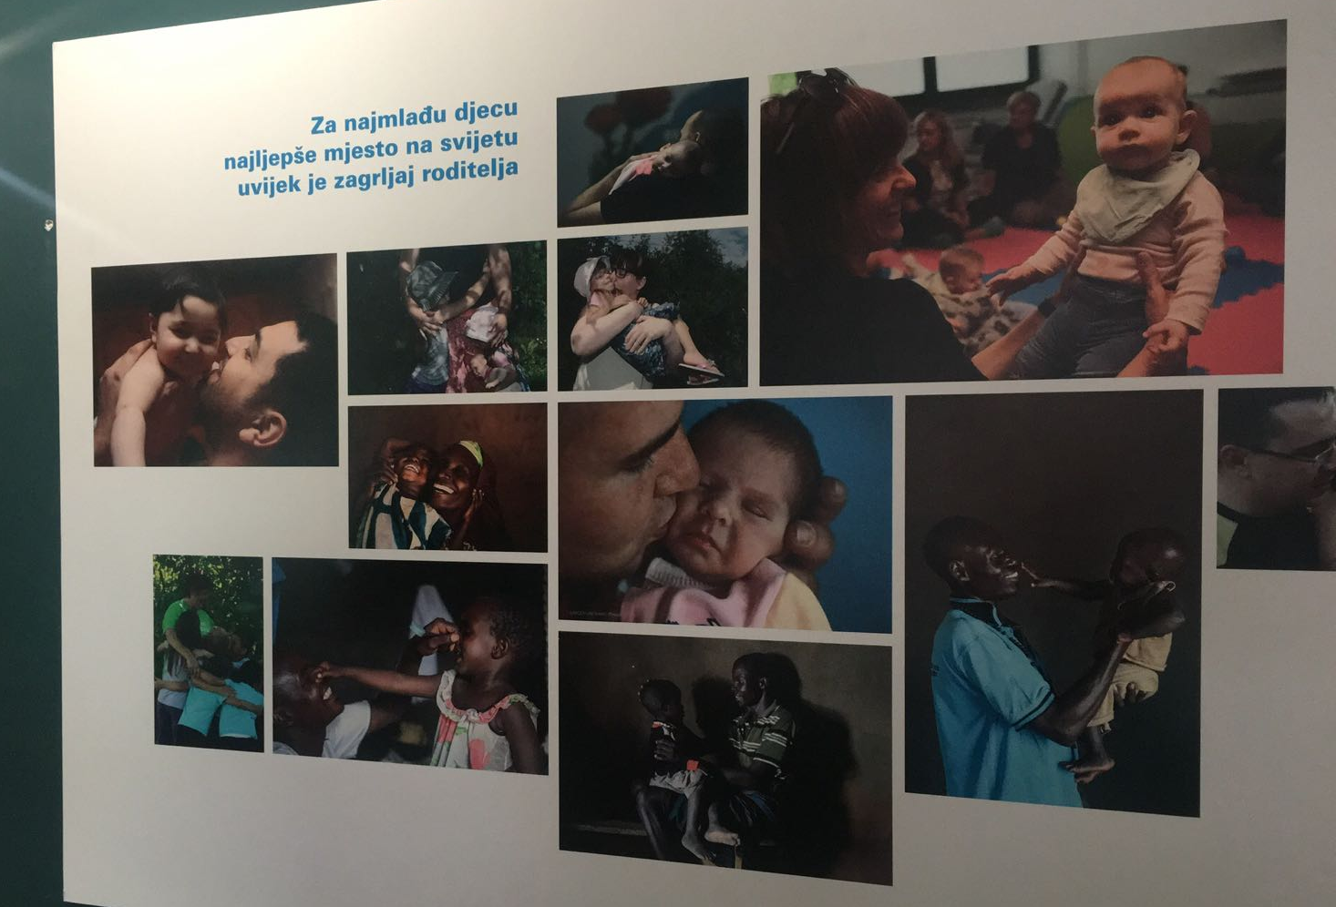

Slide 7
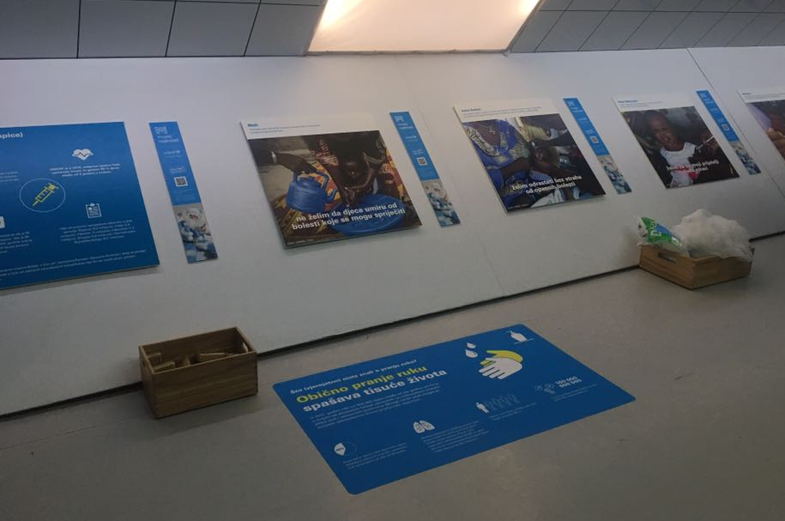
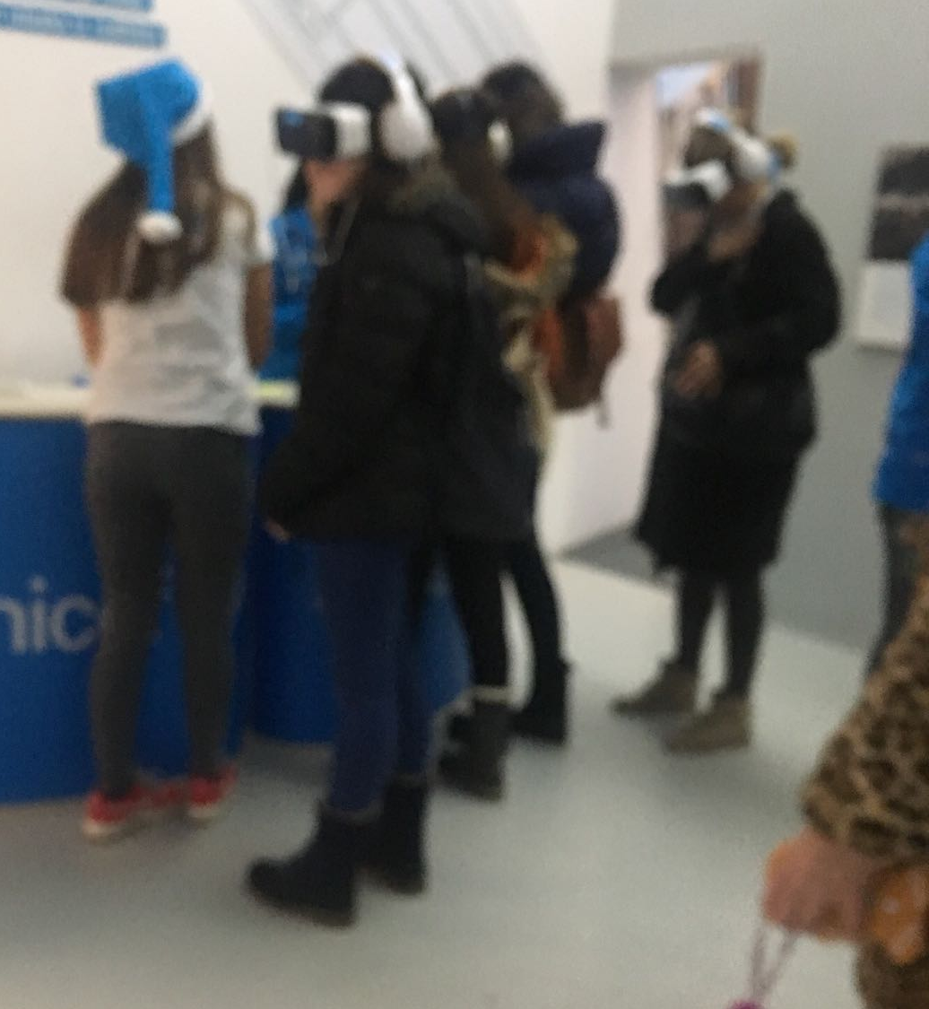

Slide 8
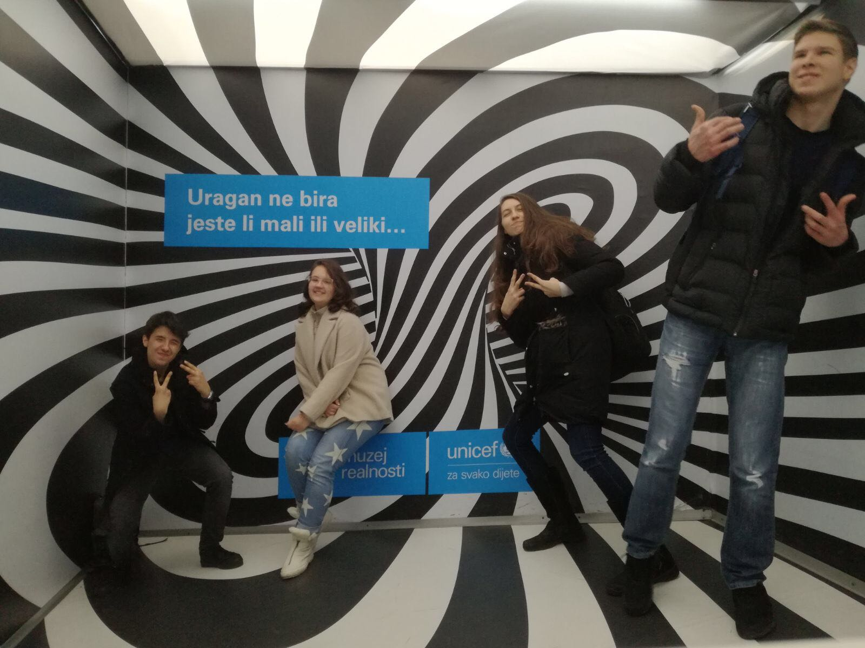
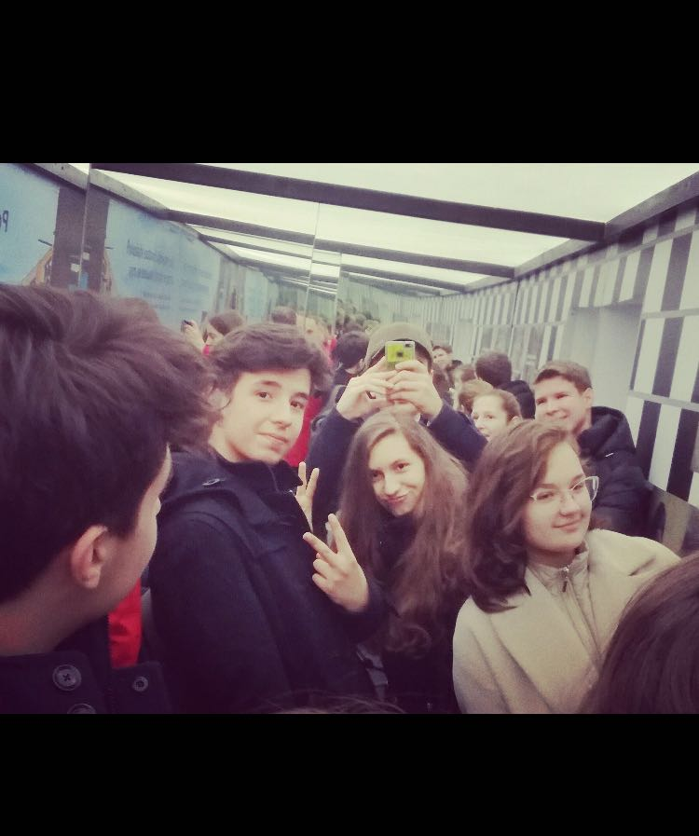

Slide 9
My experience
I was touched by all these sad children’s experiences all over the world.
Some children have too much, other do not have normal life.
We (also me) should take radical action for helping these endangered children by collecting and sending them food, water, clothes, hygienic and medical equipment, building houses, schools and hospitals for them, trying to avoid wars.
By VR goggles I was able to virtually experience all these misfortunes.

Slide 10
LEARNING OUTCOMES
Demonstrating that challenges have been undertaken, development of new skills in the process
  I tried to touch and encourage people to try to help endangered children all over the world
  To do that, I had to use advocating skills, that I had not used before, through the presentation to motivate people to help endangered children by providing arguments, experiences and serious facts
Demonstrating engagement with issues of global issue
  Endangered children are a serious global issue that civil and children rights organizations, all around the world, are concerned about, so I decided to engage in order to help to solve the issue even for a bit

Slide 11
Thank you for listening!

