Slide 1
CAS Activity: Yearbook group

Slide 2
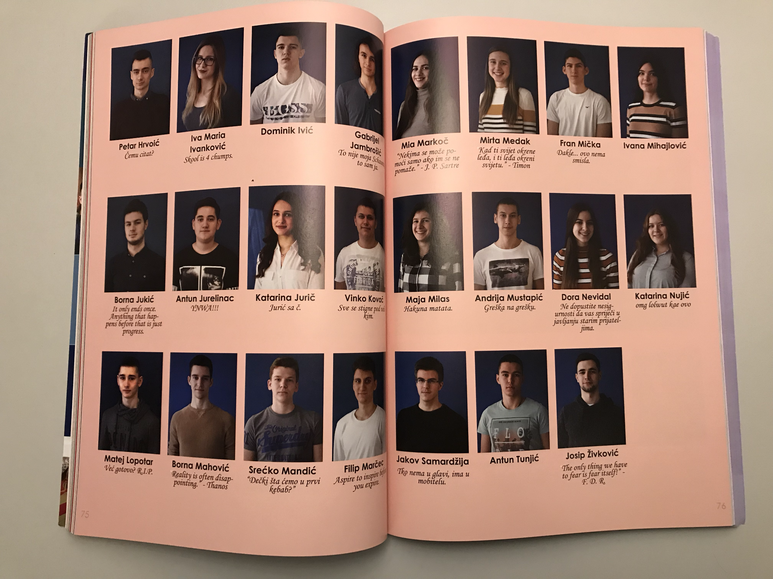
Taking students’ photos

Slide 3
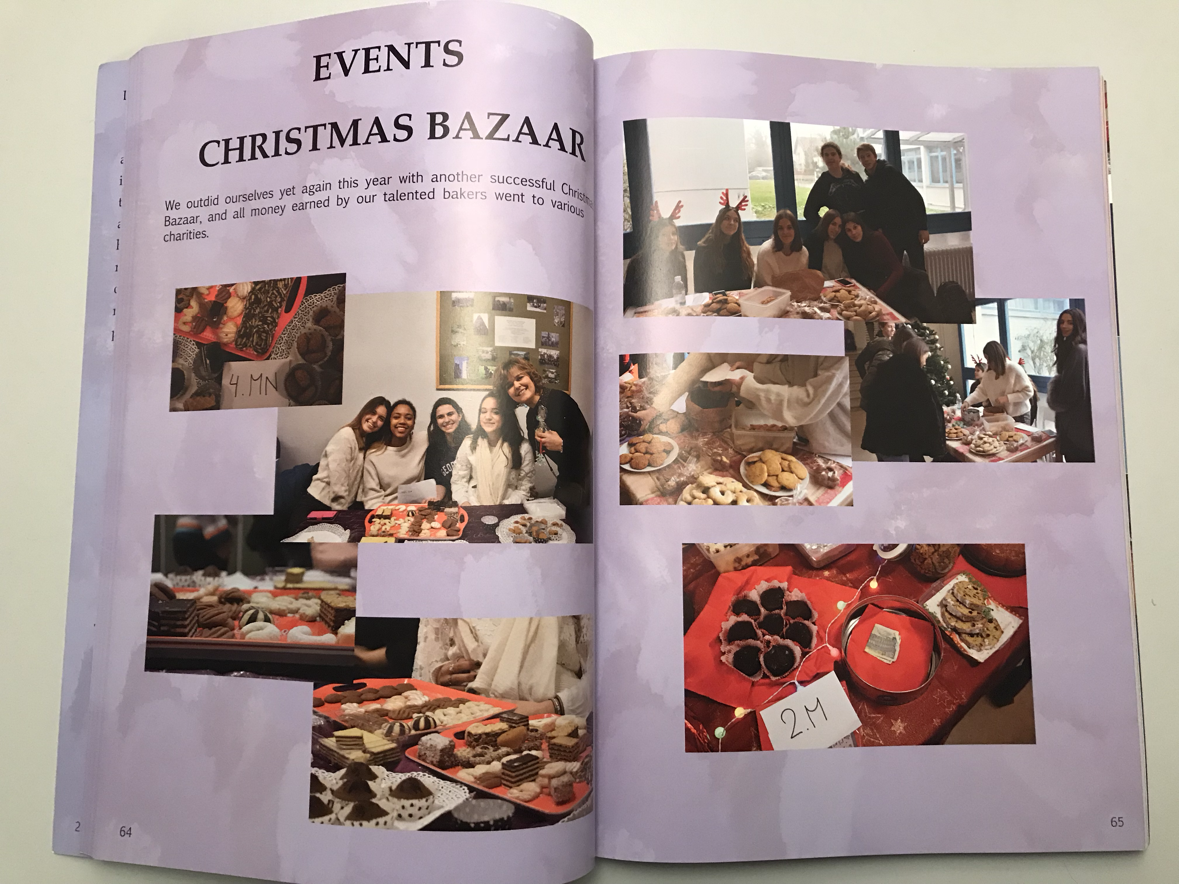
Information about school activities and important events

Slide 4
Group leader is Ms.Lada Silađin

