Slide 1
octagon
The music pavilion Zrinjevac
By: Nela Tadić

Slide 4
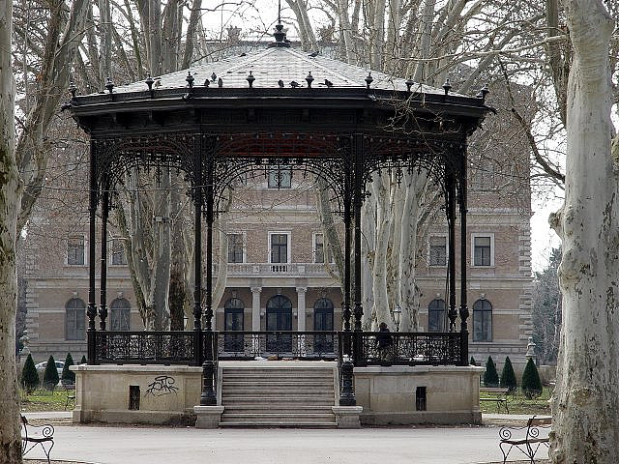
Notes:
First the pavilion and history

Slide 5
History of the pavilion
Notes:
It was a gift for the city from Eduard Prister in 1891
In it´s history the Zrinjevac park was a place to be seen and to drink a cup of coffe
Today people spend there afternoons and many musicions perform in the Music pavilion
It is also a place for many gatherings and fairs

Slide 6
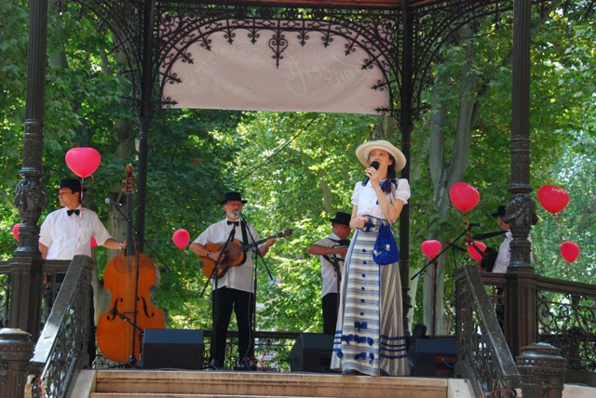

Slide 7
But first...
Notes:
The pavilion has the stairs that open it towards the north. Now lets talk about the octangle.

Slide 8
Notes:
As you can see we can draw an octangle with a little help of the cirle. The octangle has 8 lines with the same length and with that come its 8 angles. In the middle they form 8 caracteristical triangles, all with the top angle with 45 .

Slide 9
Notes:
Here you can see the interesting and many symetrics of the octangle. When we draw 4 lines through his angles we can see that ithey form those 8 triangles I talked about. Every line itself defines the octangle by half:

Slide 10
Notes:
Zrcalna i osna simetrija

Slide 11
Notes:
Centralna simetrija - midpoint

Slide 12
Regular octagon

Slide 13
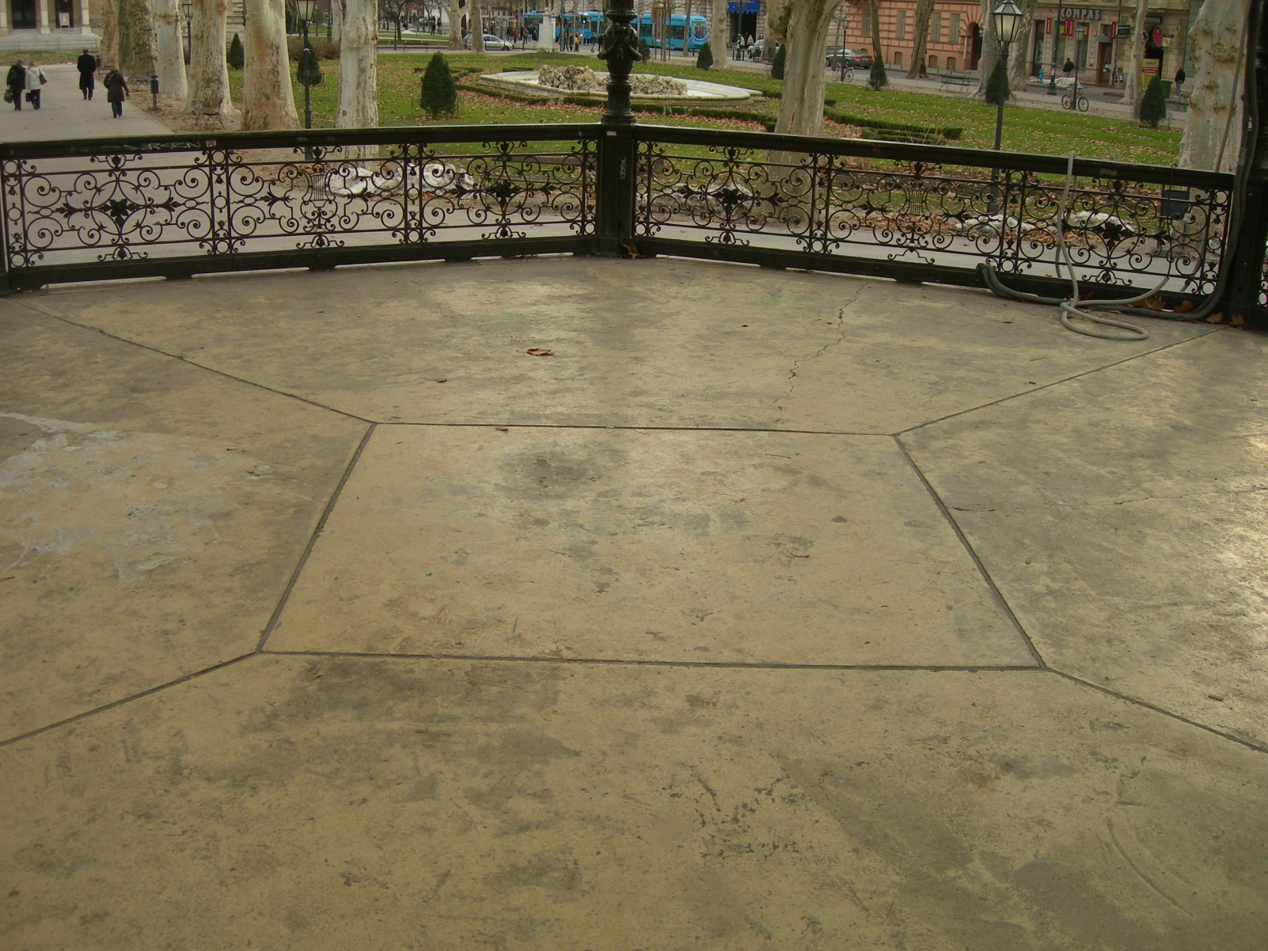
Ground
Notes:
On the floor you can see an interesting square which separates the octangle in 4 pentagonals which are all the same.

Slide 15
Ceiling
Notes:
The ceiling shows of the octangle too. As you can see the ceiling is full of octangles and triangles that form a very beautiful picture.

Slide 16
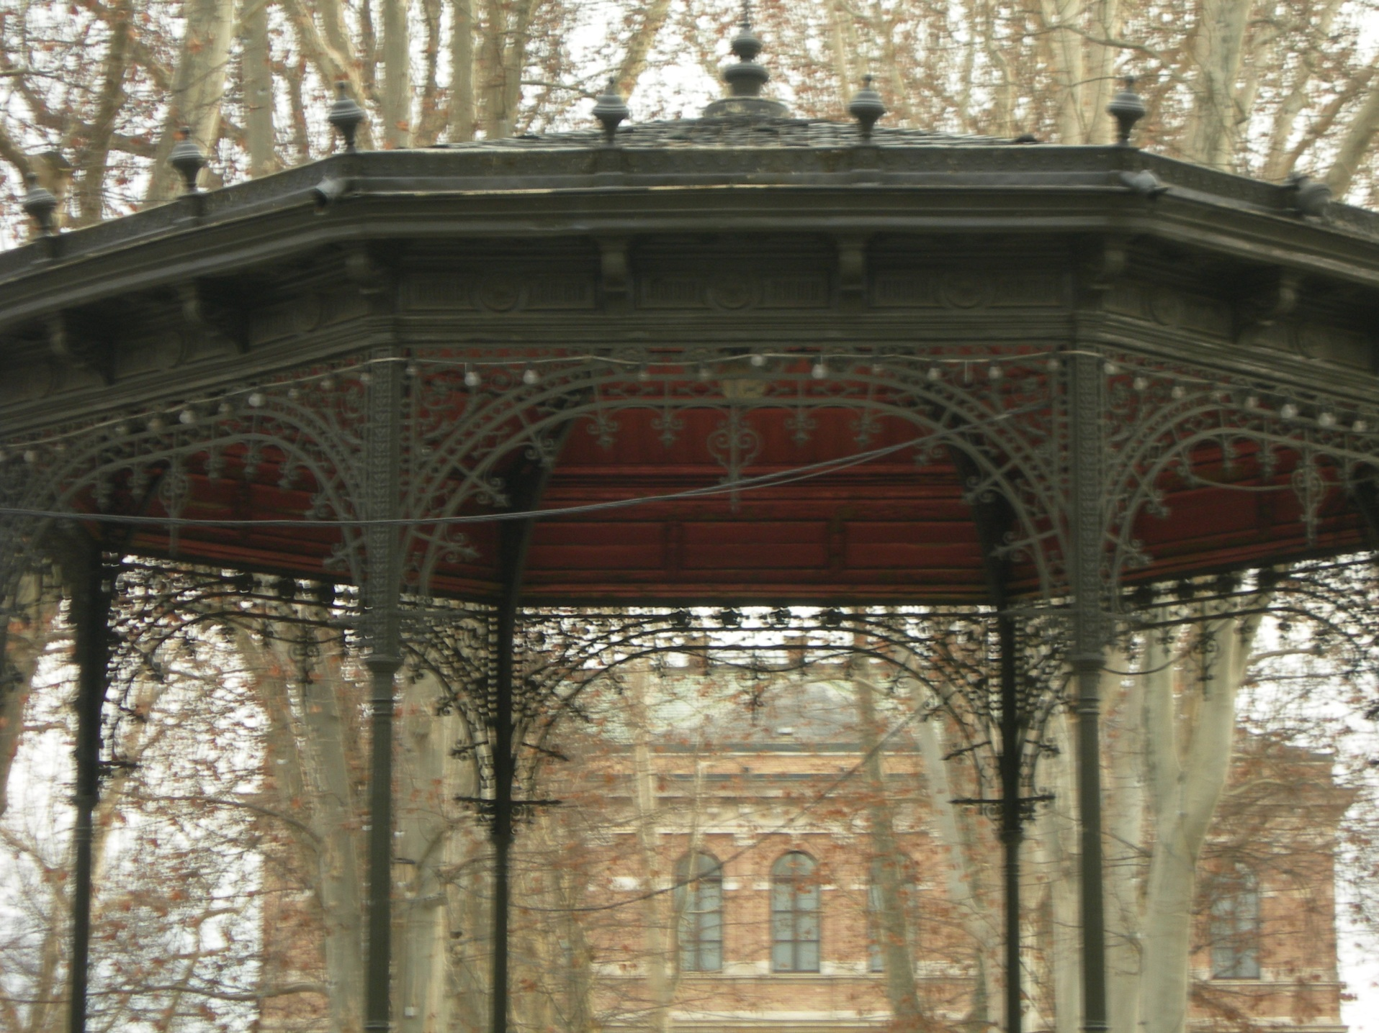
Notes:
This is the picture of the top of the pavilion and its garnishments. The garnishments (decorations) are also symetric by half and by quarter.

Slide 17
THE END
Notes:
We are going to end this presentation with the picture of the pavilion. If there are no questions thank you for listening.

