Slide 1
Stanko Bilinski:
Semi-regular convex polyhedron
XV. gimnazija, Zagreb, Croatia
Kristijan Štefanec & Mislav Vuletić
Mentors: Buga Mikšić & Vesna Ovčina

Slide 2

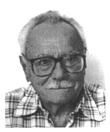
Stanko bilinski
Born in Našice(22.4.1909.)
Died in Varaždin(6.4.1998.)
Was a regular professor in Zagreb
He taught the headmaster of XV. gymnasium
Not very well known in Croatia, but
in 2010. a monument was raised in his
honor and a street was named
after him in Našice

Slide 3


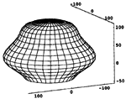
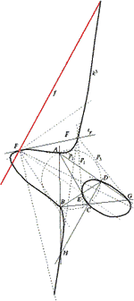
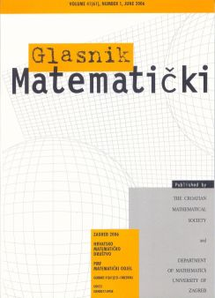
Part 2
He posted: 47 scientific reports
7 expert reports
2 textbooks
4 obituaries

Slide 4
One of his expert works
NEW ARCHIMEDEAN SOLID!?!?

Slide 5
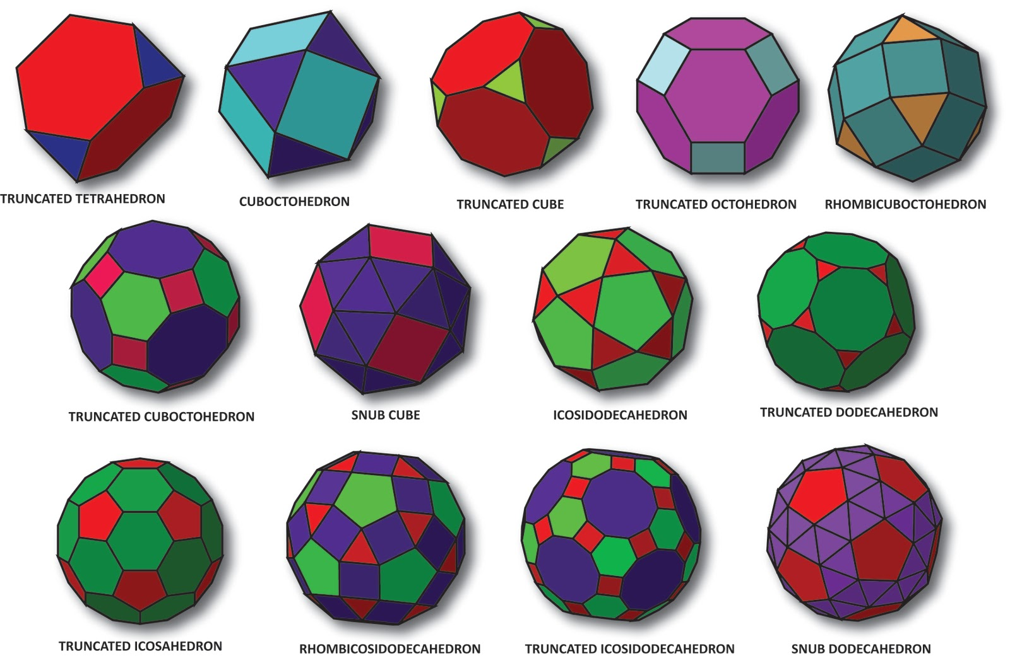
Archimedean solids
Archimedean solids are regular convex polyhedrons, that are made of two or more regular polygons

Slide 6
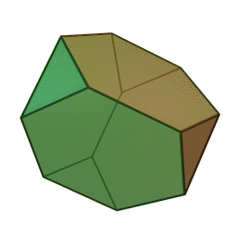
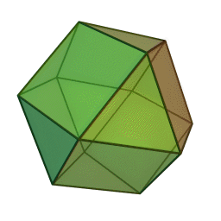
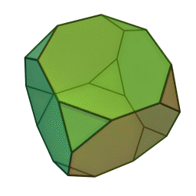
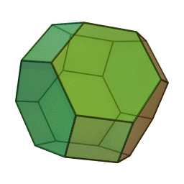
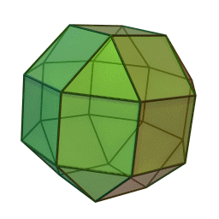
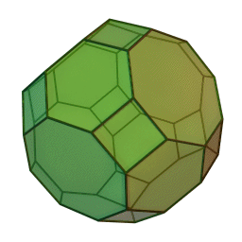
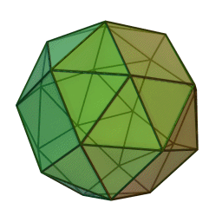
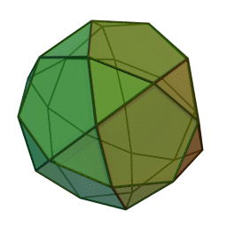
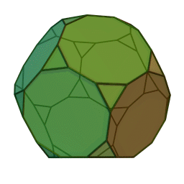
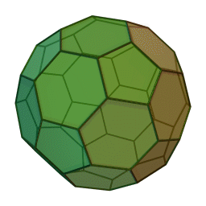
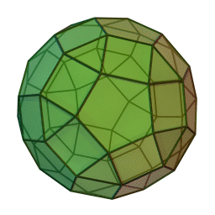
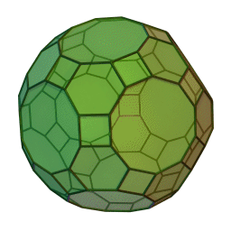
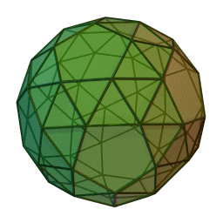
Archimedean Solids
Rhombicuboctahedron

Slide 7
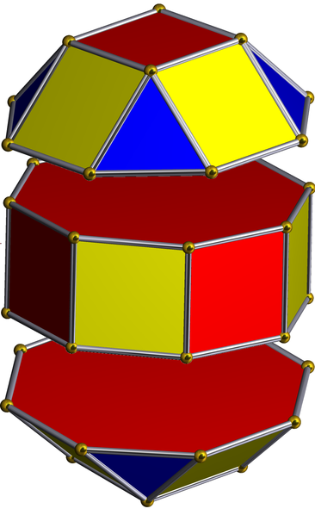
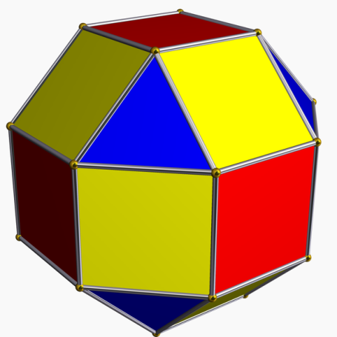
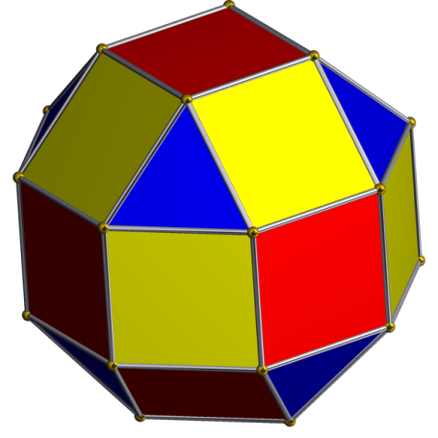
Pseudorhombicuboctahedron
triangle
square
triangle
45˚

Slide 8
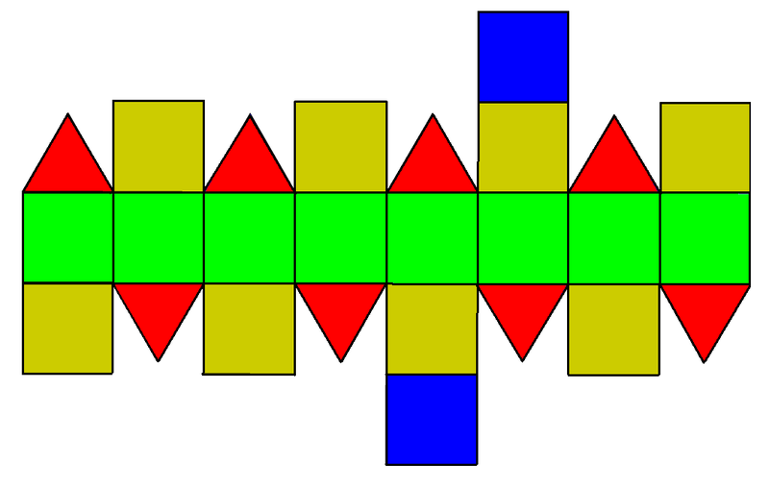
Pseudorhomicuboctahedrons net
Polygonal faces around the middle polygonal face are not isosymetrical!

Slide 9
Johnson solids
Convex polyhedrons, with all sides equal lenght, that are not isosymetrical
93 of polyhedrons are Johnson solids

Slide 10
Pseudorhombicuboctahedron is NOT an archimedean solid!
It is a Johnson solid!

Slide 11
Hope you enjoyed
Kristijan Štefanec

Slide 12
http://en.wikipedia.org/wiki/Archimedean_solid http://en.wikipedia.org/wiki/Johnson_solid http://en.wikipedia.org/wiki/Elongated_square_gyrobicupola http://en.wikipedia.org/wiki/Rhombicuboctahedron http://en.wikipedia.org/wiki/Polyhedron http://web.math.pmf.unizg.hr/glasnik/33.2/33214.pdf http://info.hazu.hr/sbilinski_biografija http://www.hdgg.hr/kog/kogk3.htm http://hrcak.srce.hr/glasnik-matematicki http://web.math.pmf.unizg.hr/glasnik/glascro.html
Sources:

