Slide 1
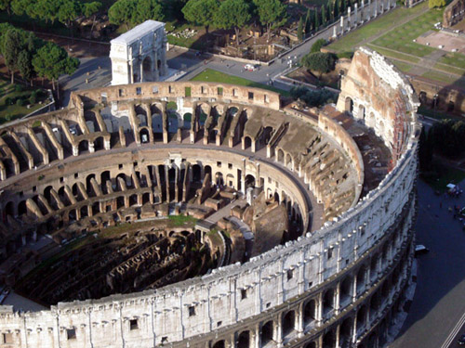


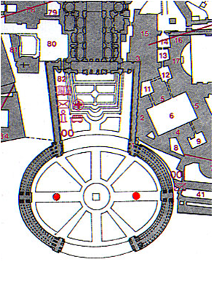
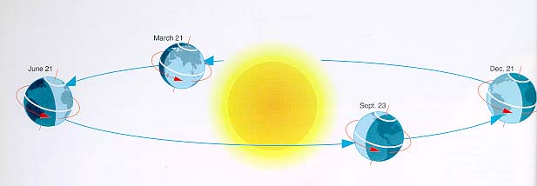

Slide 2
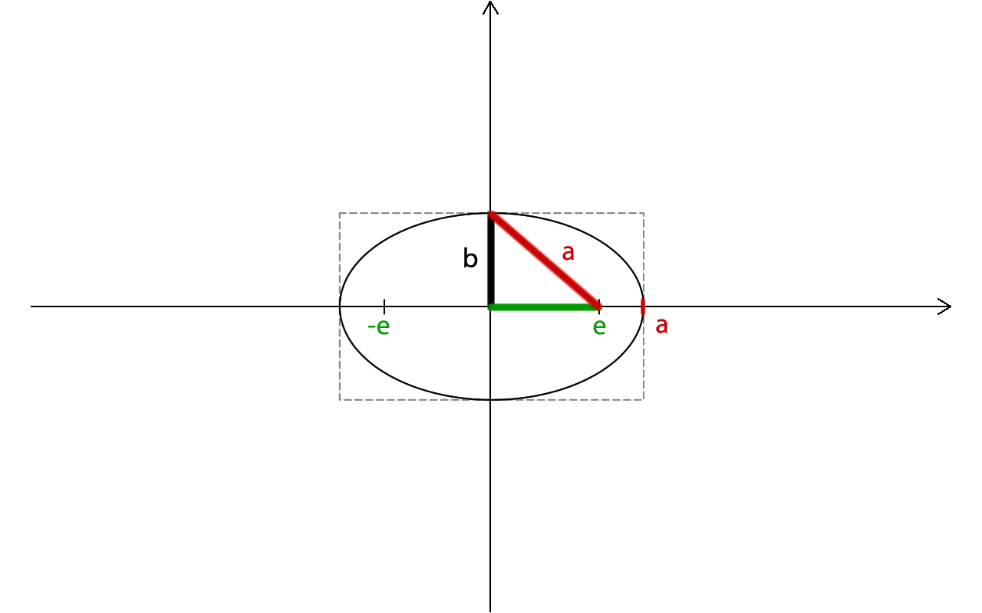
Ellipse

Slide 3
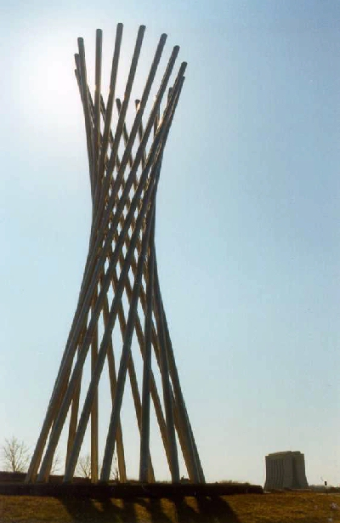
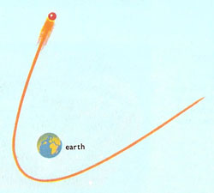
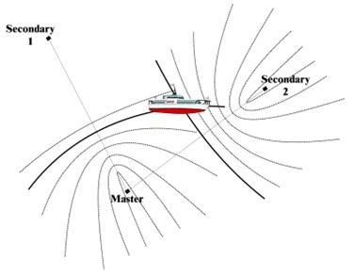
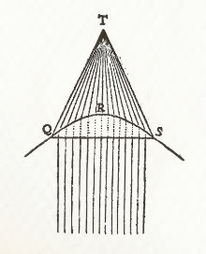
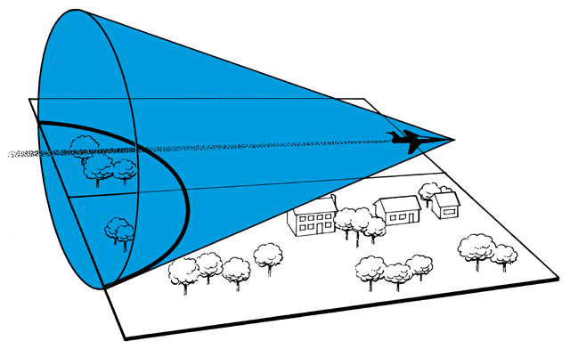


Slide 4
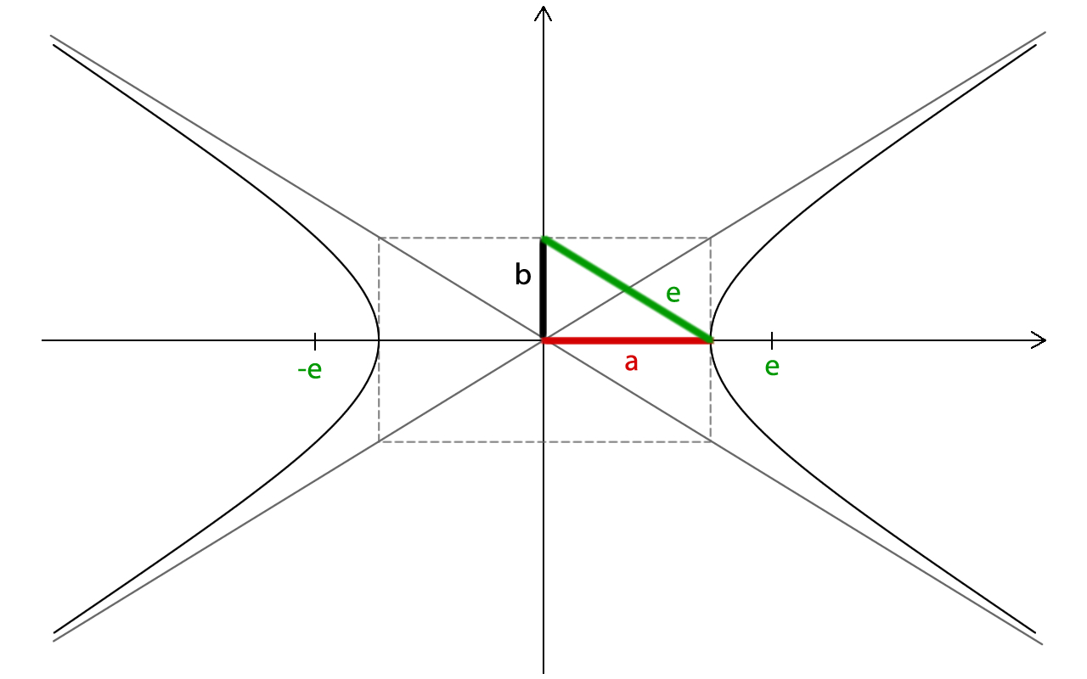
Hyperbola

Slide 5
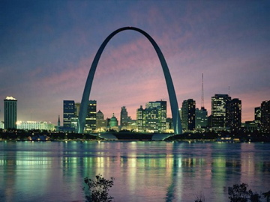
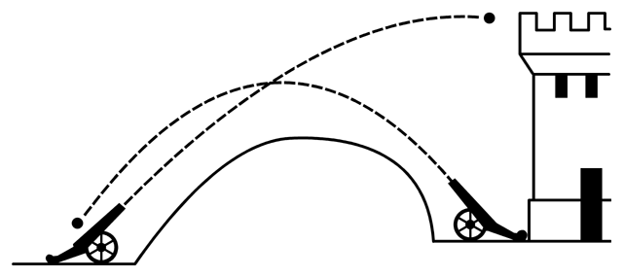
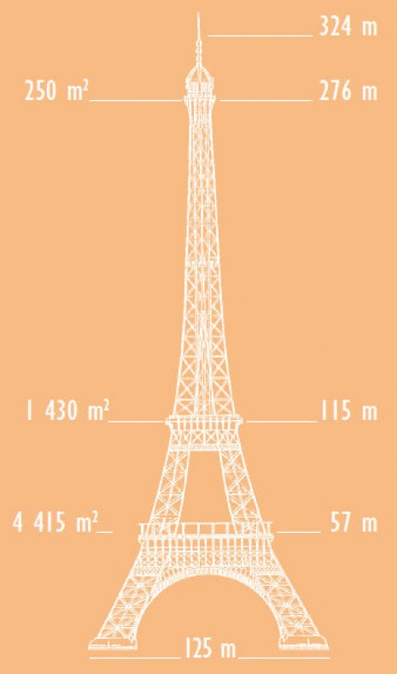
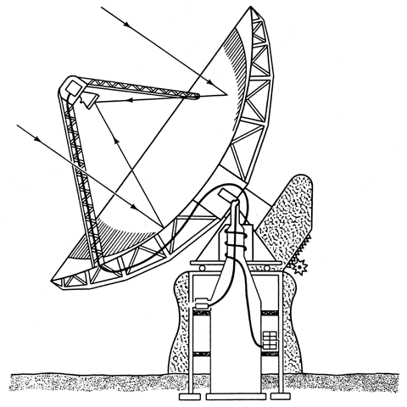

Slide 6
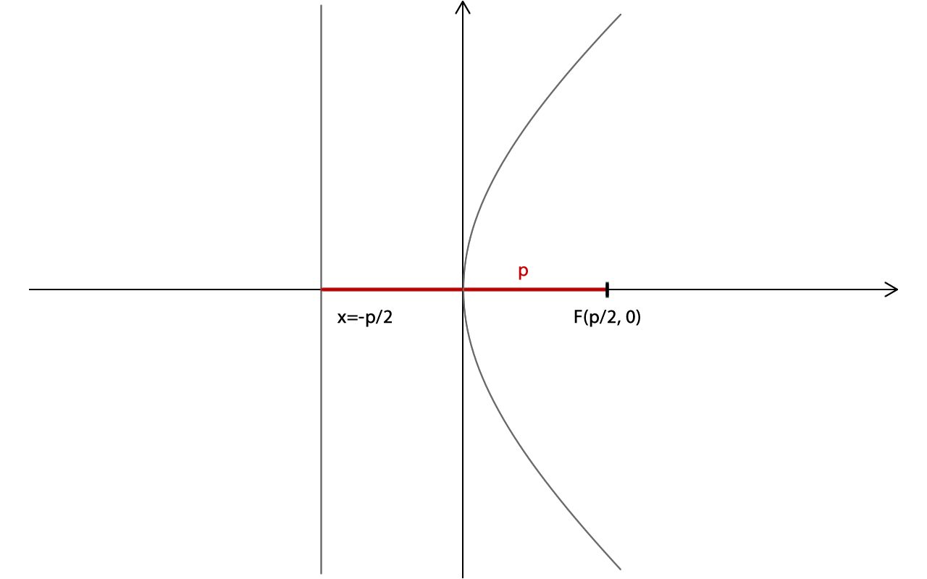
Parabola

Slide 7
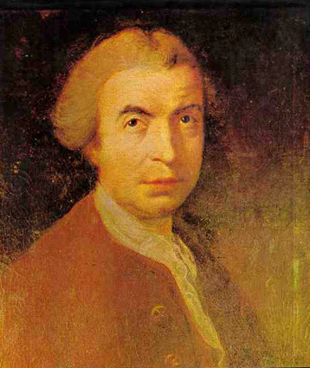
Ruđer Josip Bošković
“When I see faded monuments, erased letters which they bore, I think of what will happen with what I am doing!”

Slide 8
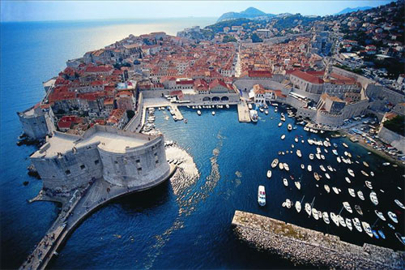
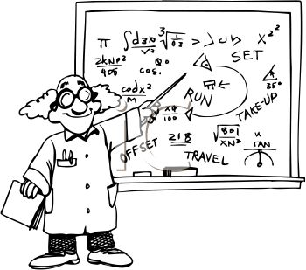

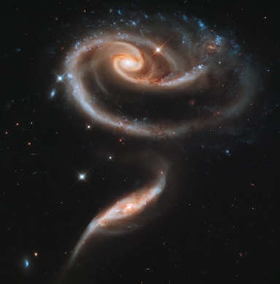
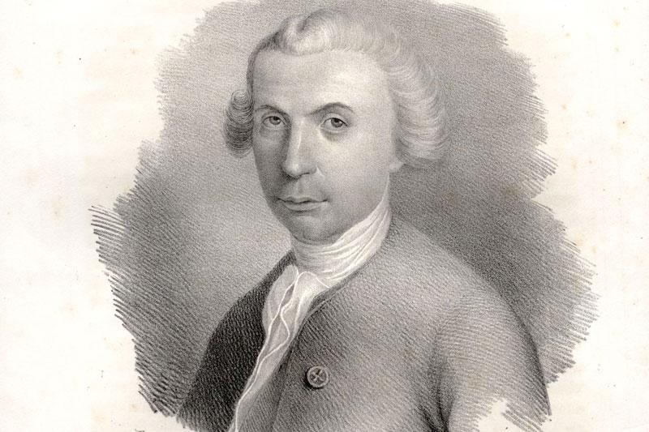
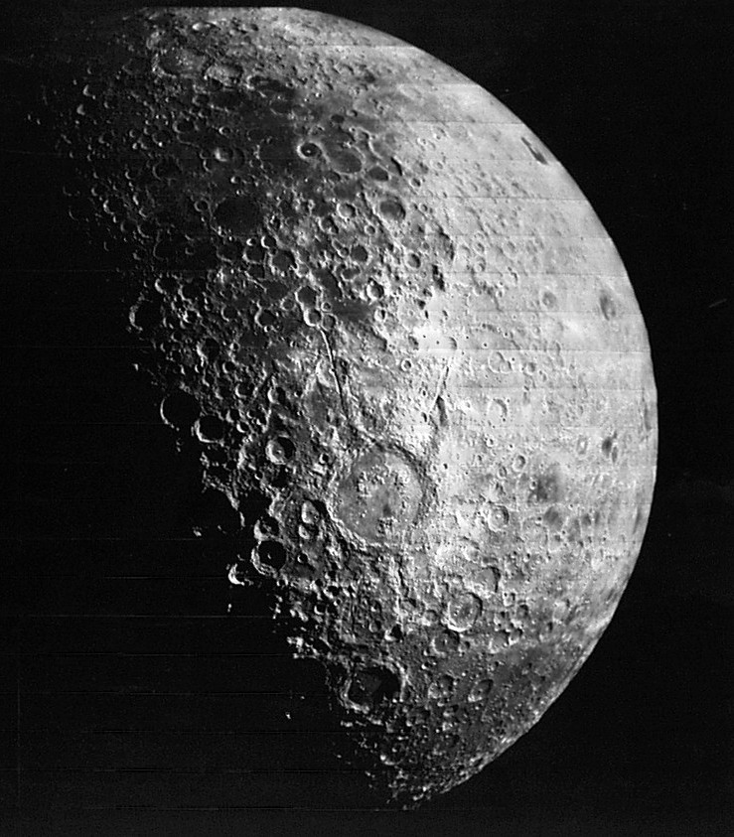
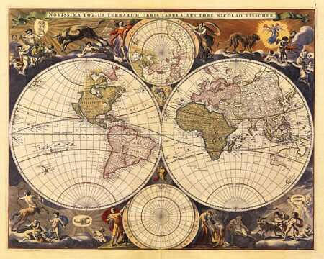

Became a professor of mathematics in Rome
Optics
Dubrovnik, hometown
Astronomy
One crater is named after Ruđer Bošković
Atom theory
Geodesy

Slide 9
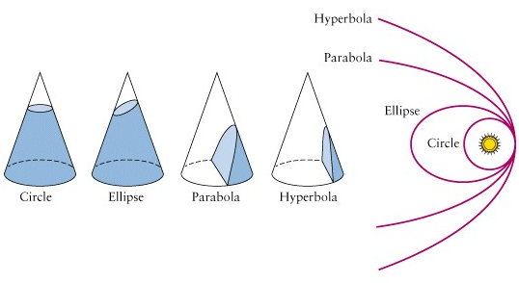
Conic sections
By intersecting a cone with a plane we get all four curves.

Slide 10




Papo-Bošković’s definition of conics
Papo introduces the terms focus and directrix
Bošković defined conics with ε and Papo's curve descriptions (focus and directrix)
ε [epsilon]
real number

Slide 11
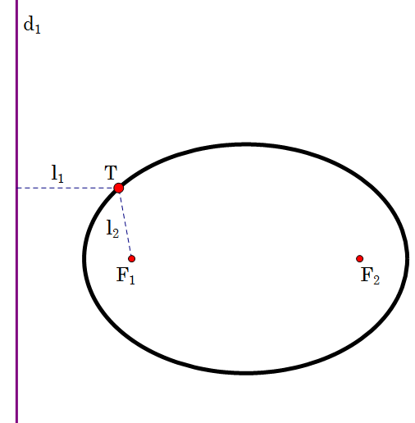
Directrix
The ratio of the distance between the point and the focus, and the distance of a point from the line directrix is constant.

Slide 12
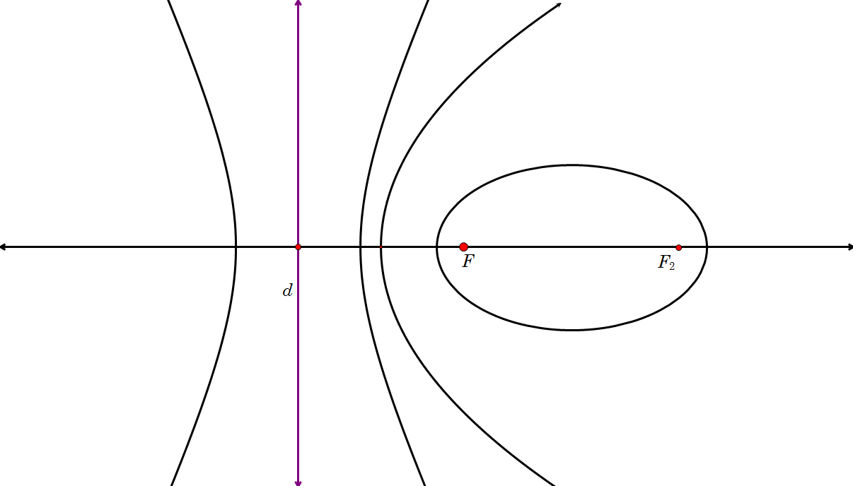
Bošković’s definition of conics
directrix

Slide 13
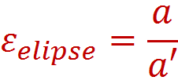
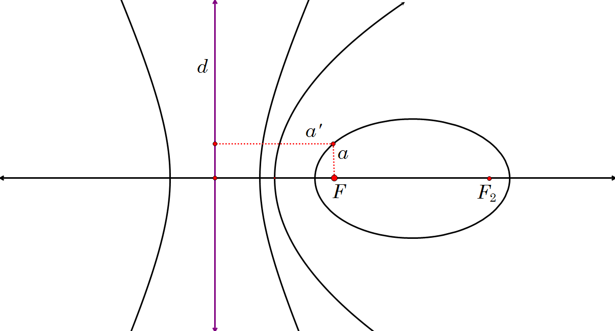
Bošković’s definition of conics

Slide 14
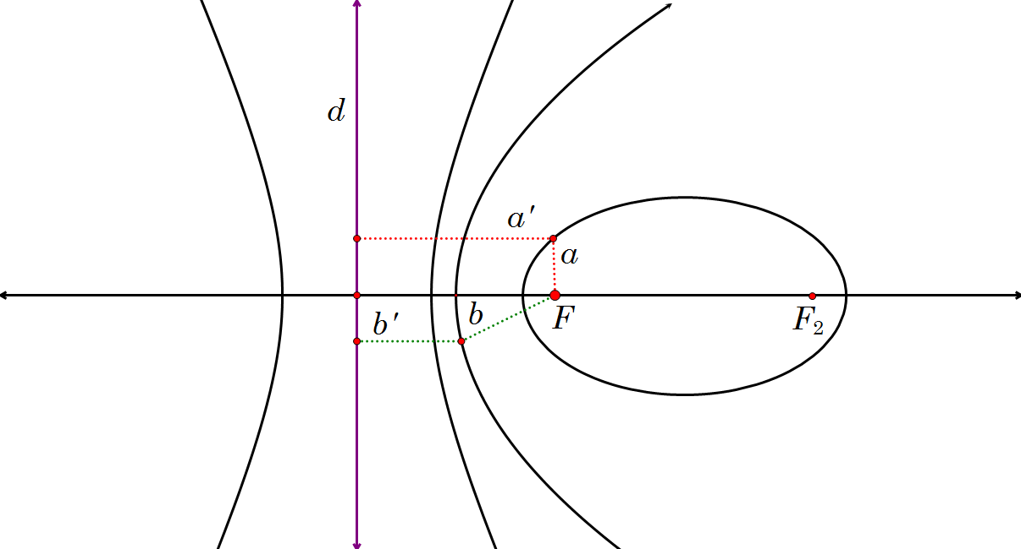
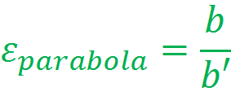
Bošković’s definition of conics

Slide 15
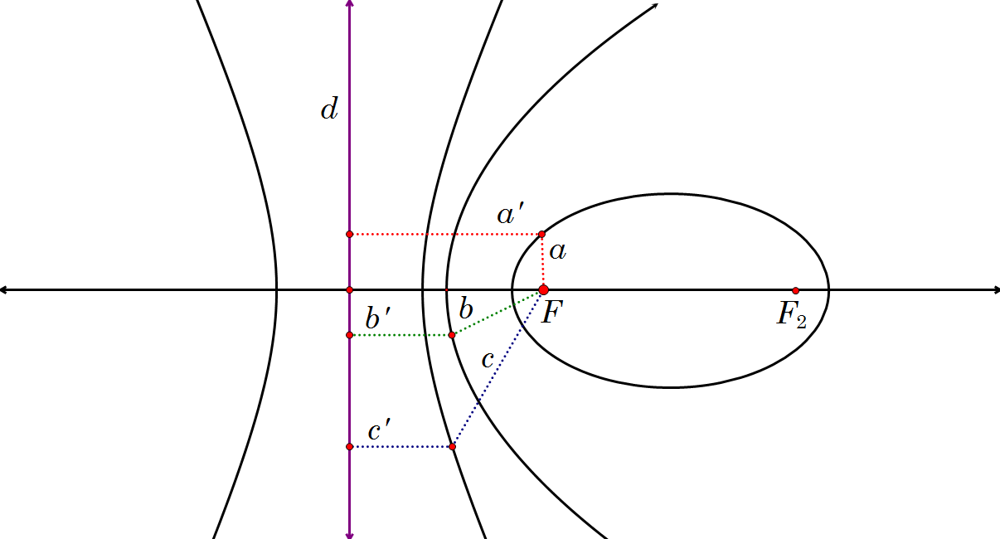
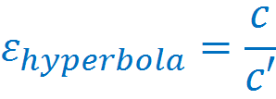
Bošković’s definition of conics

Slide 16
Bošković’s definition of conics
For ε = 0 the curve is a circle
For ε < 1 the curve is an ellipse
For ε = 1 the curve is a parabola
For ε > 1 the curve is a hyperbola
What if ε = ∞?

Slide 17
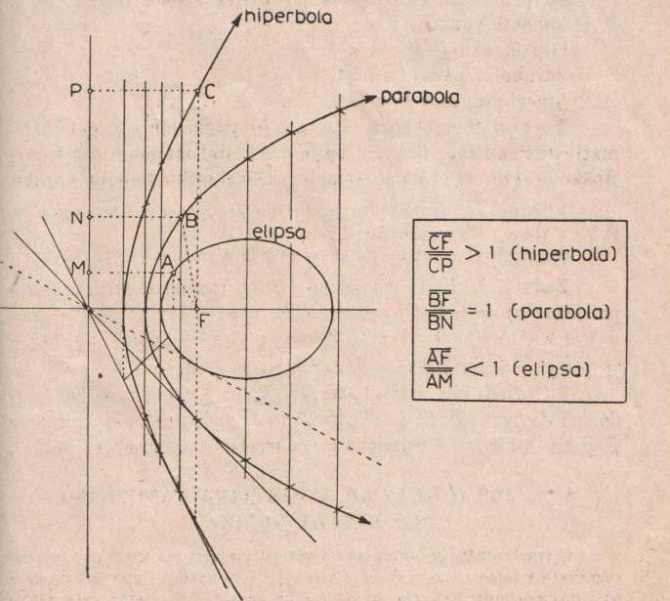

Slide 18
Thank you for listening!
Petra Baček and Gayatri Čaklović
XV. Gimnazija
Zagreb, Croatia

