Slide 1
Rainbow geometrical optics
Domagoj Pluščec
XV. gimnazija, Zagreb
Croatia
Notes:
The rainbow is at one and the same time one of the most beautiful visual displays in nature and, in a sense, an intangible phenomenon. It is illusory in that it is not of course a solid arch, but like mirages, it is nonetheless real. It can be seen and photographed, and described as a phenomenon of mathematical physics, but it cannot be located at a specific place, only in a particular direction. What is a rainbow?

Slide 2
12 Questions about the rainbow
Is red inside or outside ?
What is radius of the bow (in degrees)?
What is lenght of the bow (in degrees)?
What is widith of the bow (in degrees)?
Light intensity inside vs outside
In what direction should we look ?
Notes:
And I would like to start, asking you 12, perhaps, simple
questions about the rainbow just to see how much do you know about rainbows.

Slide 3
12 Questions about the rainbow
At what time of the day we can see it ?
How many bows are there ?
9. – 12. If more than one
where are they ?
what is color sequence of them ?
what is radius (in degrees) ?
what is width (in degrees) ?

Slide 4
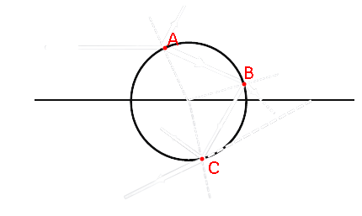
One drop
Snell law $$n=\frac{\sin{θ_{i}}}{\sin{θ_{r}}}$$
$$θ_{i}$$
$$θ_{r}$$
$$θ_{r}$$
$$φ$$
$$θ_{r}$$
$$δ$$
$$θ_{r}$$
$$θ_{i}$$
$$φ =180−δ=4θ_{r}−2θ_{i} \\ φ=4arcsin\left(\frac{\sin{θ_{i}}}{n}\right)−2θ_{i}$$

Slide 5
One drop - cone
Dispersion
No light
„All colors”
$$φ≈40.7°$$
$$n≈1.343$$
$$n≈1.331$$
$$φ≈42.4°$$
$$φ=4arcsin\left(\frac{\sin{θ_{i}}}{n}\right)−2θ_{i}$$
$$\max\left(φ\right)≈42.4°$$
Red is the first color
Violet is the last added color

Slide 6
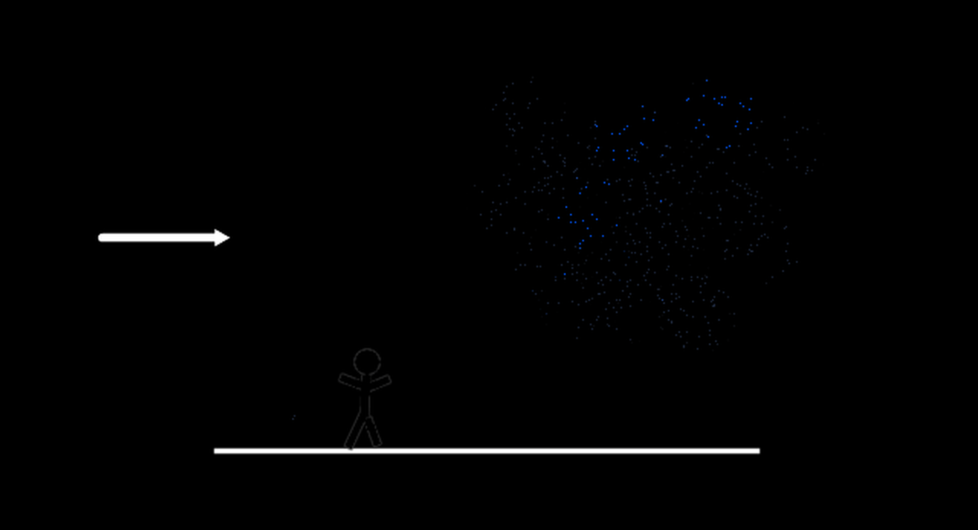
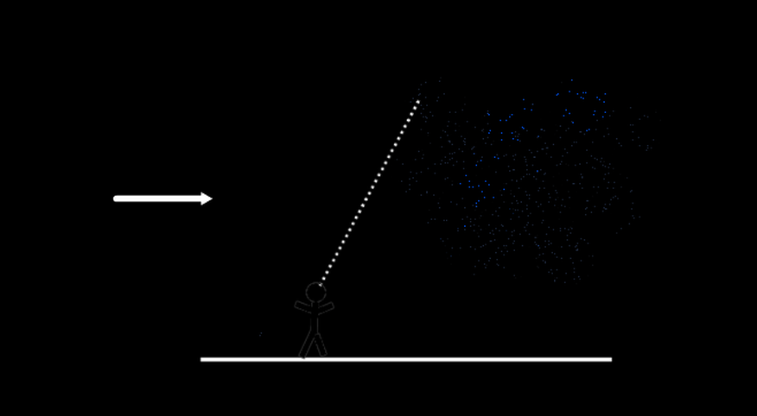
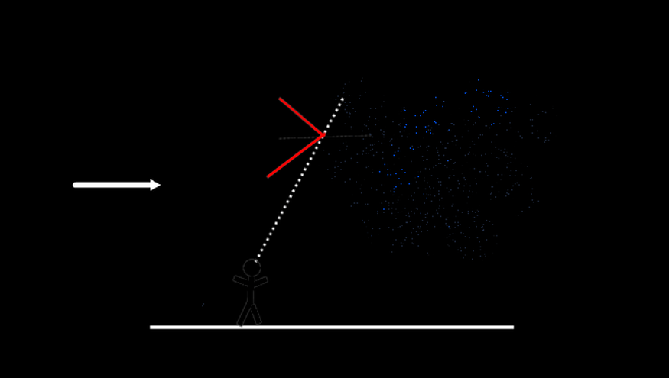
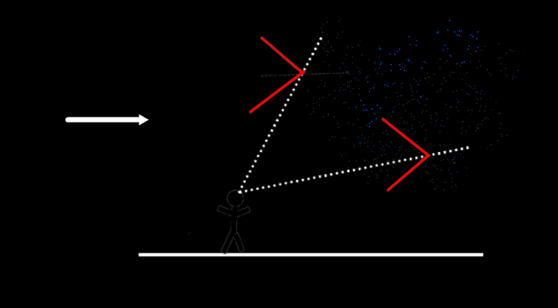
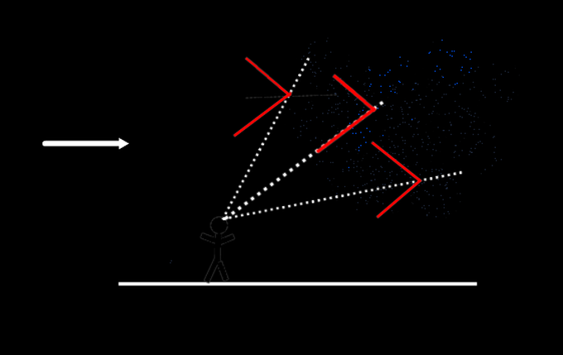
What we actually see 1/2

Slide 7
What we actually see 2/2

Slide 8
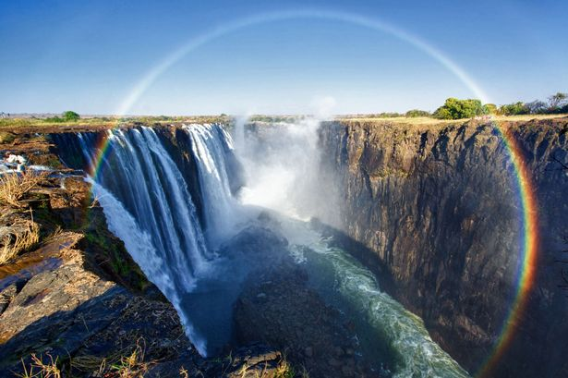
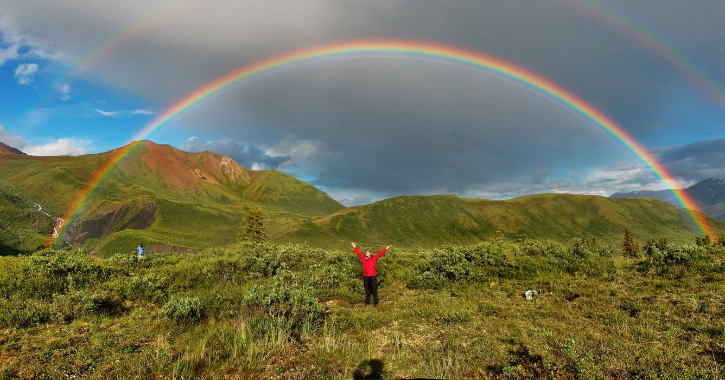
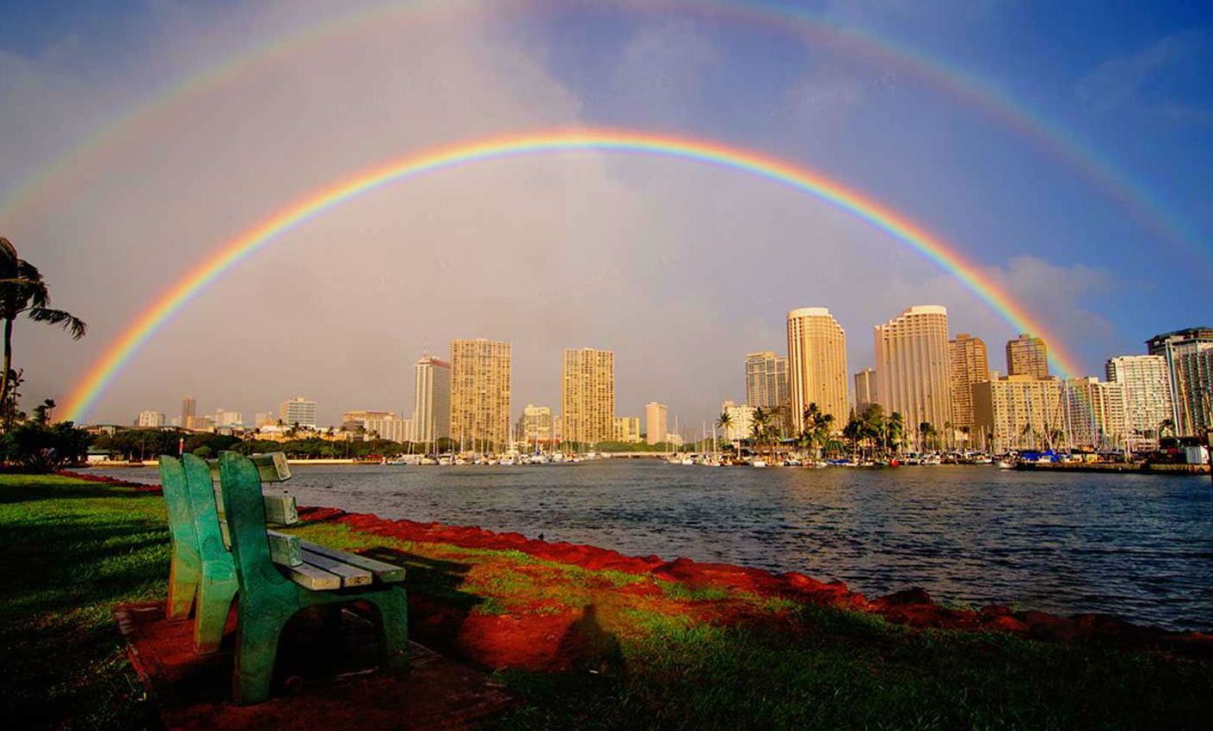
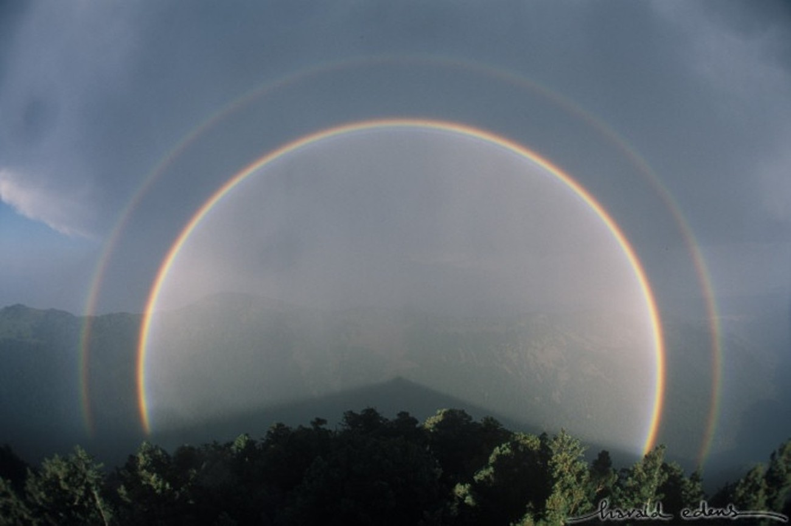
Answers
Is red inside or outside ? In primary bow red is outside. (Red has the smallest refraction index)
What is radius of the bow (in degrees)? About 42°for the primary bow
What is lenght of the bow (in degrees)? Depends on the sun’s location, where there is rain, etc. If the sun is high, the bow goes downwards, and not much is left to see. The bow is part of a circle with a radius of 42 degrees, so we can find the length by knowing how much of it is visible.

Slide 9
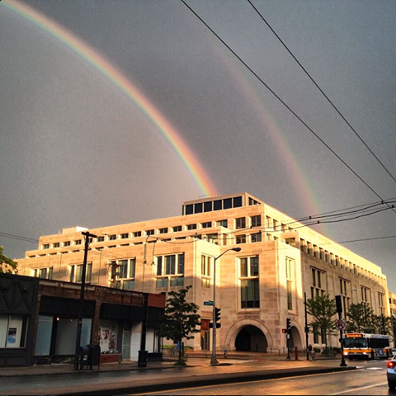
Answers
What is widith of the bow (in degrees)? About the 1.7 degrees
Light intensity inside vs outside The light intensity will be greater inside, as all colors will be present there (and appear as white light). None of this light can end up outside, so the outside should be darker.
In what direction should we look ? In the direction opposite to the sun

Slide 10
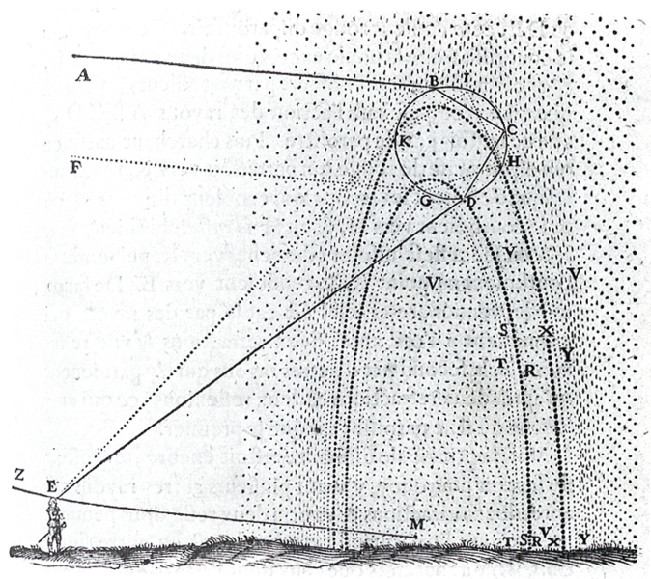
Answers
At what time of the day we can see it ? The sun should preferably be fairly low in the sky, to make a bow visible, so morning or afternoon is perhaps better than mid-day
How many bows are there ? Two; there is a secondary. (Not counting the ones we essentially cannot see.) In fact, there is a tertiary and forth bow in the direction of the sun, but it was only first photographed in 2011.

Slide 11
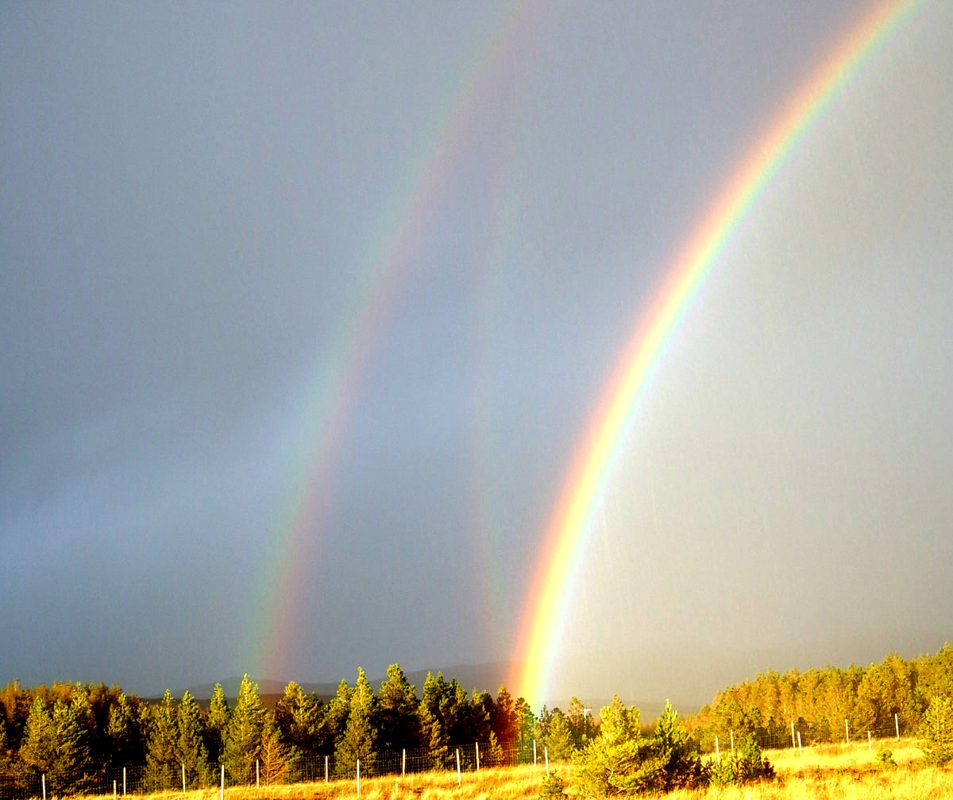
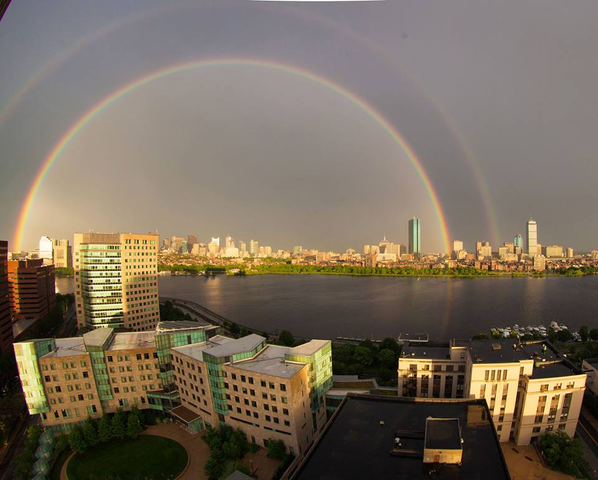
Answers – for the second bow
Where is the second? The secondary is about 10 degrees higher than the primary.
What is the color sequence of the second? The secondary has its color order, when compared to the primary.
What is the radius of the secondary? About 52 degrees.
Width of the secondary? About 3.5 degrees or so, based on the difference in angles plus the sun’s apparent size.

Slide 12
White rainbow

Slide 13
Thank you
Domagoj Pluščec
XV. gimnazija, Zagreb
Croatia

