Slide 1


Comenius Project: Geometry in everyday life
Geometry in architecture
XV. gimnazija, Zagreb, Croatia

Slide 2
Day 1
13 March 2013
students from all around Europe arrived to Croatia for a meeting about geometry in architecture
Comenius meeting in Zagreb was attended by 36 students from 8 countries
since the meeting began a few days before the first day of spring, snow surprised both us and our guests

Slide 3
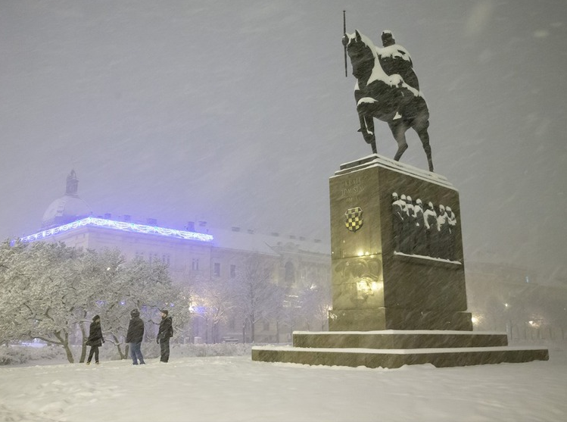
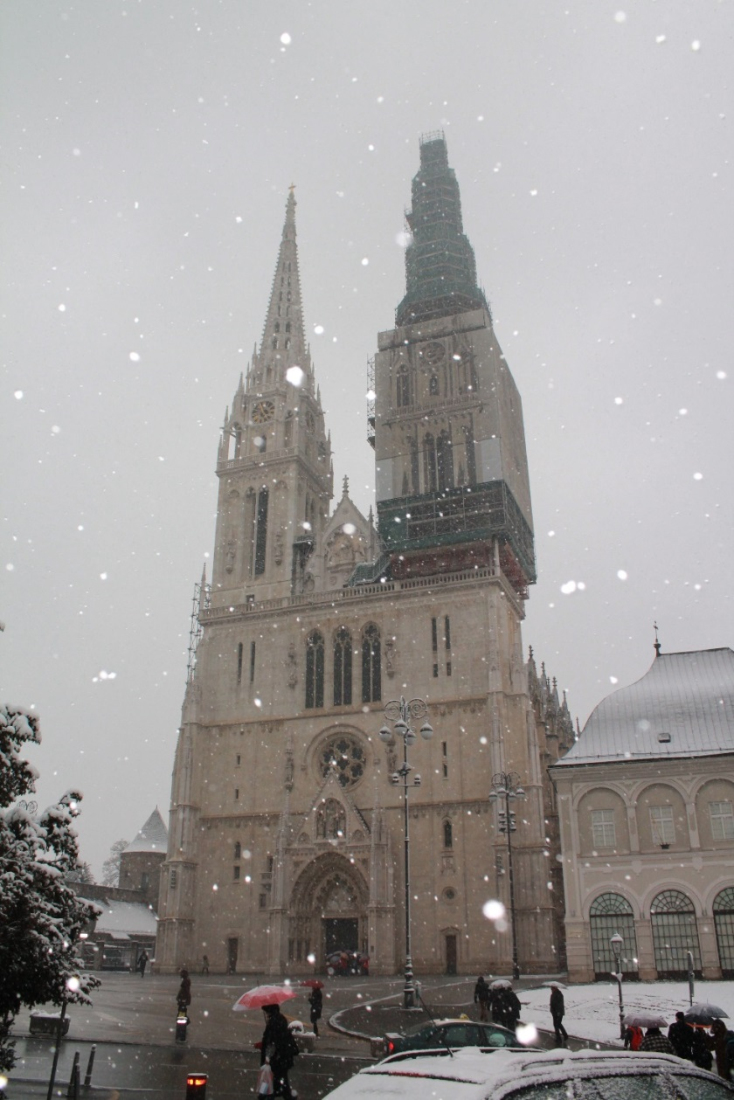

Slide 4
Day 2
14 March 2013
the meeting was scheduled in the morning hours in XV. gimnazija
our coordinator, Mrs Buga Mikšić, and our principal, Mr Josip Harcet gave a welcoming speech to the participants
the guests were invited to the celebration of π-day, the annual day of our school
we organized a tour around the school for the groups comprising of students and teachers

Slide 5
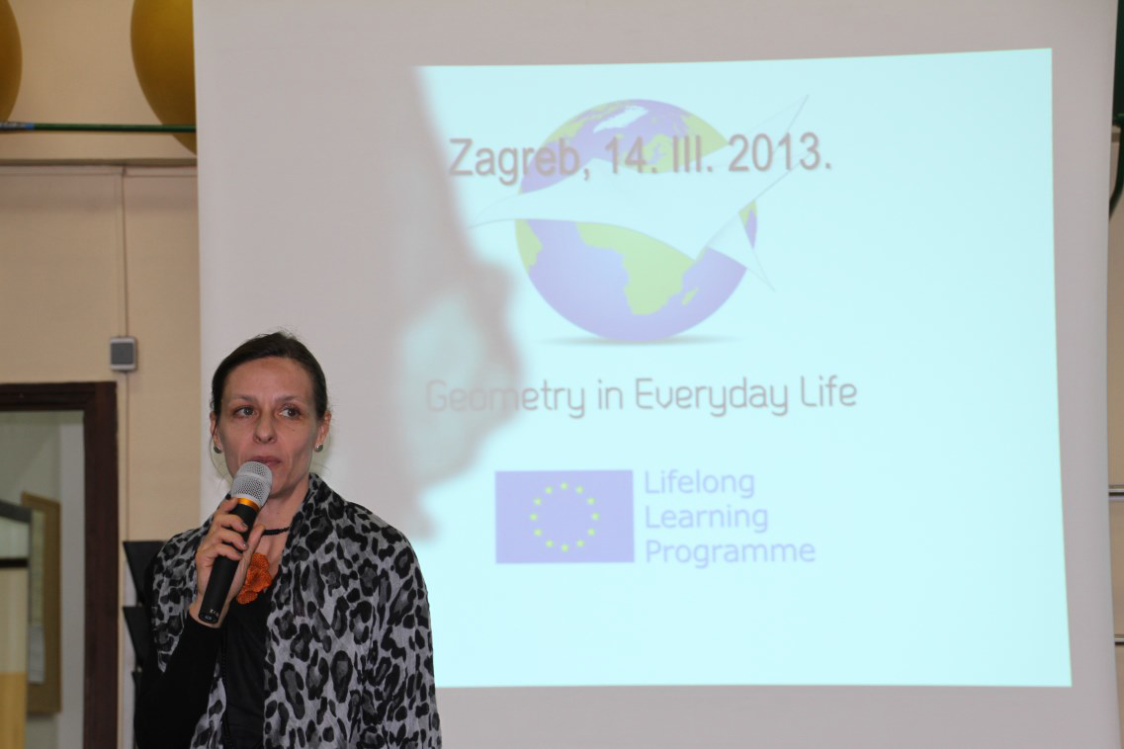
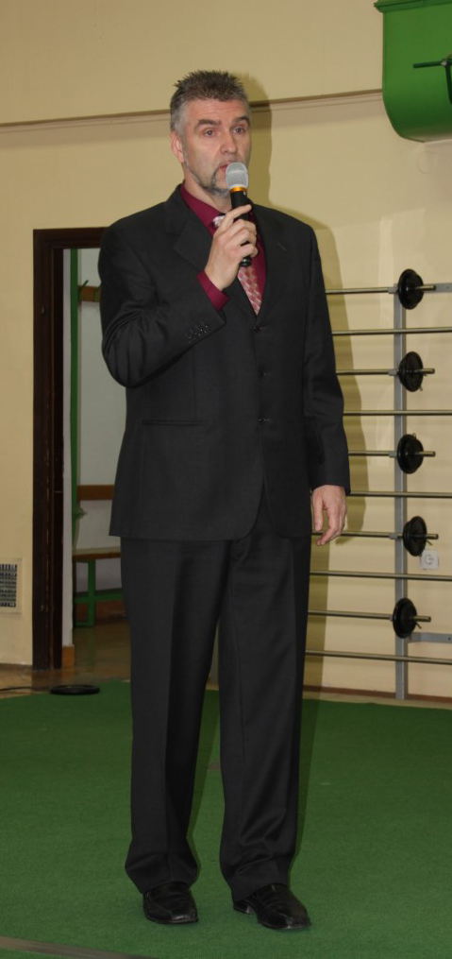
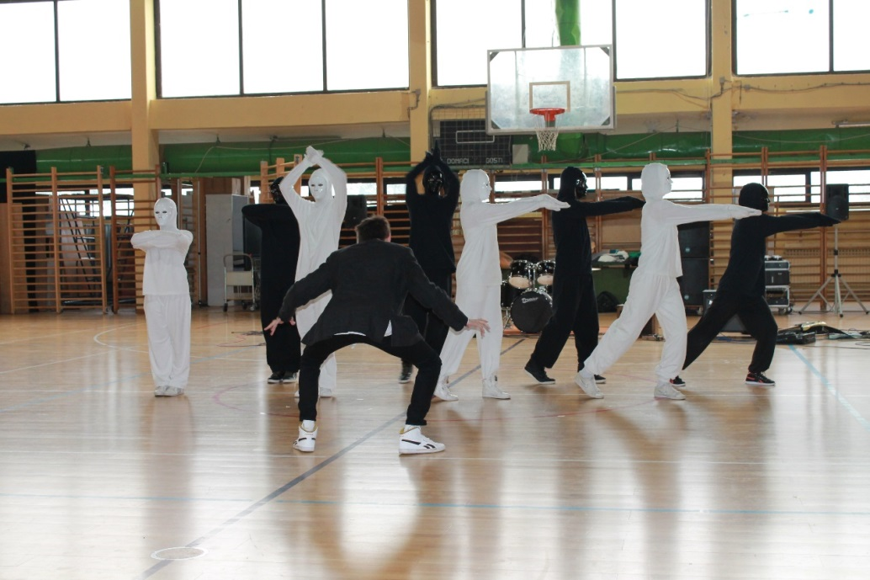

Slide 6
Day 2
14 March 2013
our students organised an amusing city tour for the guest students
groups of students explored the city using maps made of geometrical tasks or riddles, which they had to solve first
they saw many of Zagreb's sights
some of our new friends were a bit frozen, because it snowed that day

Slide 7
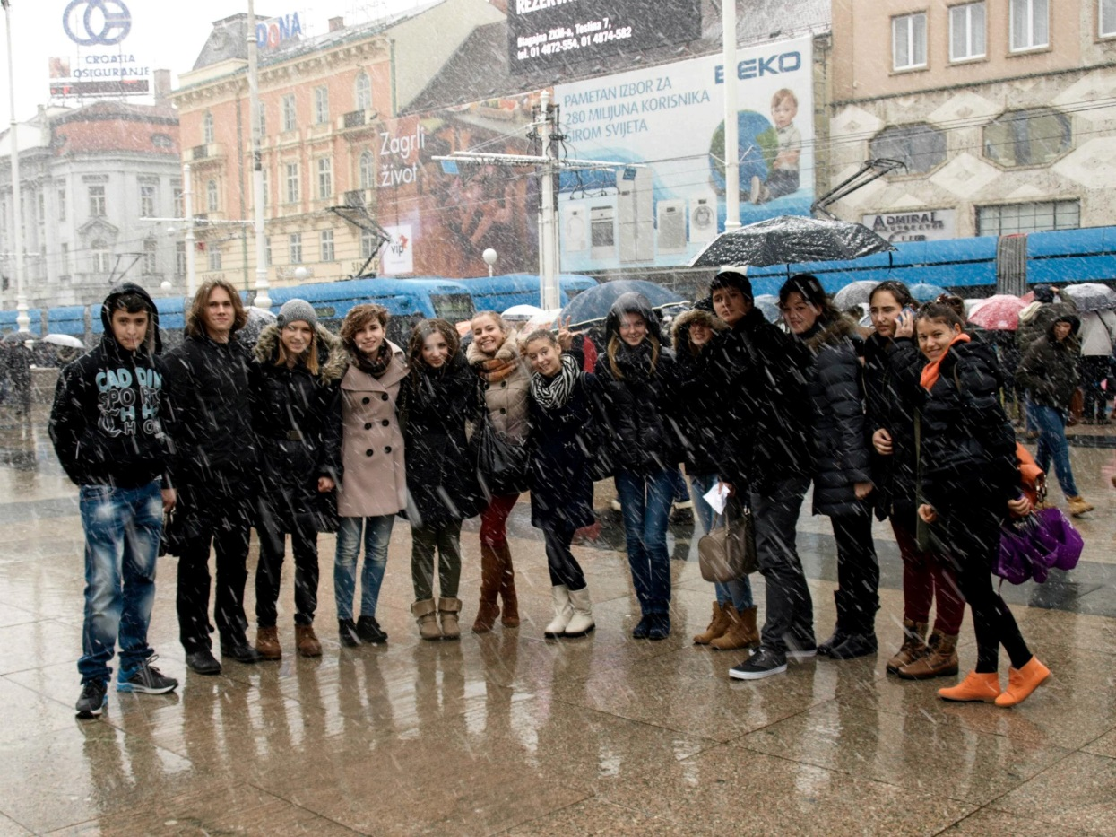
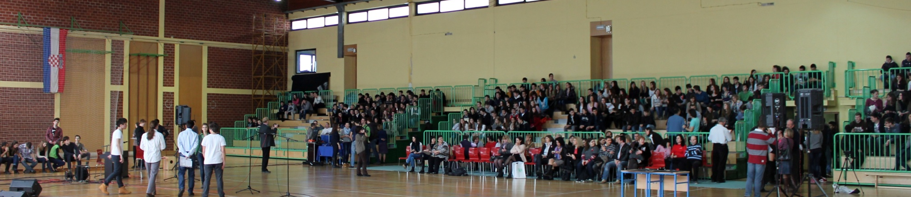

Slide 8
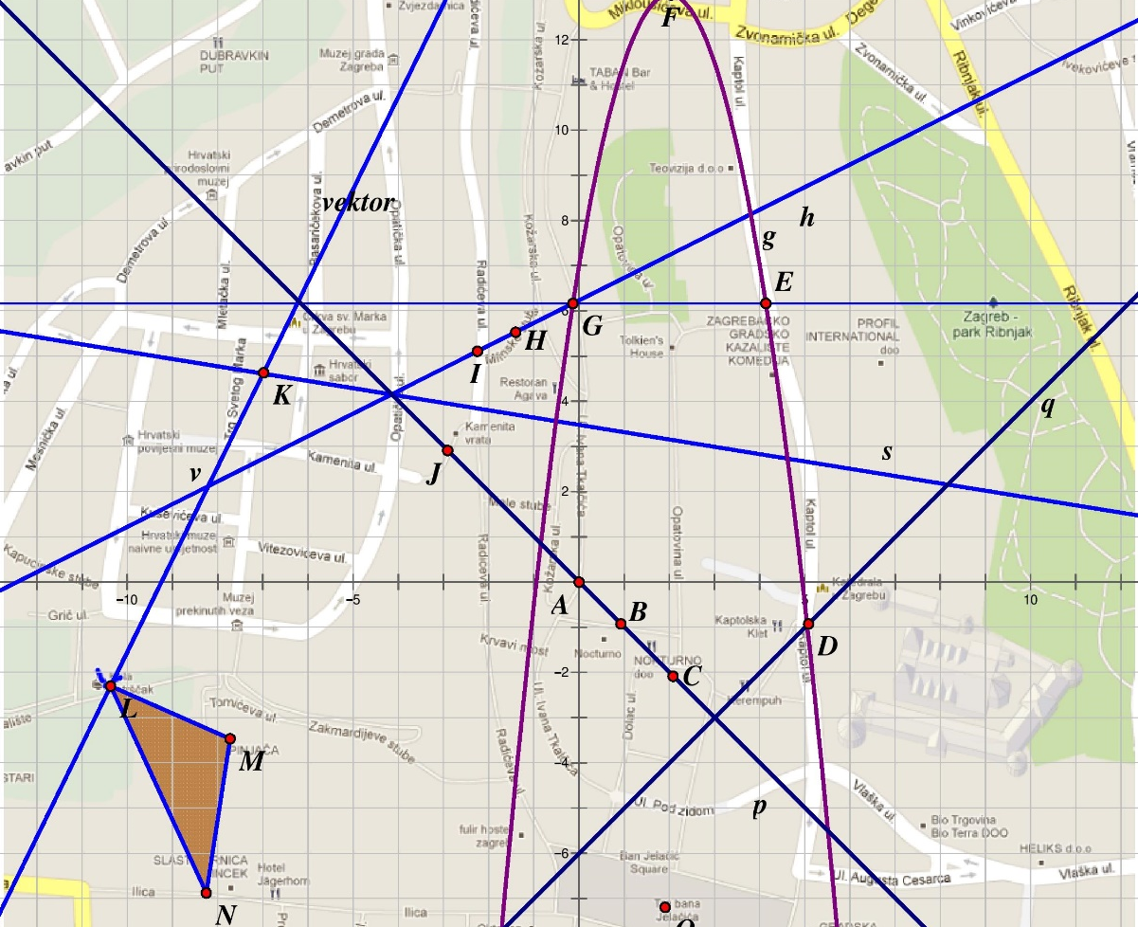

Slide 9
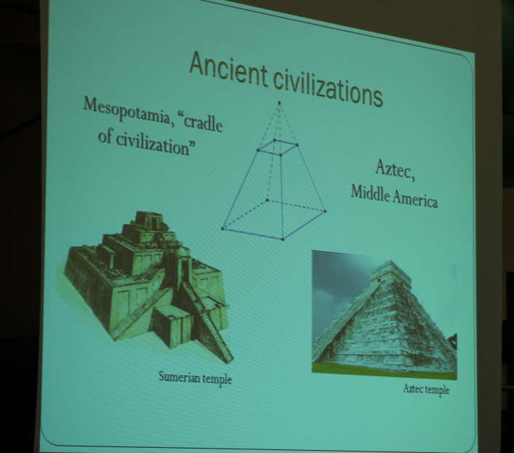
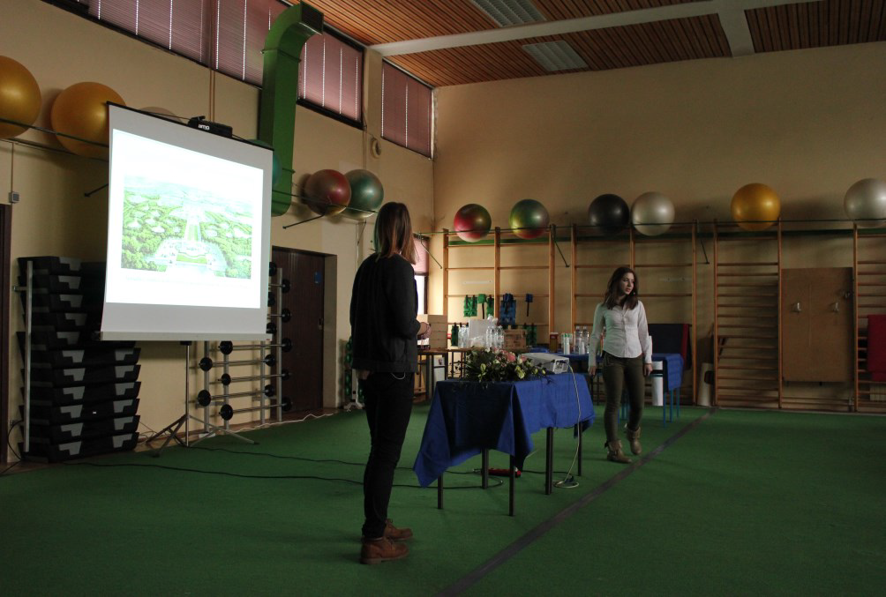
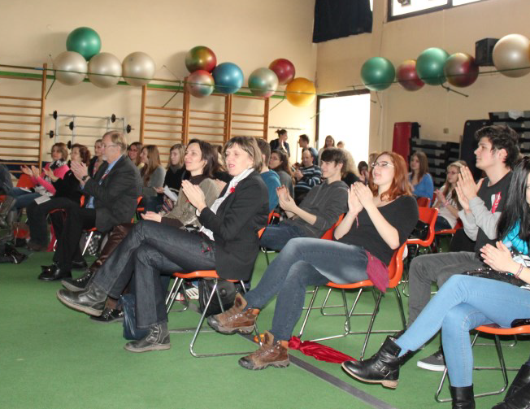
Day 2 & 3
14 -15 March 2013
students presented their works about geometry in architecture

Slide 10
Our students’ presentations
8 Powerpoint presentations:
  The Echo Pavilion in Maksimir and a model (by Tina Rukavina & Filip Novkoski)
  A bridge in Sisak (by Dora Matek & Lucija Ulaga)
  The Music Pavilion at Zrinjevac Park (by Nela Tadić)
  Circles in architecture (by Dora Bobovčan)
  Golden ratio in architecture (by Kristijan Štefanec)
  Modern architecture in Zagreb (by Dijana Modrić)
  Geometry in the architecture of Croatia’s castles (by Nikola Čulumović)
  Geometry in architecture (by Lucija Dobrović & Sanja Priselac)

Slide 11
Our students’ presentations
2 films:
  ”Interview with an architect: mr. Andrija Rusan” (by Nikša Ovčina & Mak Gračić)
  “Anechoic chamber at FER” (by Lovro Marković, Domagoj Badanjak & Mislav Matić)
A model of St. Donat’s church made in front of the audience (by Marija Gaćina)
A poster about the geometry of Ban Josip Jelačić square (by Helena Majetić, Zvonimir Gršković & Nikola Duvnjak)

Slide 12
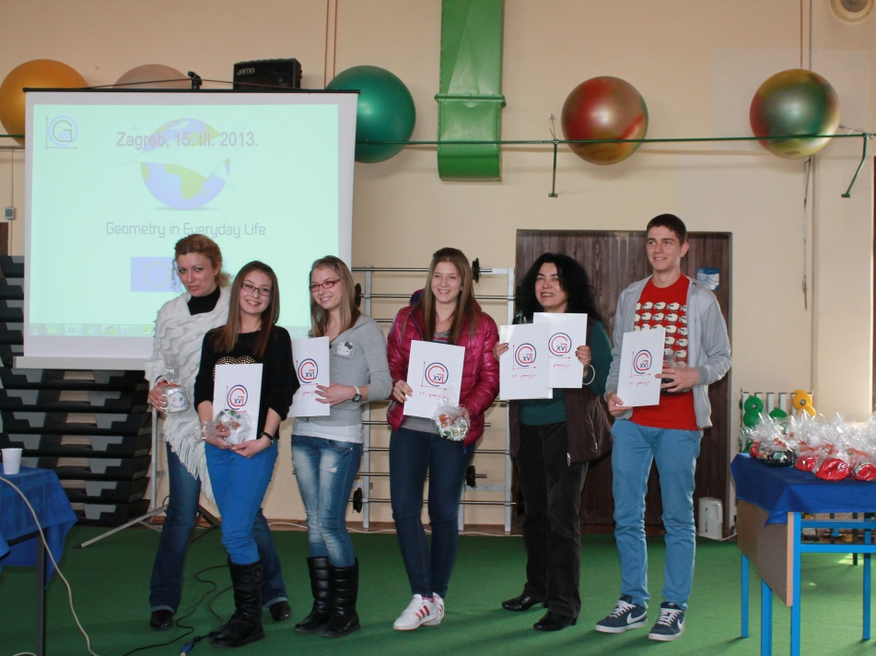
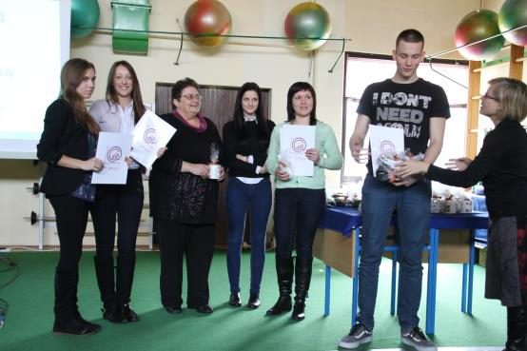
Day 3
15 March 2013
after the rest of the presentations, on the closing ceremony our guests were given certificates for participation
the official part of the meeting was over

Slide 13
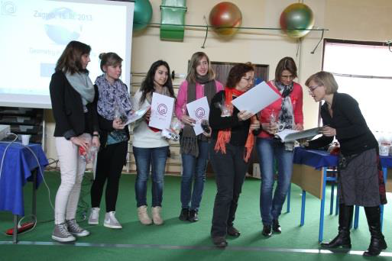
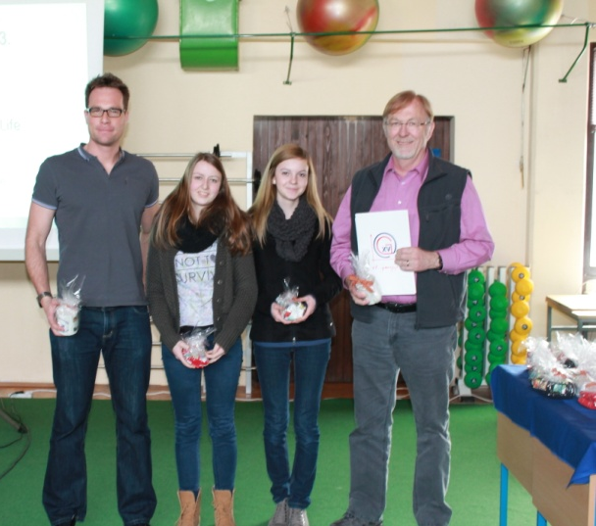
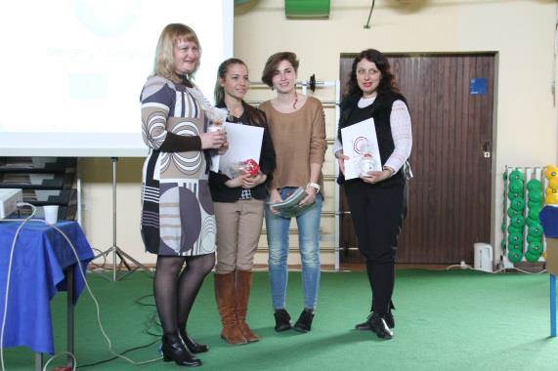
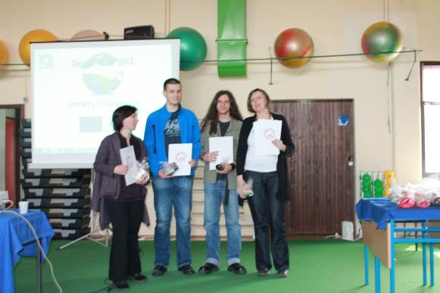
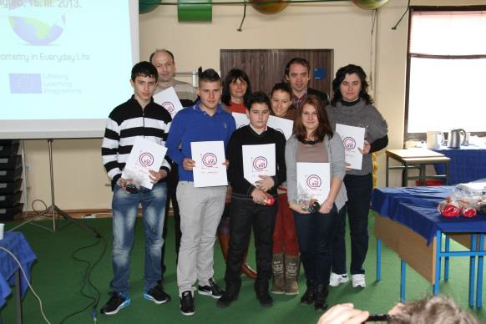
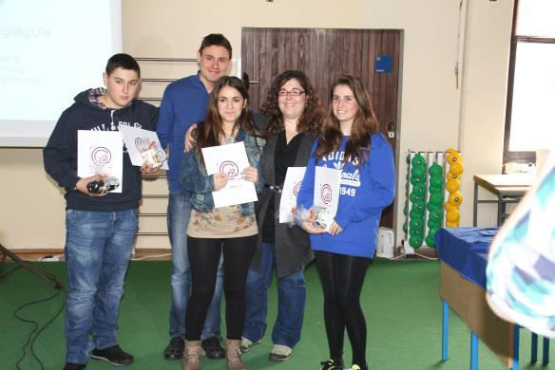

Slide 14
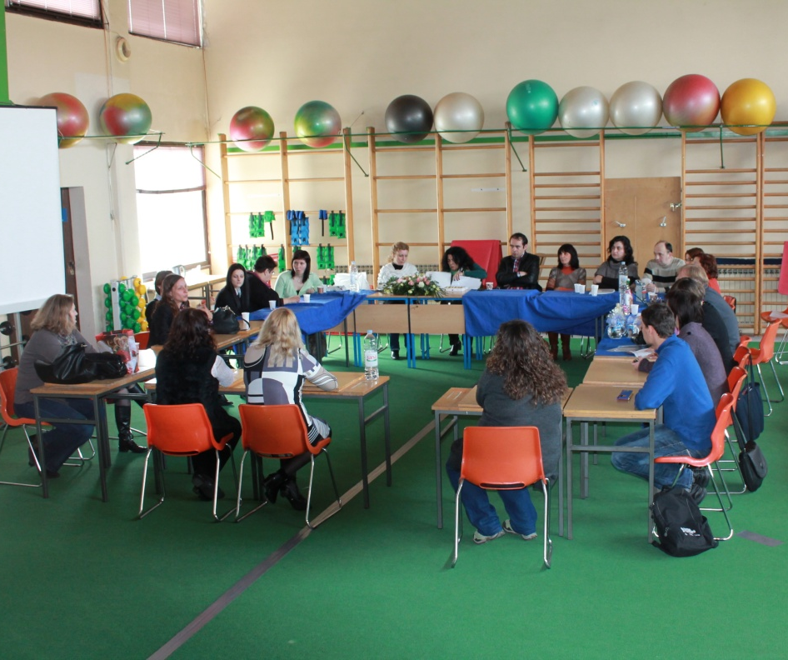
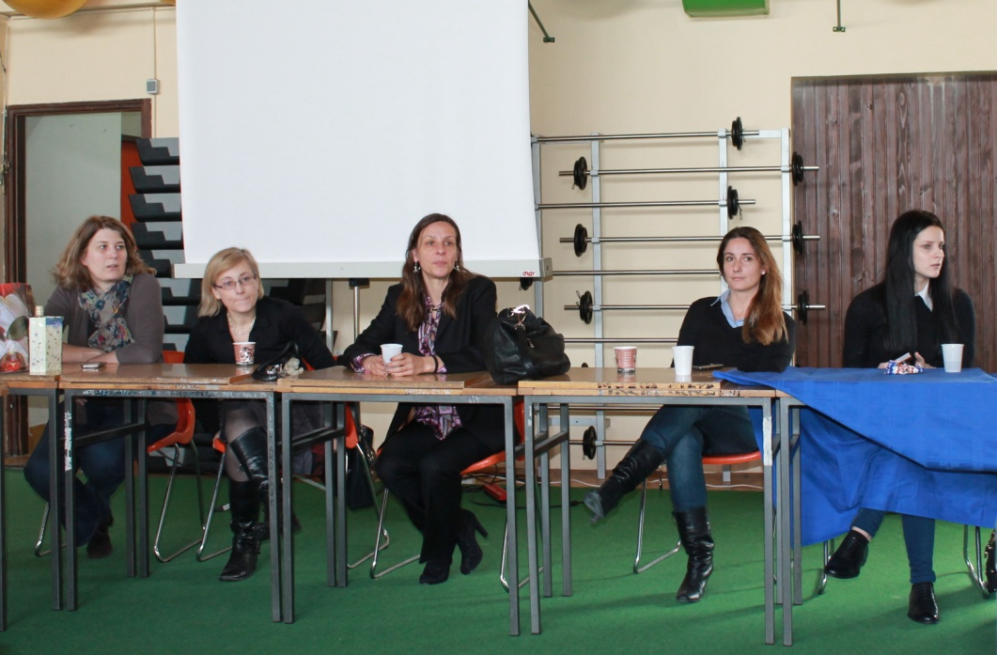
Day 3
15 March 2013
teachers evaluated results of the meeting in Zagreb

Slide 15
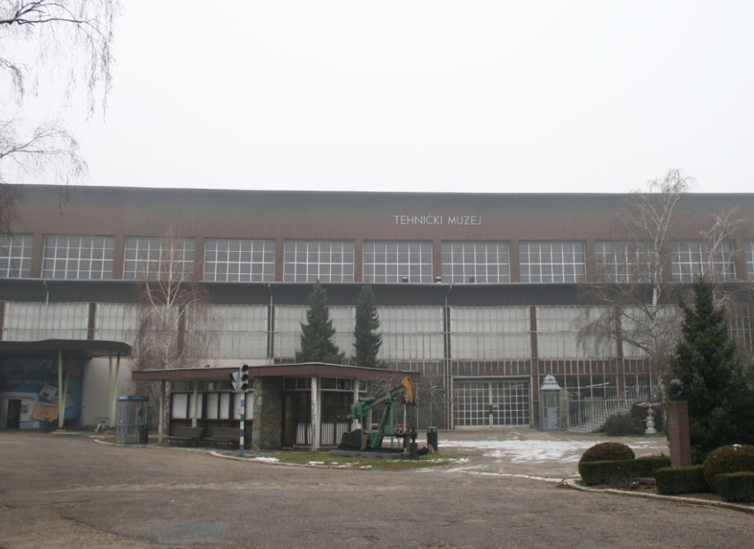
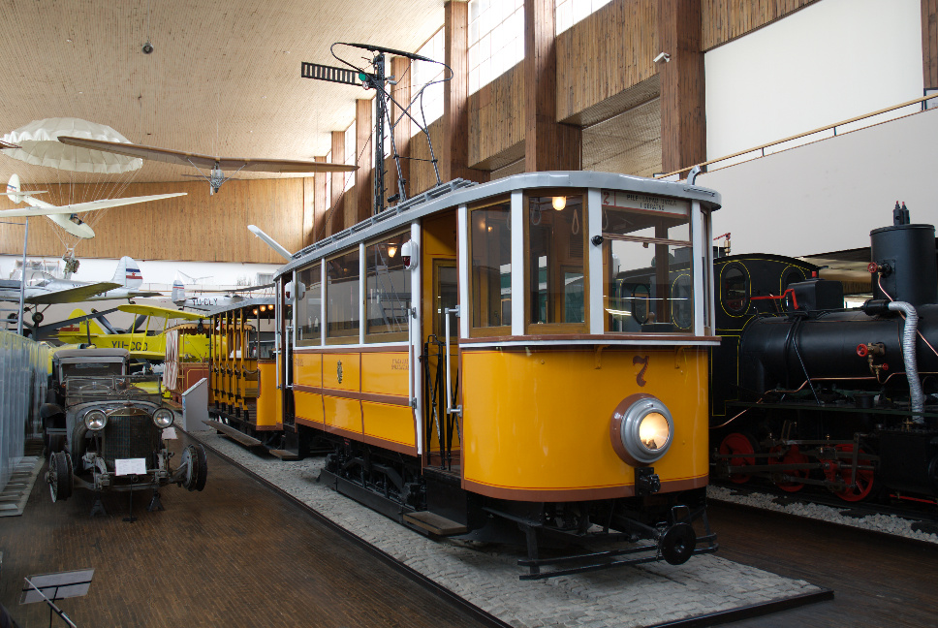
Day 3
15 March 2013
in the afternoon we had a tour in Zagreb’s Museum of Technical Sciences
students also visited Planetarium and Laboratory of Nikola Tesla

Slide 16
Day 4
16 March 2013
after two days of hard work it was time for relaxation
we organized a trip to Brijuni Islands National Park for our guests
on Brijuni Islands our guests could enjoy the nature and see Croatian natural wonders
after arriving on Brijuni Islands, we went sightseeing with our guests

Slide 17
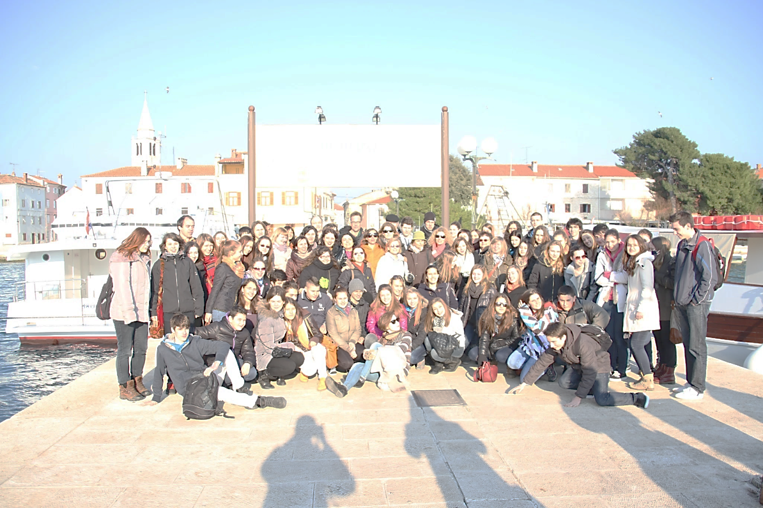
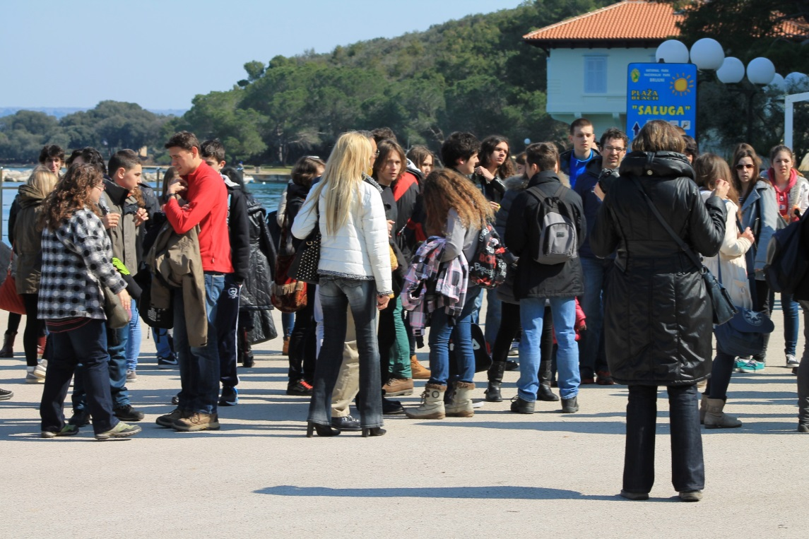

Slide 18
Day 4
16 March 2013
Brijuni Islands are packed with cultural, historical and natural sights
our guests visited a church and a museum on the island
students analyzed geometry in ancient Roman archaeological sites
in their free time, our guests took a walk around the island, lied on the shore and saw interesting (and some unusual) animal species

Slide 19
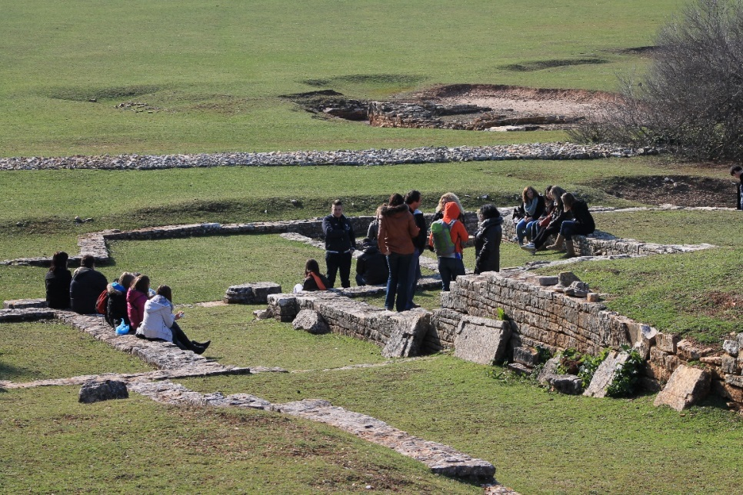
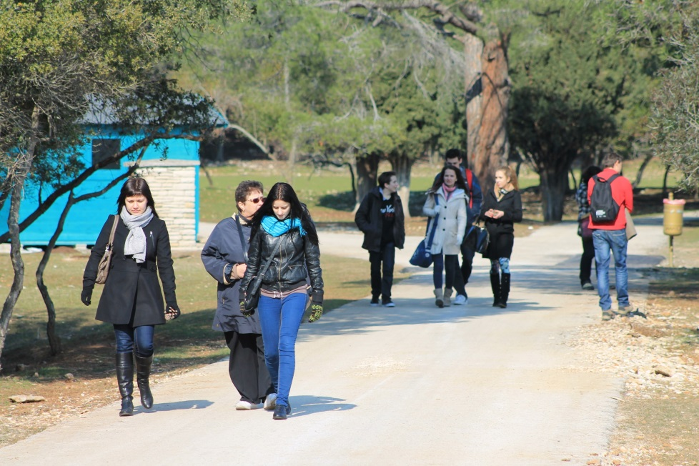
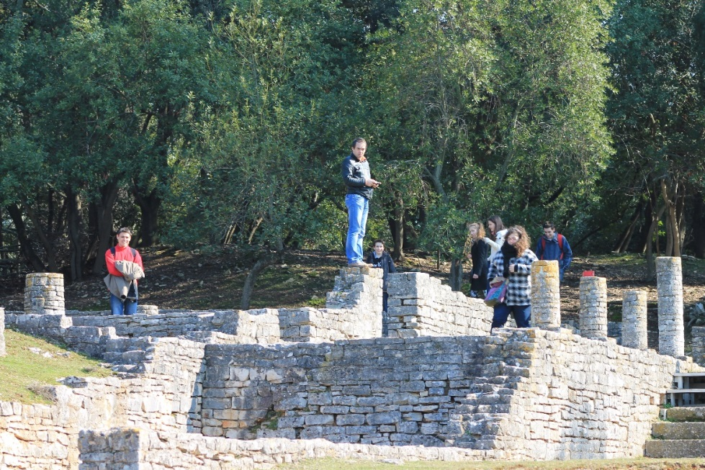

Slide 20
Day 5
17 March 2013
time to say goodbye, our partners had to return to their homes
we took a little rest and started preparing for the meeting in Lithuania and our next topic 'Fractals'

Slide 21
The end
Thank you for your attention!

