Slide 1
MODERN ARCHITECTURE in ZAGREB
Dijana Modrić, XV. Gimnazija, Croatia

Slide 2
Geometric apstraction appears as the reaction on historical style in architecture of 19th century

Slide 3
Time between World War One and World War Two is marked as the beginning of modern arhitecture in Zagreb

Slide 4
FOUNDATION BLOCK (cro. ZAKLADNI BLOK)
Well known facade at the main square.

Slide 5
Foundation hospital (cro. Zakladna bolnica)
The old hospital called 'Zakladna bolnica' instead of which ‘Zakladni blok’ was built.

Slide 6
The first example of functionalistic modern architecture interpolated in matrix of the city

Slide 7
Geometric fact
The skyscraper, which was built 20 yeras later at the north side, is determined by the only verticale of balconies on the facade of the south side .
We can draw axis that connects them.

Slide 8
In the centre of the city. It is composed of a few buildings.

Slide 9
NAPRETKOVA ZADRUGA
Interesting building which is changed by shape upon 4th floor from the west direction and upon 5th floor from the south direction into shape of squeezed cylinder.

Slide 10
Last floor is built in
It gives a broad sight to the city

Slide 11
From the ground floor to 4th
From 5th floor to the top

Slide 12
Geometric fact
It rises spirally to the top.

Slide 13
WOODEN SKYSCRAPER (cro. DRVENI NEBODER)
The building is valuable by the theory of architecture and the building typology.
It is involved in the key buildings of croatian modern architecture.

Slide 14
Geometric fact
Shape follows cuboidic construction.
Perfect example of structuralism.

Slide 15
OKTOGON
It was built for the first croatian saving bank.
Historicism.

Slide 16
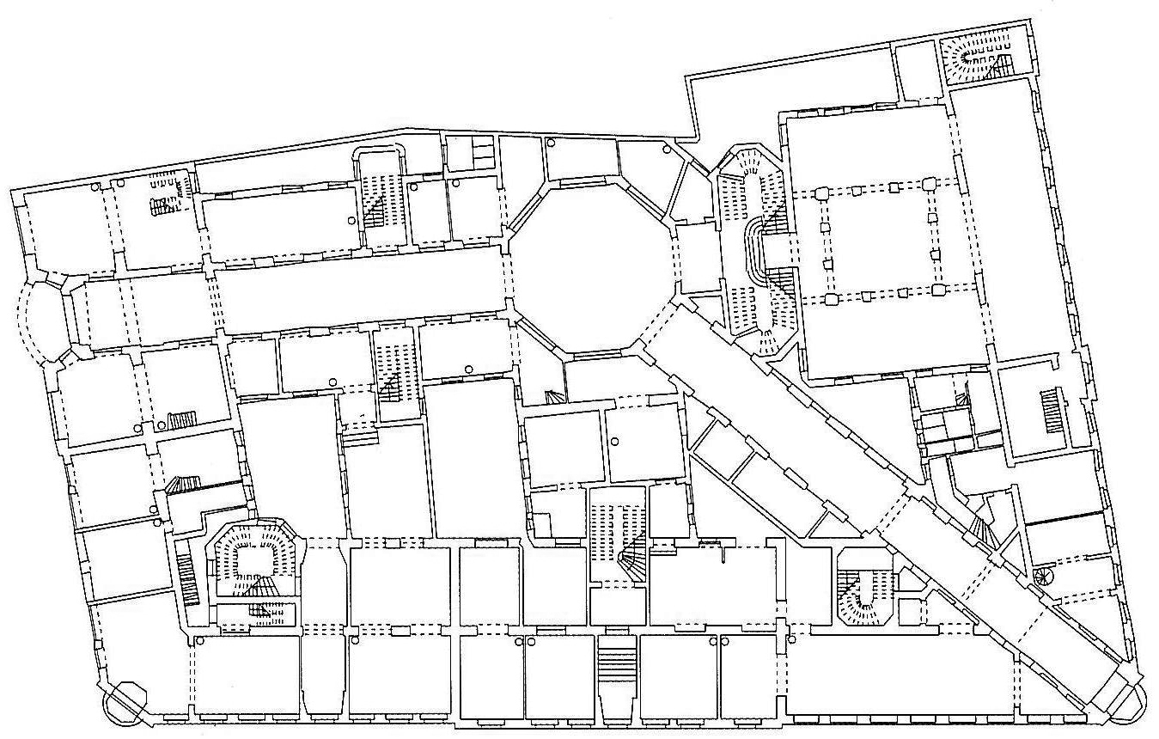
Geometric fact
It is called after central part of interior passage

Slide 17
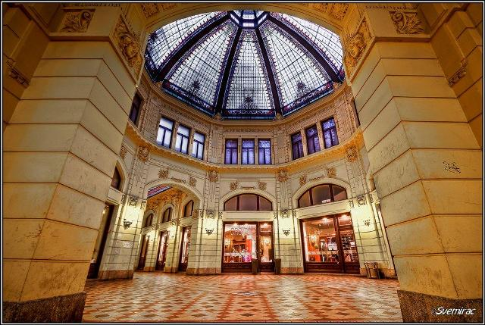
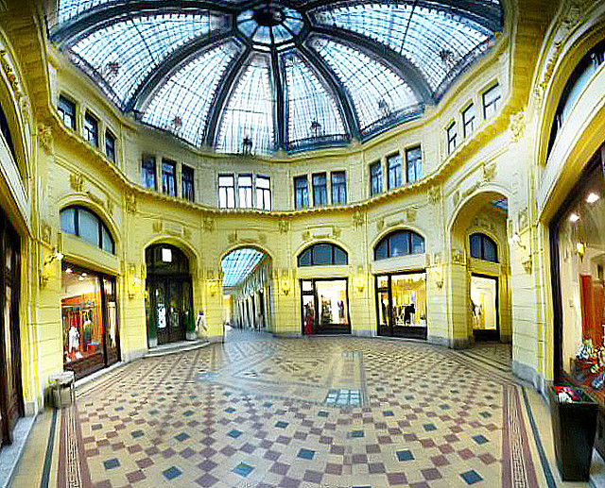
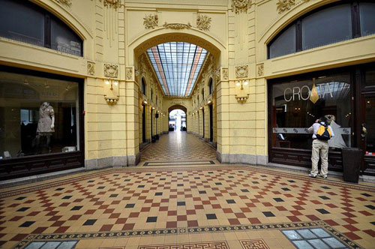

Slide 18
CVJETNI TRG
ILICA
Hallway connects square Cvjetni trg and main street Ilica

Slide 19
STOCK EXCHANGE BUILDING (CRO. ZGRADA BURZE)
It has characteristics of both modern and classic architecture.
Masterpiece of croatian architecture.

Slide 20
Geometric fact
The main facade is on the cutted corner of two streets
Streets make acute angle of 45˚
45˚

Slide 22
Burza tooks important position and it is significant in urban planning of the city.
It opened first diagonal to east-sotuh part of the city.

Slide 23
Line dragged from building’s border is tangent line on Meštrović’s Pavillon

Slide 24
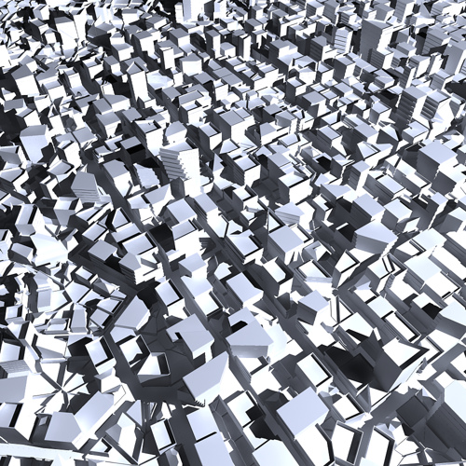
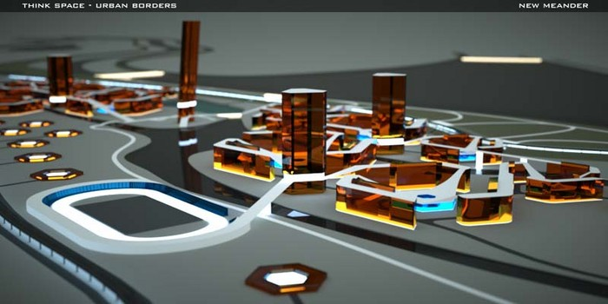
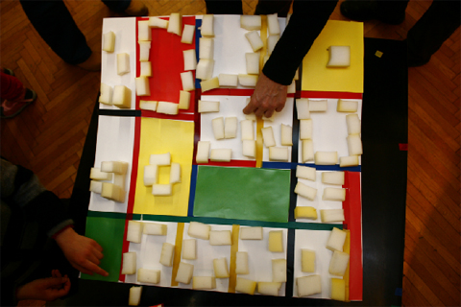
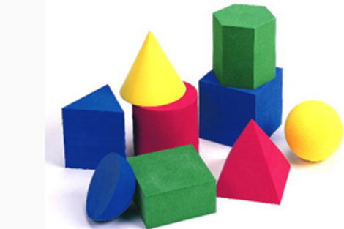
THANK YOU FOR YOUR ATTENTION !

