Slide 1
The golden ratio in architecture
Kristijan Štefanec

Slide 2
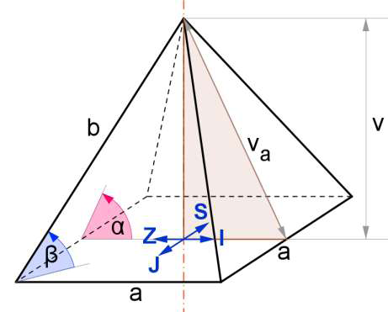
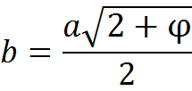
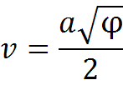
The golden ratio
Also called φ
Two quantities a and b are said to be in golden ratio if = =φ
The second definition of φ is: φ-1=
From this one, we can easily calculate φ:
- φ-1=0
φ= ≈1.618
Dymenzions of the Great Pyramid of Giza can be easily expressed by φ
φ²

Slide 3
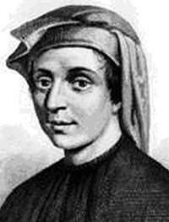
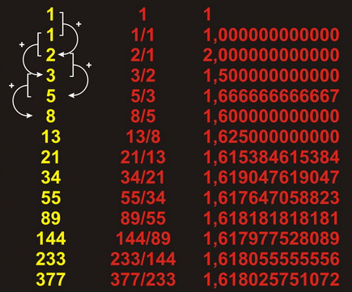
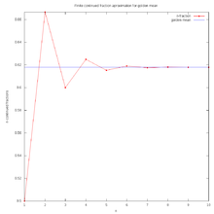
Fibonacci series
Fibonacci was Italian mathematican
from 13th century.
Numbers in Fibonacci series must satisfy this conditions:F0=0, F1=1 and: Fn=Fn-1+Fn-2
The first few of them are: 0,1,1,2,3,5,8,13,21,34,55,89...
Fi/Fi-1≈φ and that
ratio is more and more
closer to φ as i rises.

Slide 4
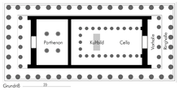
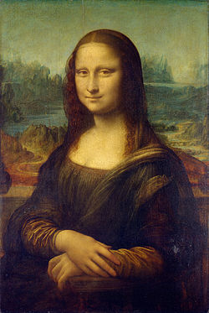
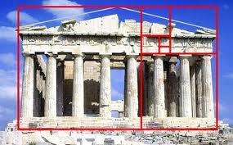
φ in art and architecture
Very important ratio in all arts and architecture
golden ratio was known even in ancient greece
for exemple here on
parthenon we have many
golden ratios
Even Mona Lisa has golden
ratio:

Slide 5
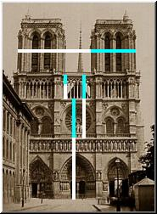
φ in architecture
In 15th century, first time called “God’s ratio”
Excelent examples for it are CN tower
in Toronto and church Notre Damme
The height of the first level is 342 meters and
the top is at 553.3 m so
the ratio is:
553.3/342=1.618
As we can see on picture,
Notre Damme has many
distances that are in
golden ratio

Slide 6
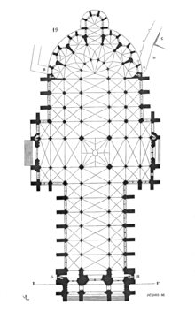
φ in Croatian architecture and Zagreb cathedral
There are plenty of buildings in Croatia with some dimensions in golden ratio
Probably the most important is chatedral in Zagreb
here are some of the golden ratios:
Also, the height of the towers
and height of the main building
are in gold ratio

Slide 7
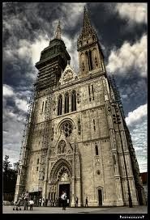
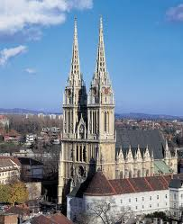
Cathedral
The Zagreb Cathedral on Kaptol is
a Roman Catholic institution and
one of the tallest buildings in Croatia.
Dedicated to the Assumption of Mary
Construction started in 1094
Destroyed in 1242 by the Tatars
Rebuild and again destroyed
in 1880 by earthquake
Restorated in Neo-Gothic style
108 meters high

Slide 8
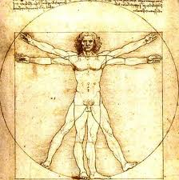
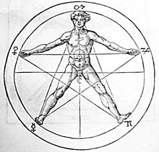
Interesting facts
φ can be found even in Pascals triangle
in pentagon, φ iz the ratio between diagonal and two parts of diagonal that are made by intersecting the first diagonal with the second

Slide 9
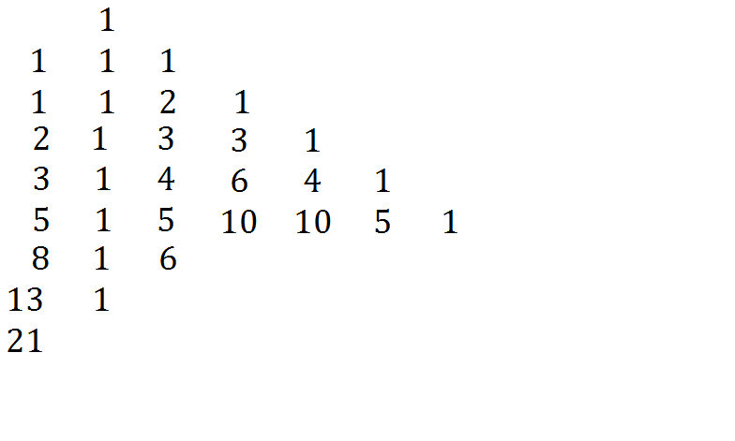
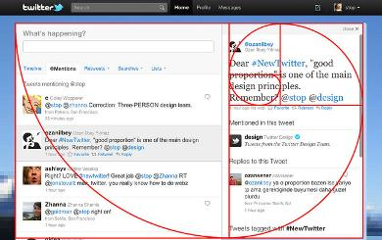
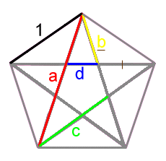
Twitter’s design was made
in golden ratio
In pentagon, diagonals
divide each others, creating
4 segments, as on the picture
below
b/d=c/b=a/c=φ
Also, there are many places where we can find Fibonacci serie
For example, in Pascal’s triangle, where the sum of numbers on each diagonal gives one number from Fibonacci serie

