Slide 1
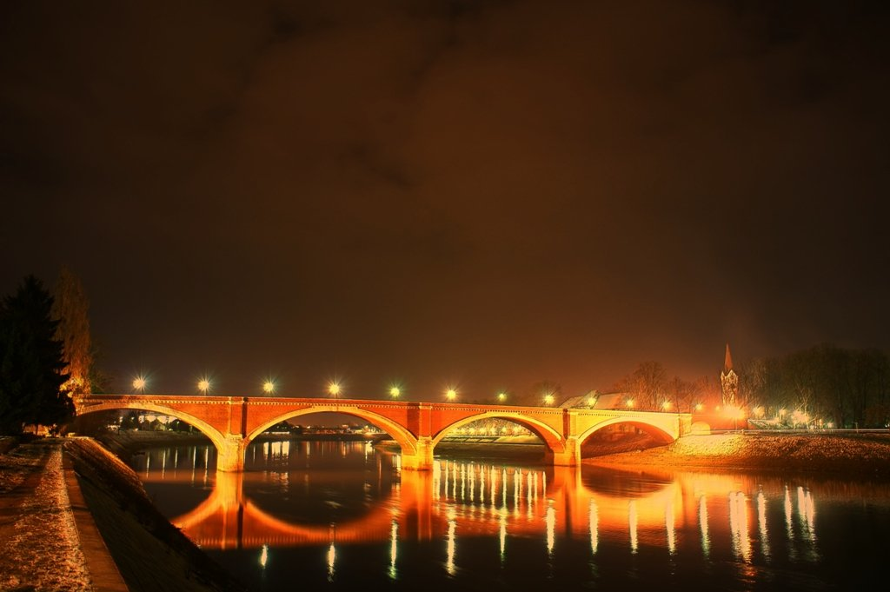
Geometry in Sisak
(The Old Bridge)

Slide 2
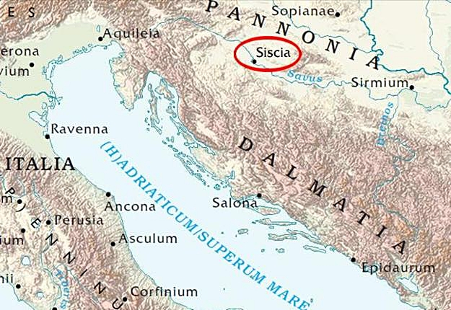
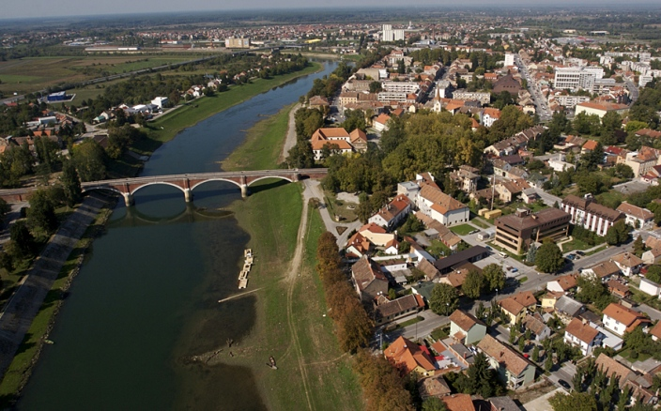
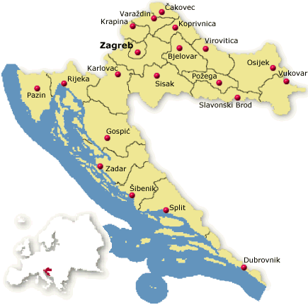

Slide 3
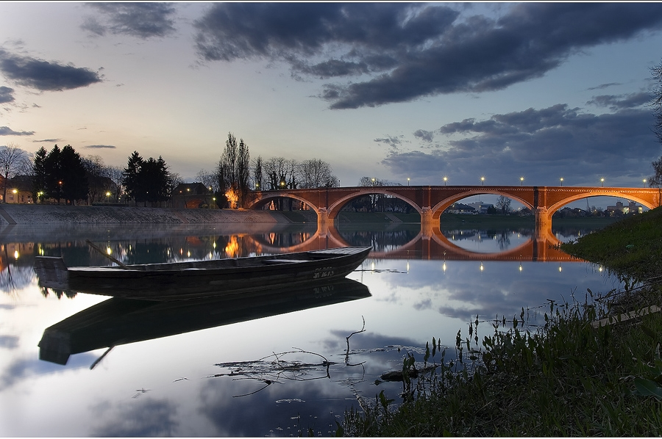
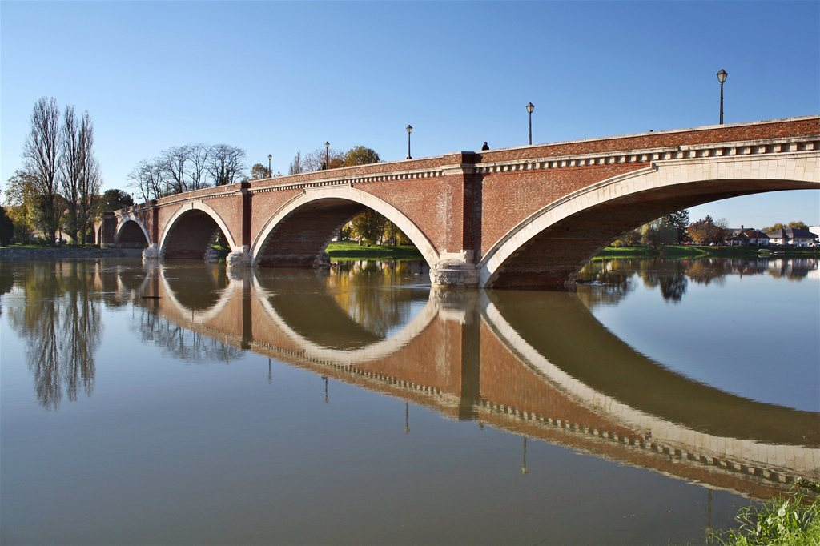
The Old Bridge is the most famous
symbol of the city

Slide 4
What do you see?

Slide 5
Length
$$s=vt=2.5∗64.4=161$$
$$161m$$
$$3m$$
$$38m$$

Slide 6
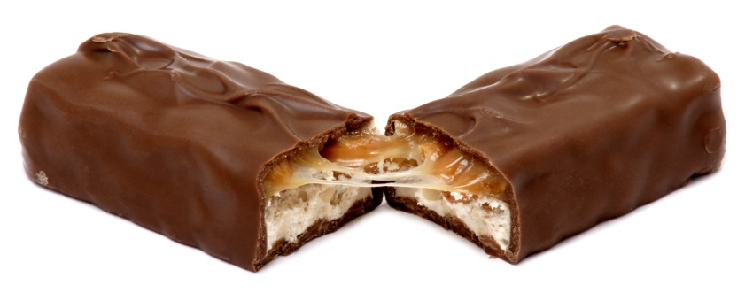
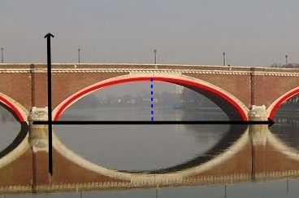
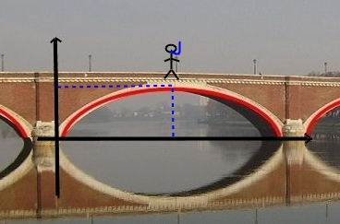
Bridge’s parabola
$$x1=0$$
$$x2=38$$
$$y0$$
$$x0=19$$
$$f(x0)=y0$$
$$x1$$
$$x0$$
$$x2$$
$$f(x)=a(x−x1)(x−x2)$$
$$y_{0}=\frac{g∙t^{2}}{2}=\frac{9.81∙2.04}{2}=10$$

Slide 7
Yeaah
$$10=19a∙\left(19−38\right)$$
$$a=−0.028$$
$$161$$
$$10$$
$$3$$
$$38$$
$$f(x)=−0.028x∙(x−38)$$

Slide 8
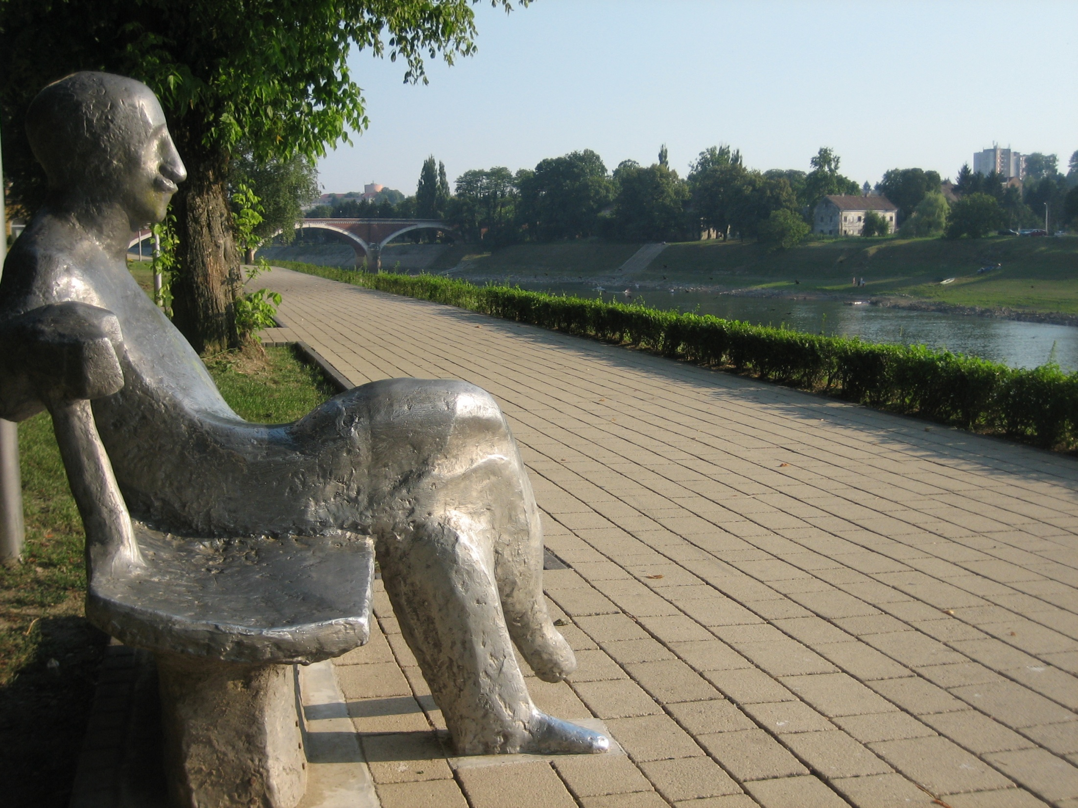

Slide 9
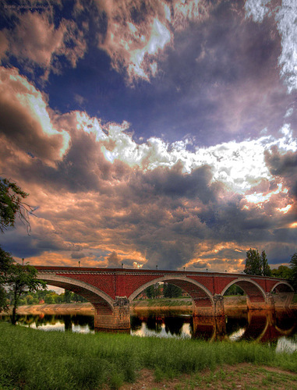
The end
Lucija Ulaga
&
Dora Matek
XV. GIMNAZIJA

