Slide 1
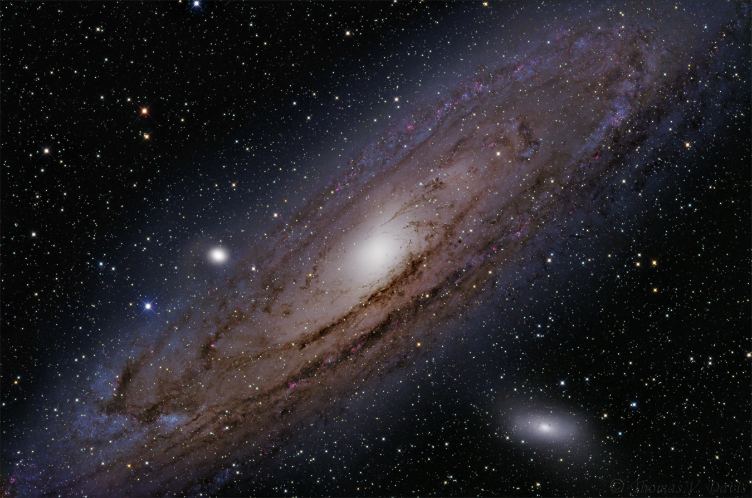

Geometrical shapes in nature

Slide 2
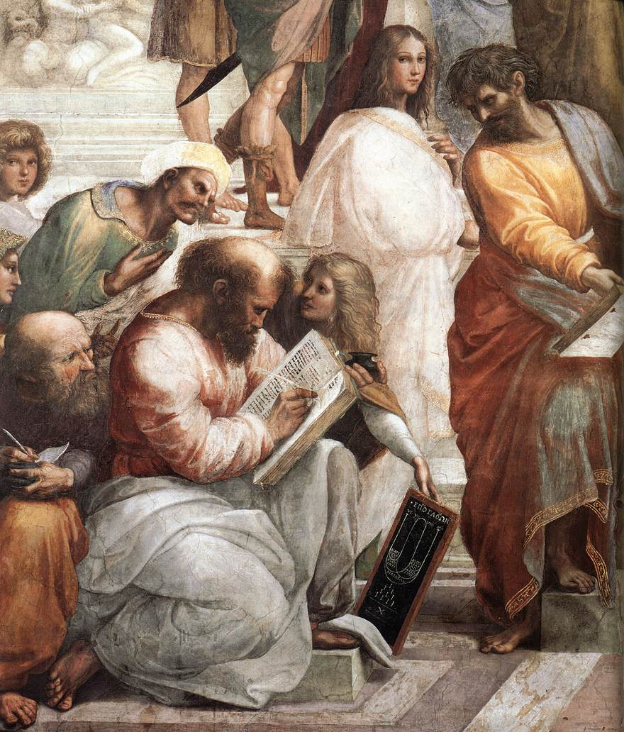
pYTHAGOREANISM
THE SYSTEM OF BELIEFS HELD BY PYTHAGORAS AND HIS FOLLOWERS
FOR PYTHAGORA:
NUMBER WAS THE SUBSTANCE OF ALL THINGS

Slide 3
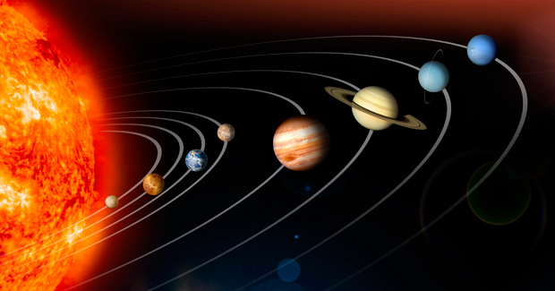
The Solar System

Slide 4
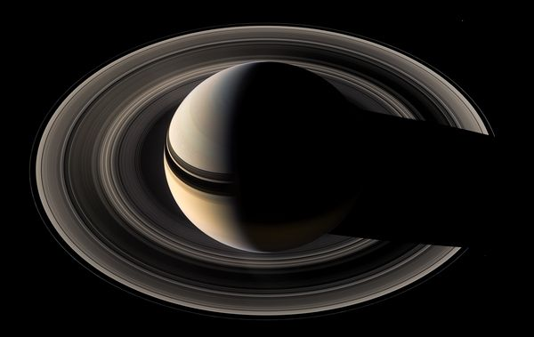
The Rings of Saturn

Slide 5
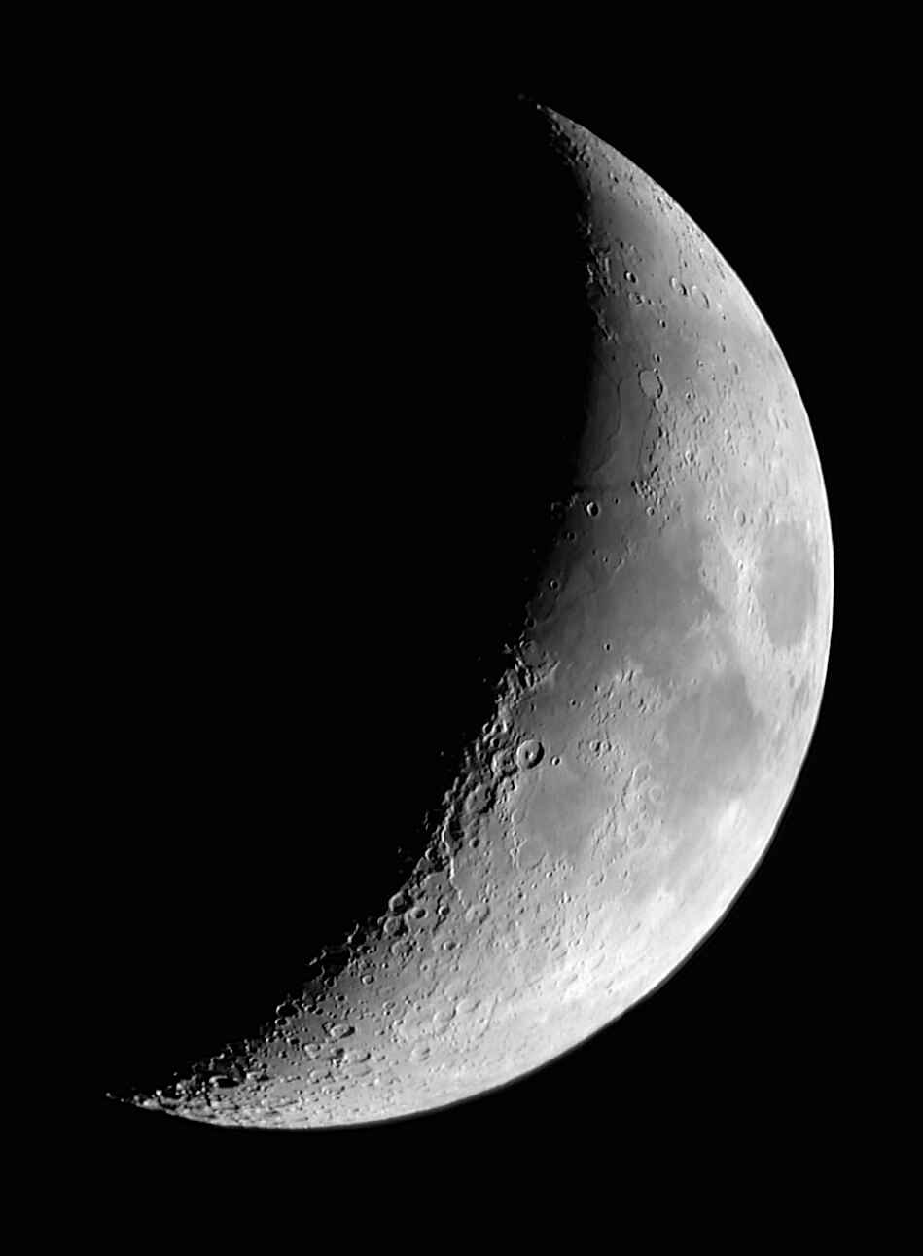
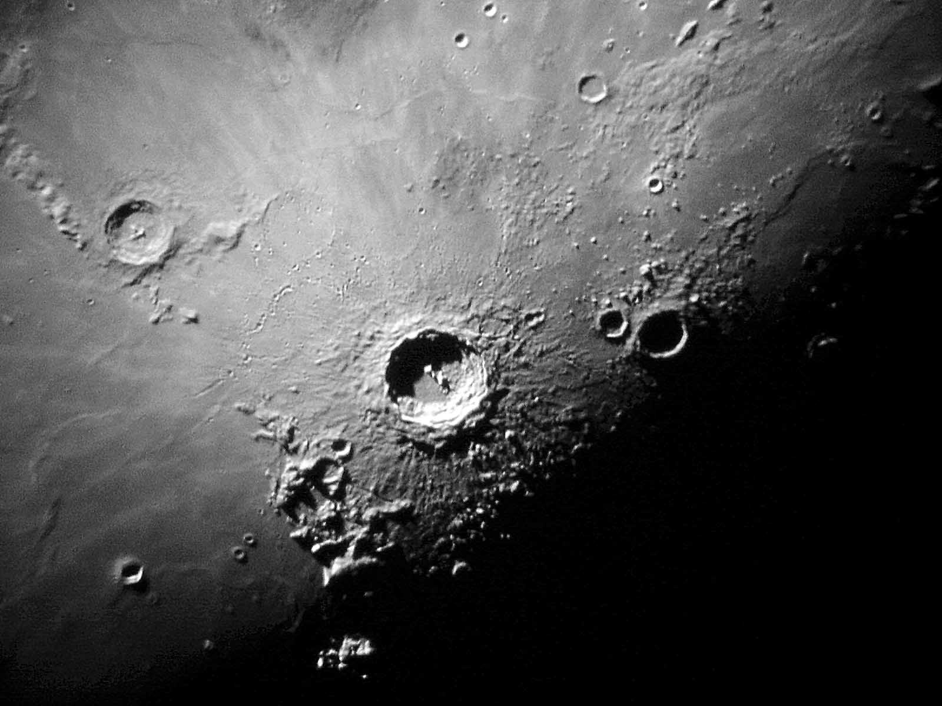
The Moon and
Boscovich crater

Slide 6
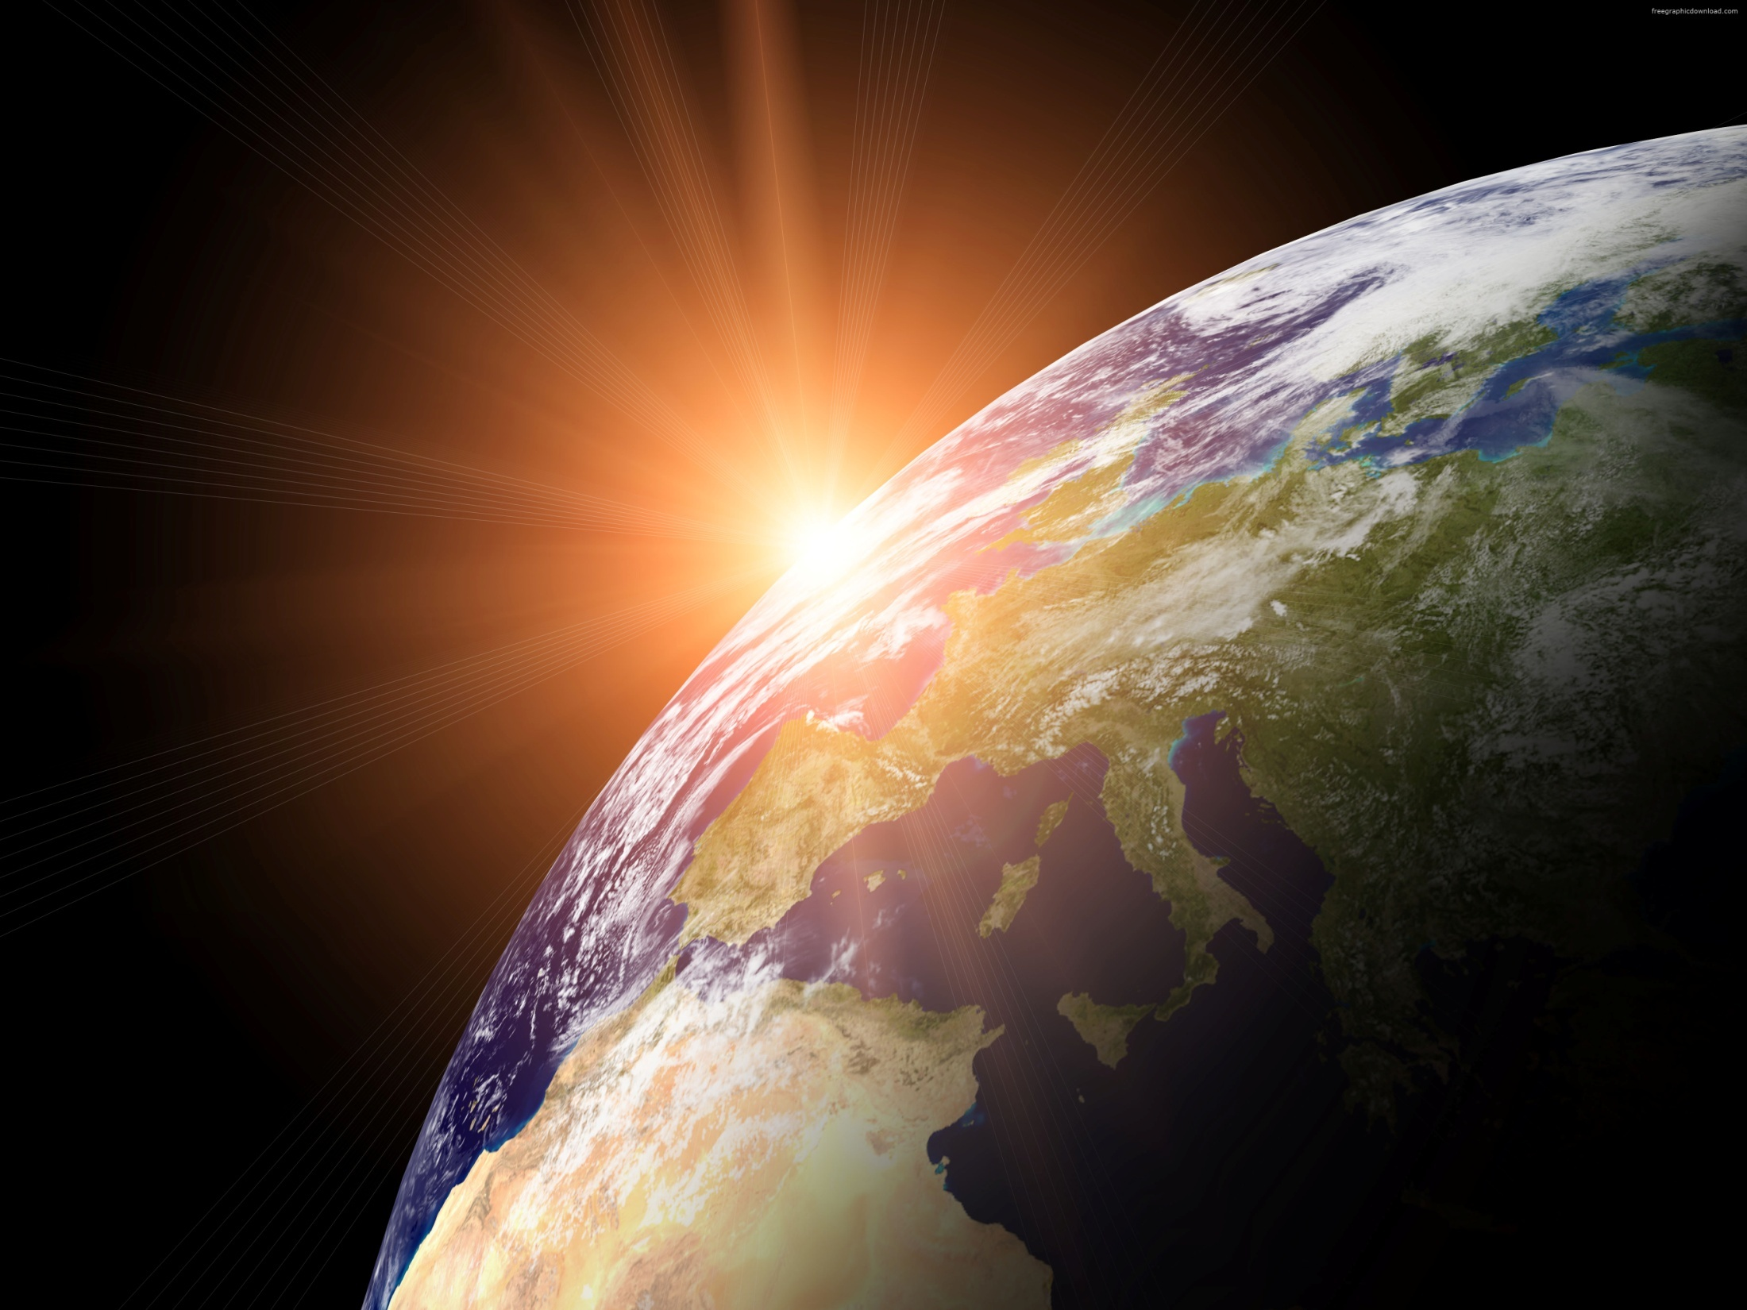
The Earth

Slide 7
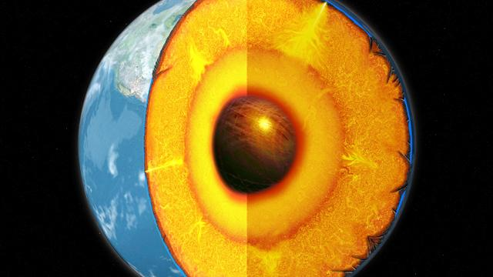
Inside the Earth

Slide 8
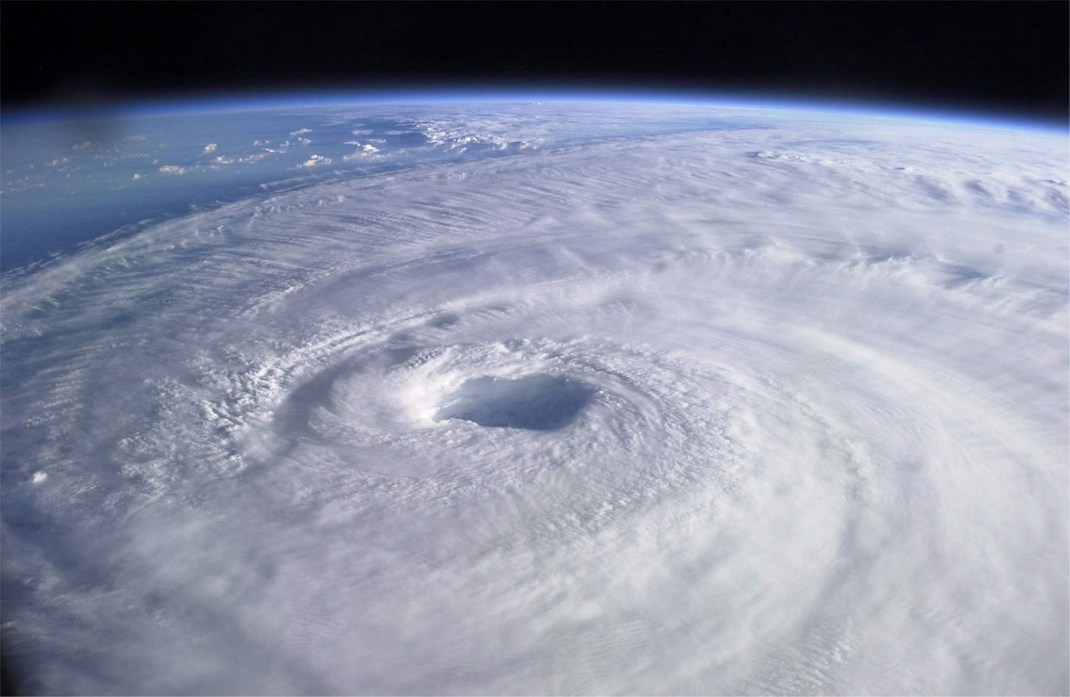
Storm cloud

Slide 9
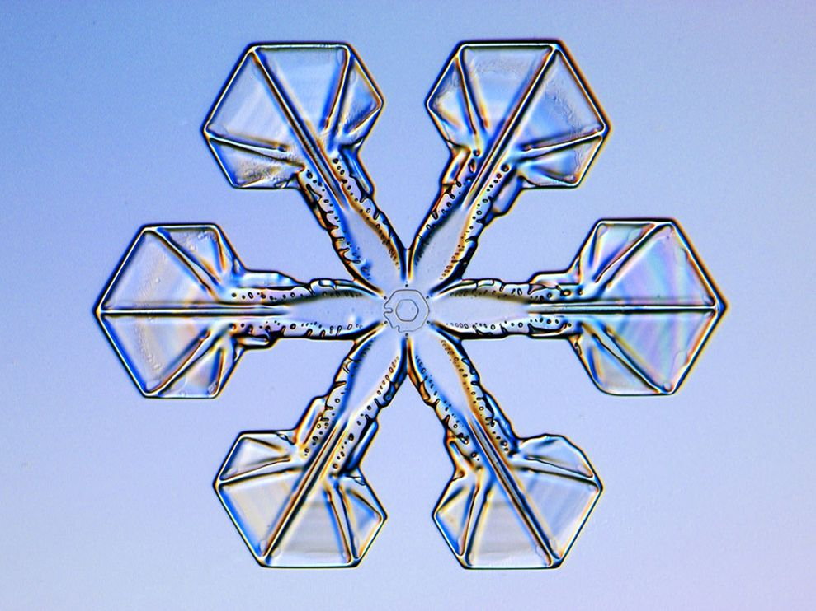
The Snowflake

Slide 10
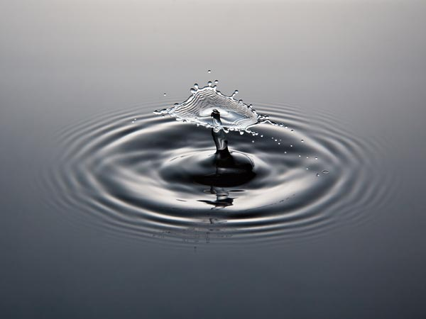
The Ripple

Slide 11
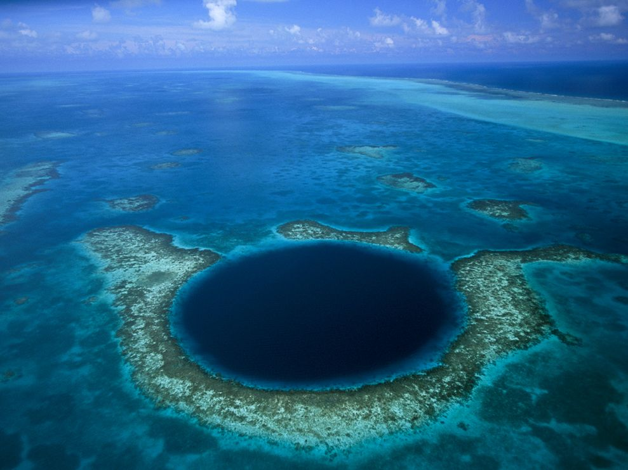
The Blue Hole

Slide 12
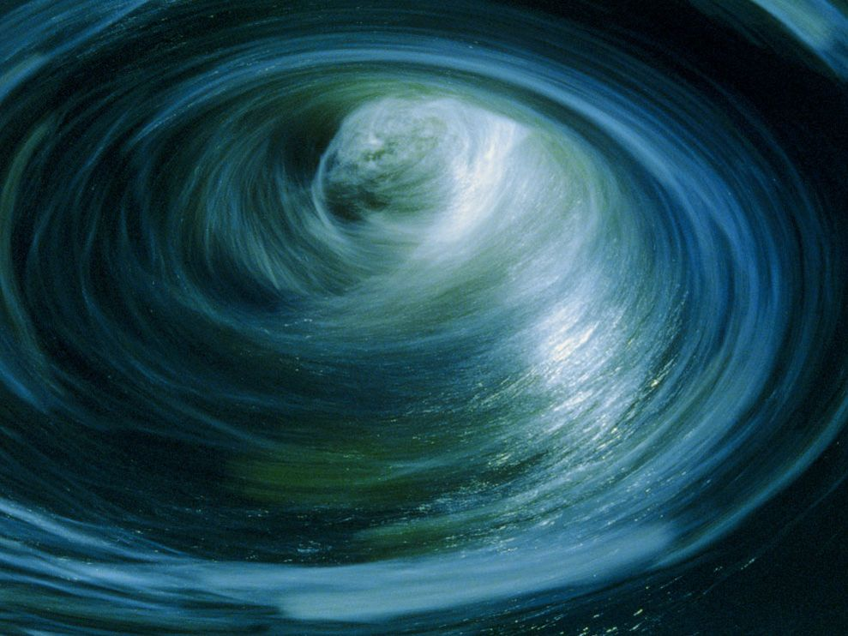
The Whirlpool

Slide 13
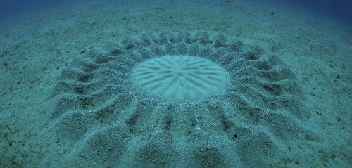
Shapes in the Sand

Slide 14
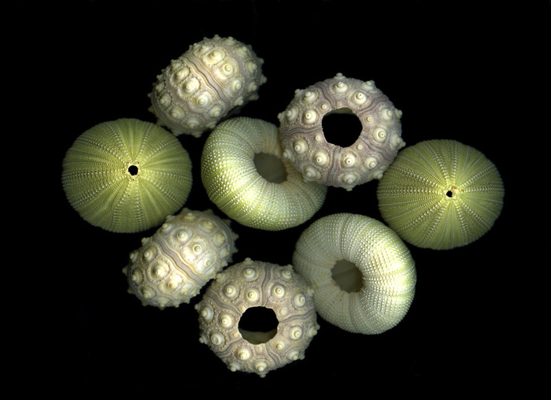
Sea urchins

Slide 15
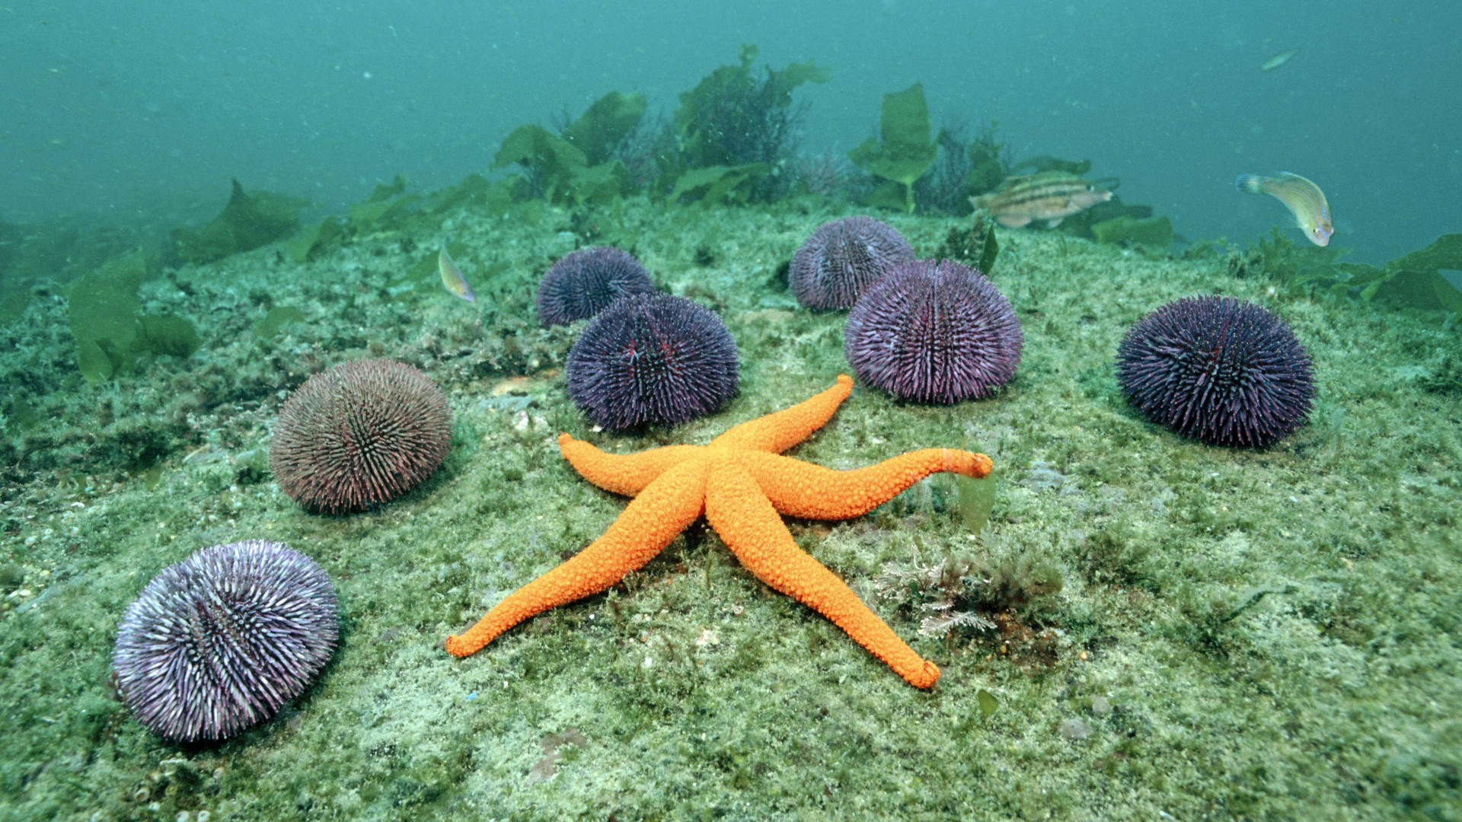
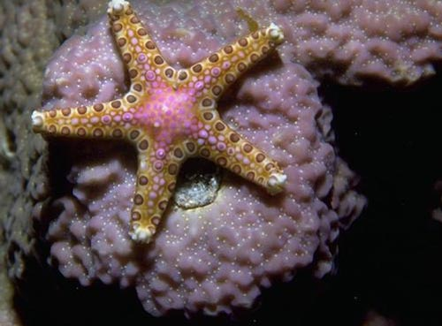
Sea animals

Slide 16
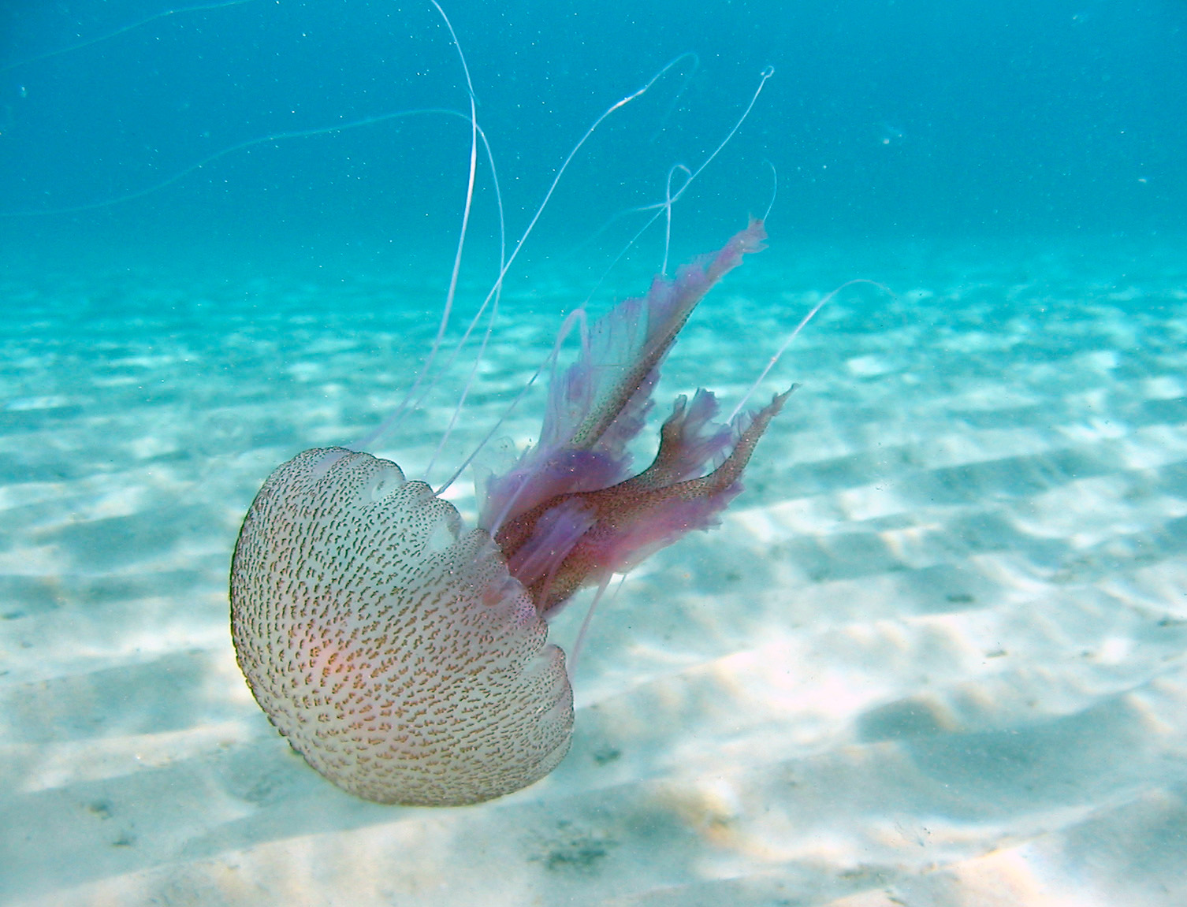
Medusa

Slide 17
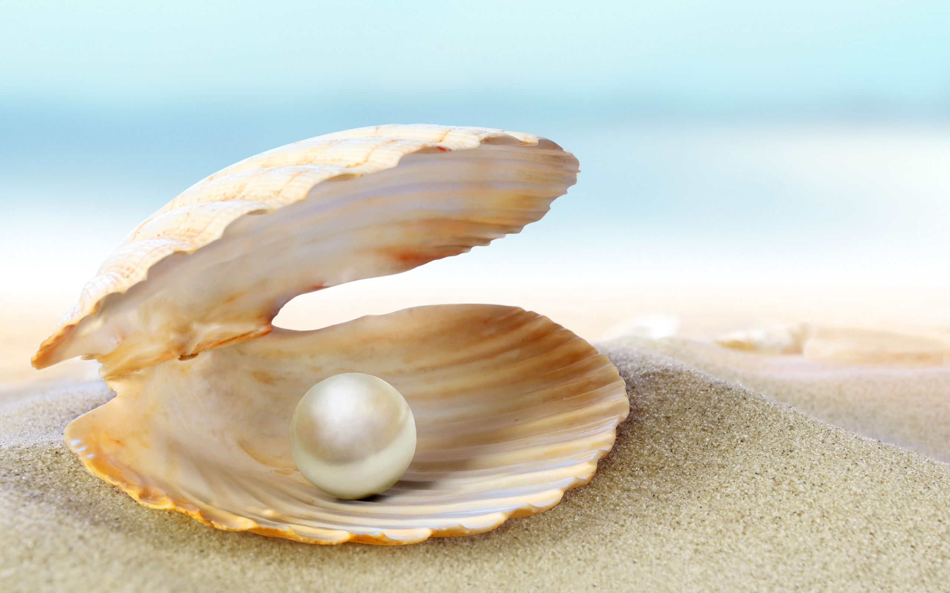
The Pearl

Slide 18
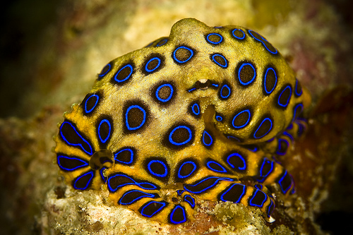
Blue-ringed octopus

Slide 19
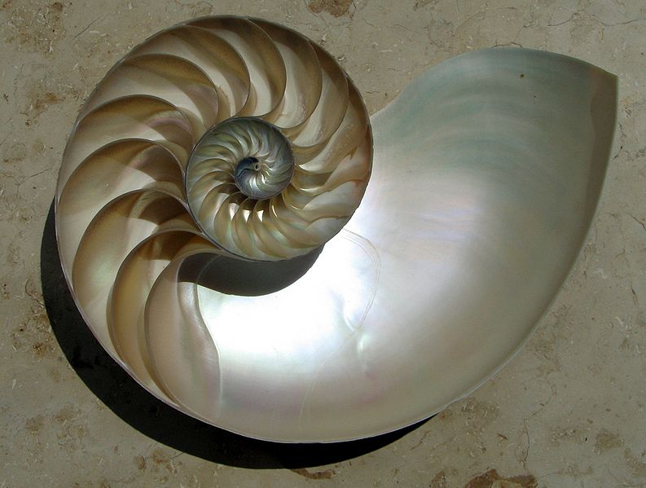
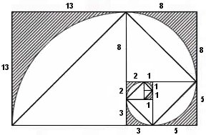
The Chambered Nautilus
Fibonacci Series

Slide 20
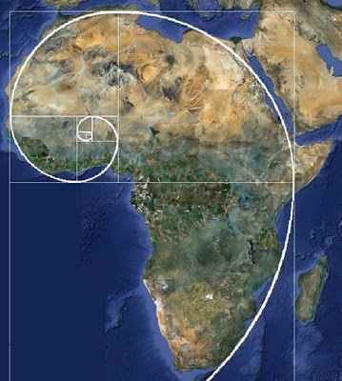
Fibonacci Series in Africa

Slide 21
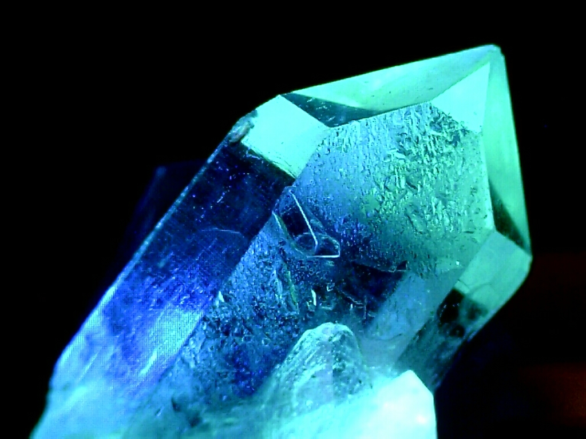
Crystals

Slide 22
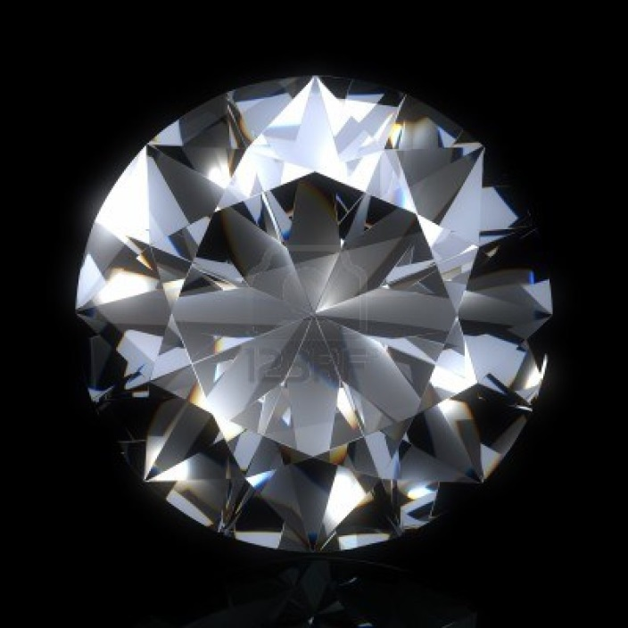
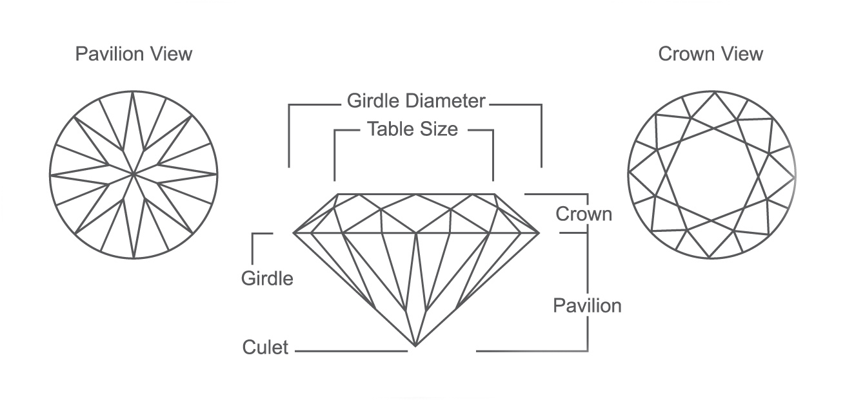
Which geometrical shapes can you see?
octagon
?
circle
triangle
kite

Slide 23
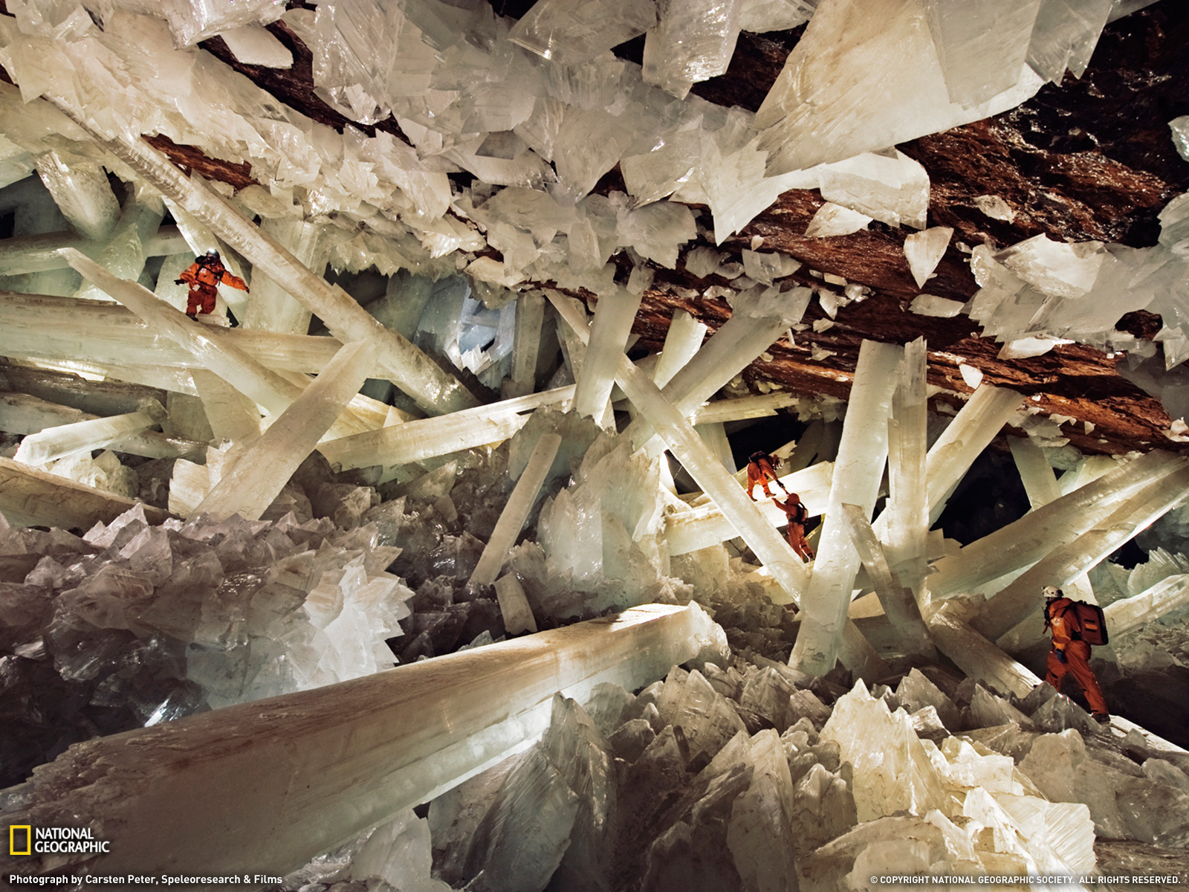
The Crystal Palace in Mexico

Slide 24
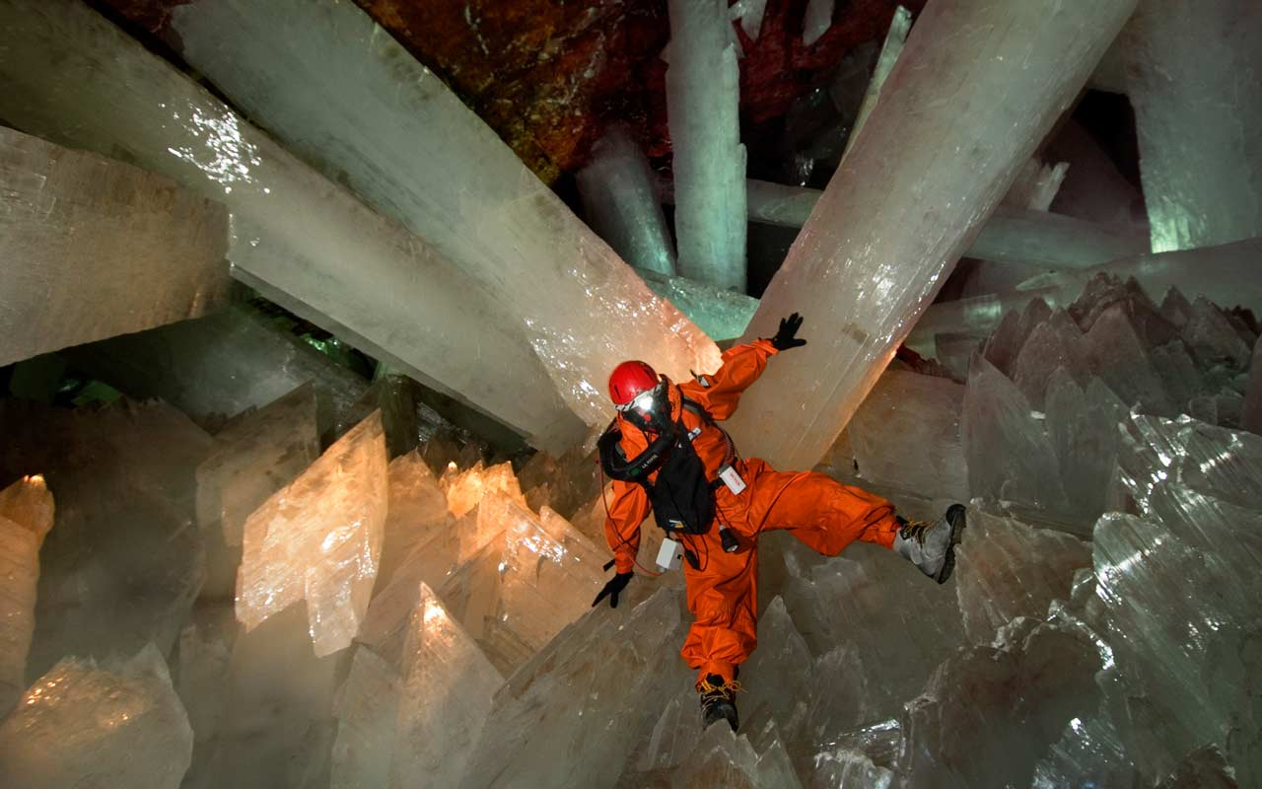

Slide 25
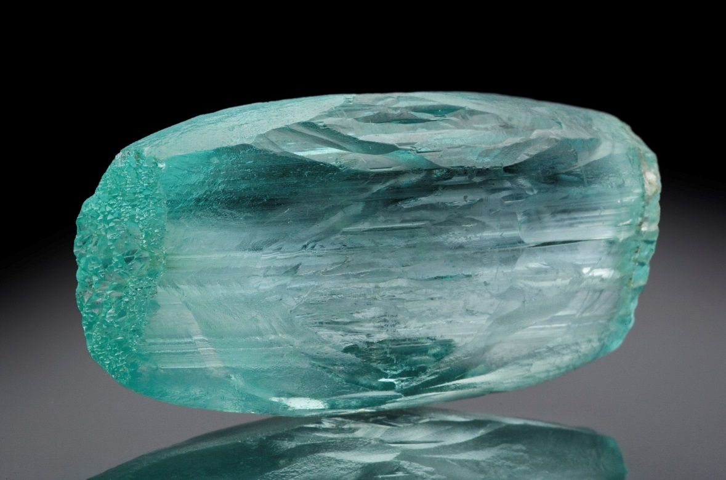
Crystal?
SOLID MATERIAL WHOSE ATOMS, MOLECULES OR IONS ARE ARRANGED IN AN ORDERED PATTERN
EXTENDS IN ALL THREE SPATIAL DIMENSIONS
aquamarine

Slide 26
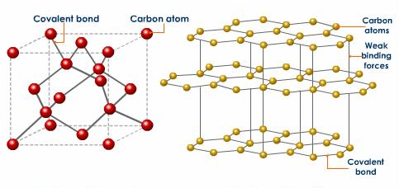
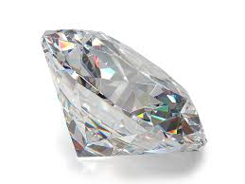
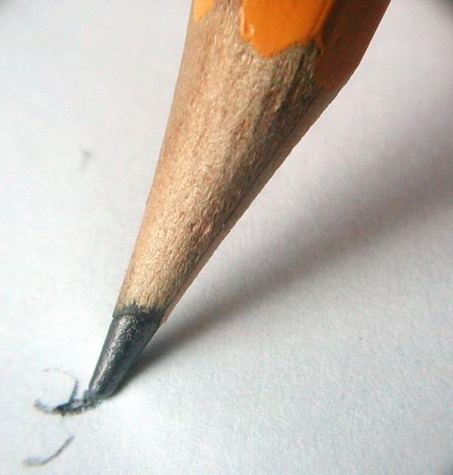
diamond
graphite

Slide 27
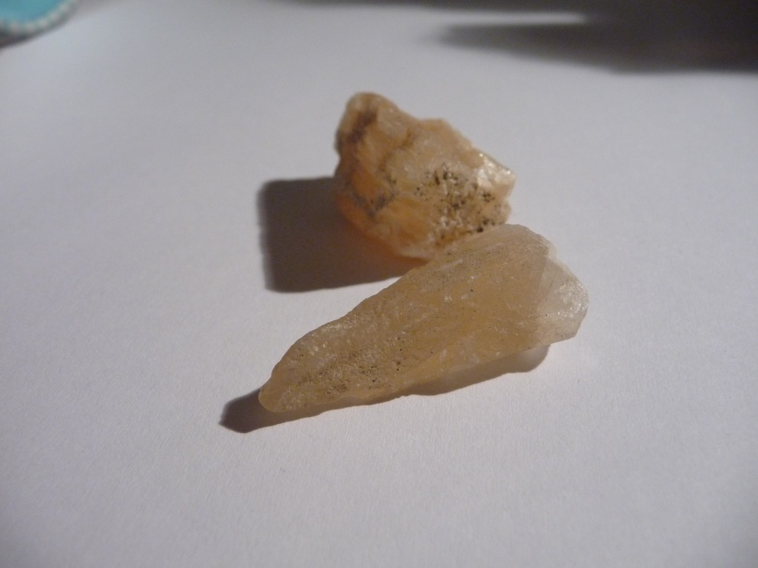
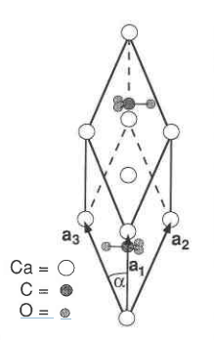
Calcite [CaCO3]
CARBONATE MINERAL
MOST STABLE POLYMORPH OF CALCIUM CARBONATE

Slide 28
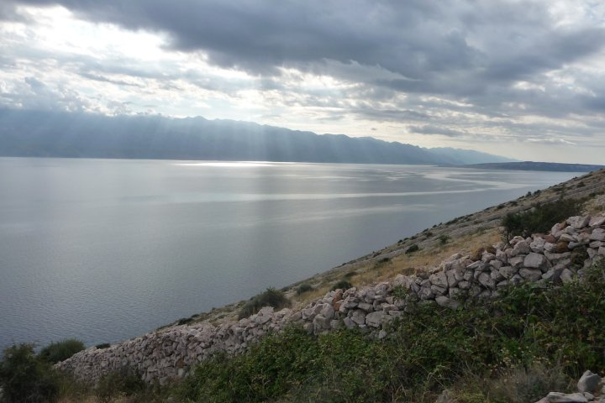
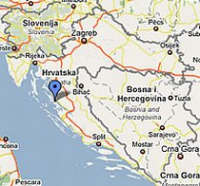
FINDING LOCATION? → island Pag

Slide 29
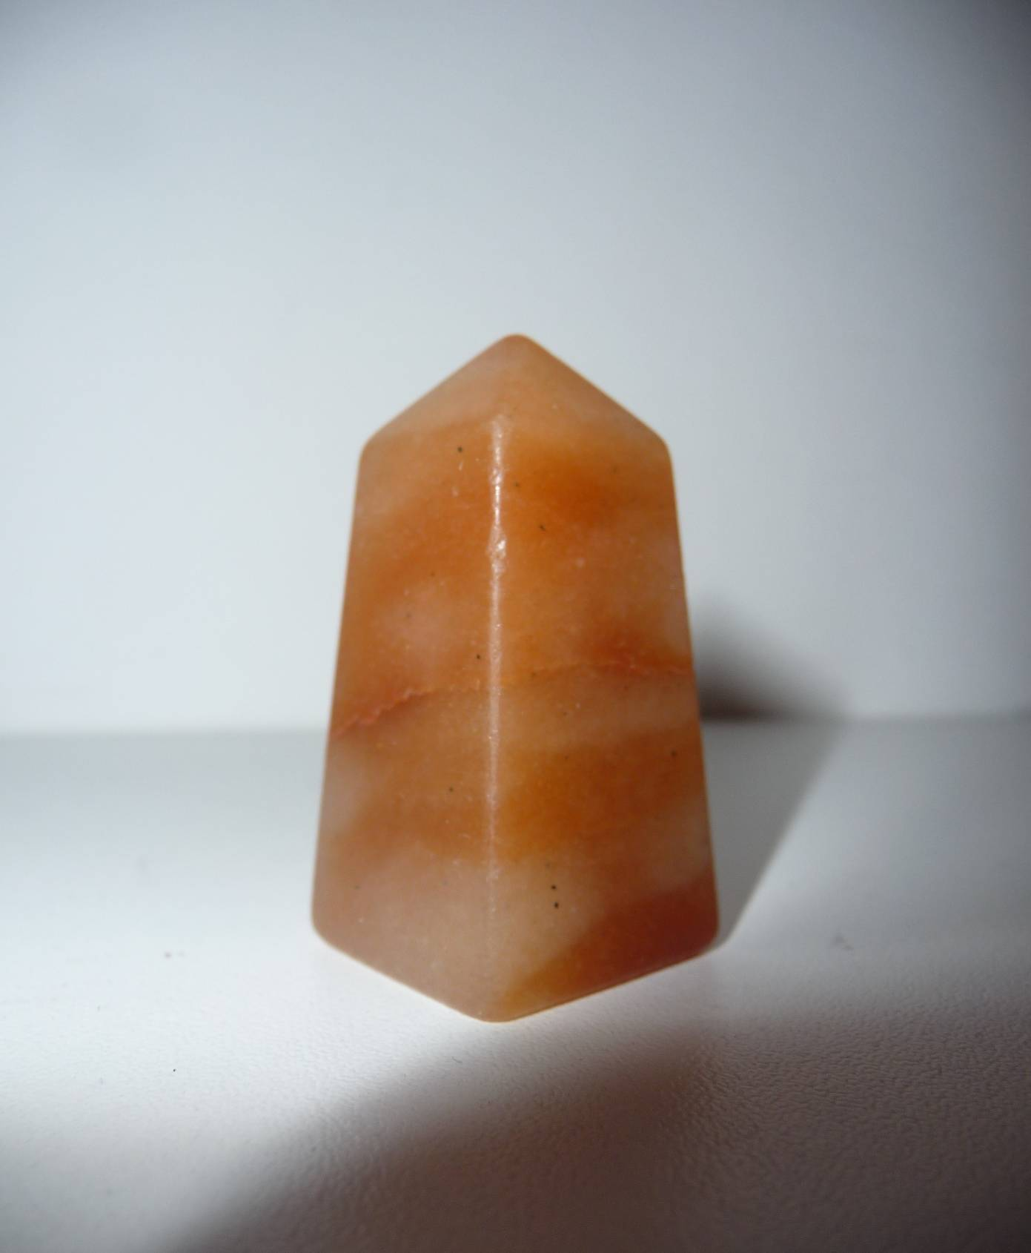
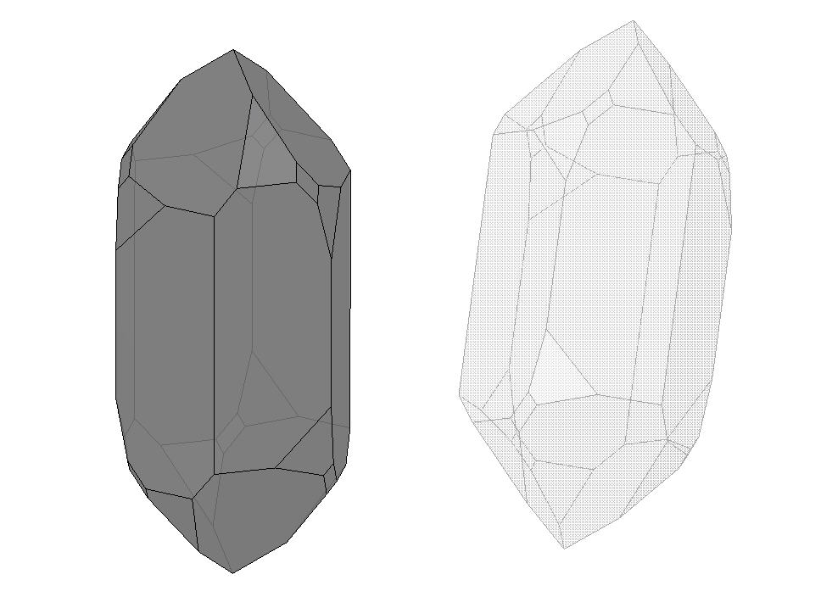
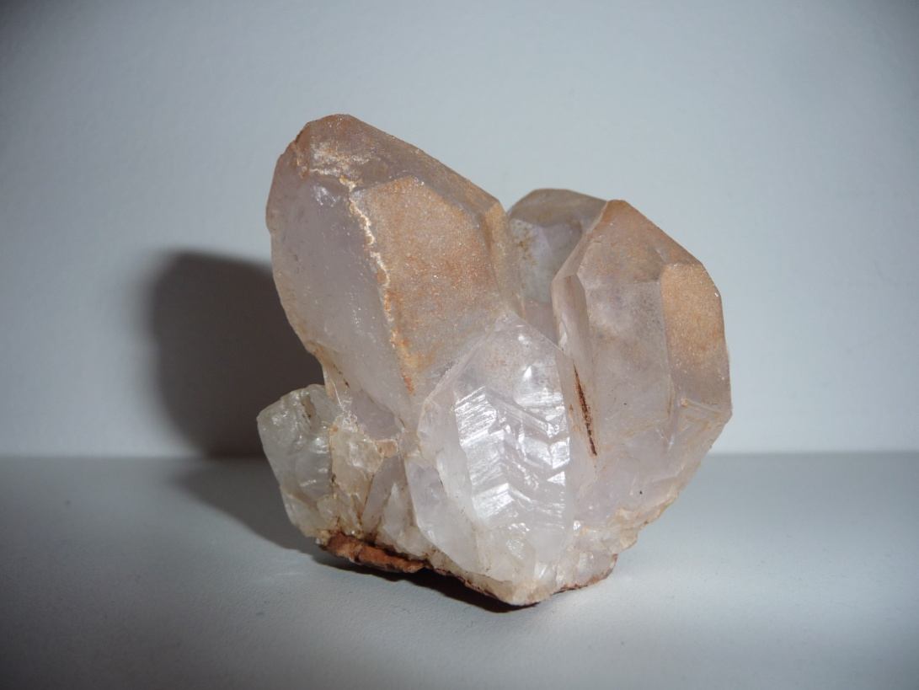
SILICON DIOXIDE AND ITS CRYSTALS

Slide 30
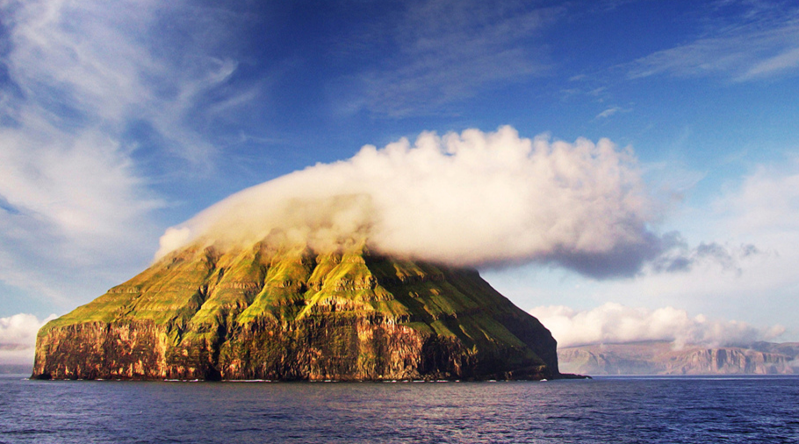
Litla Dimun

Slide 31
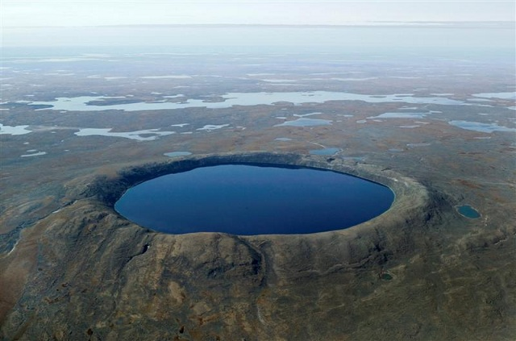
Pingualuit crater, Canada

Slide 32
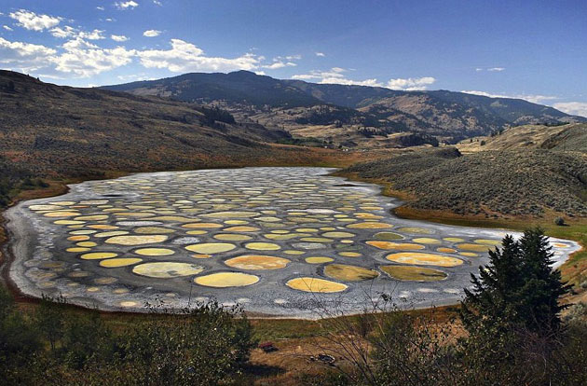
Lake Kliuk, Canada

Slide 33
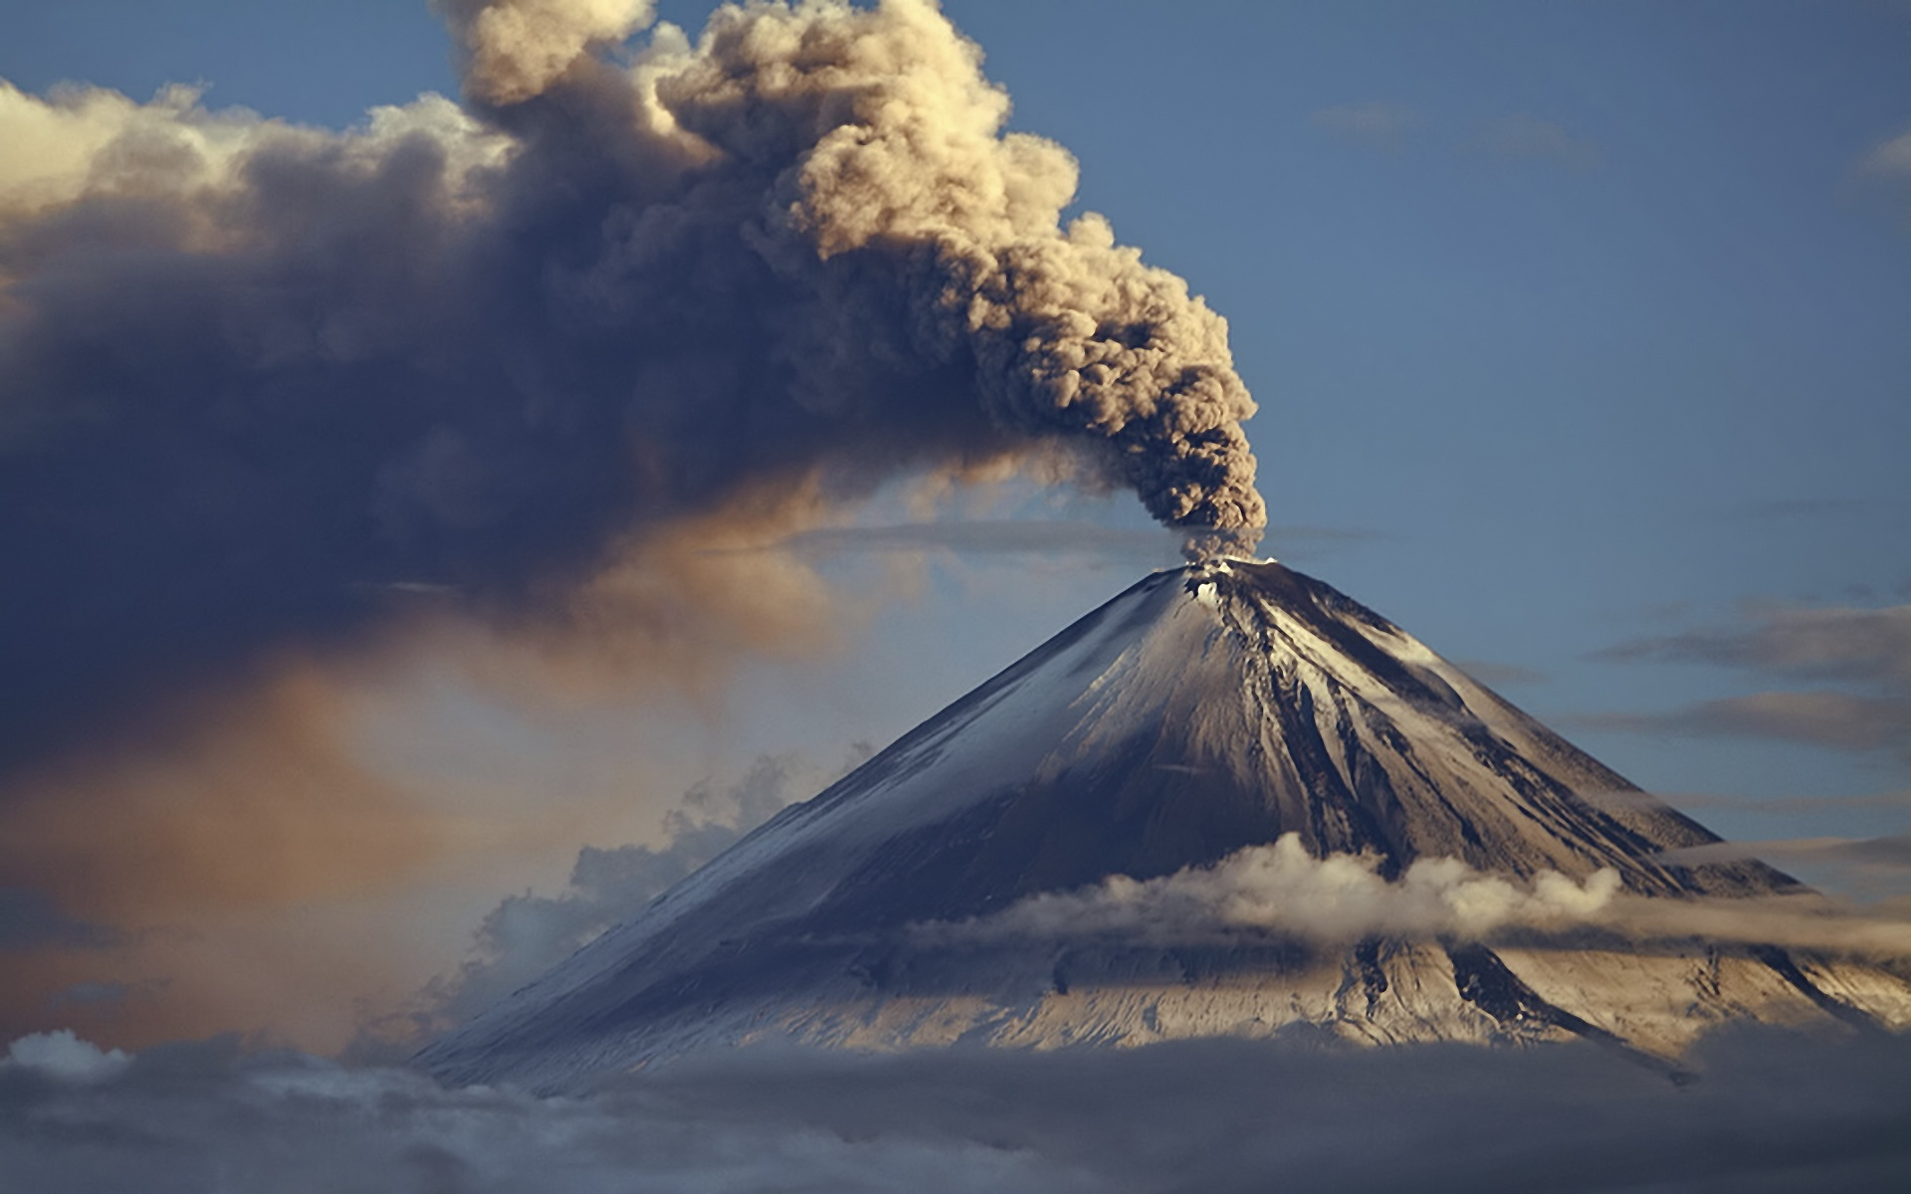
Volcano

Slide 34
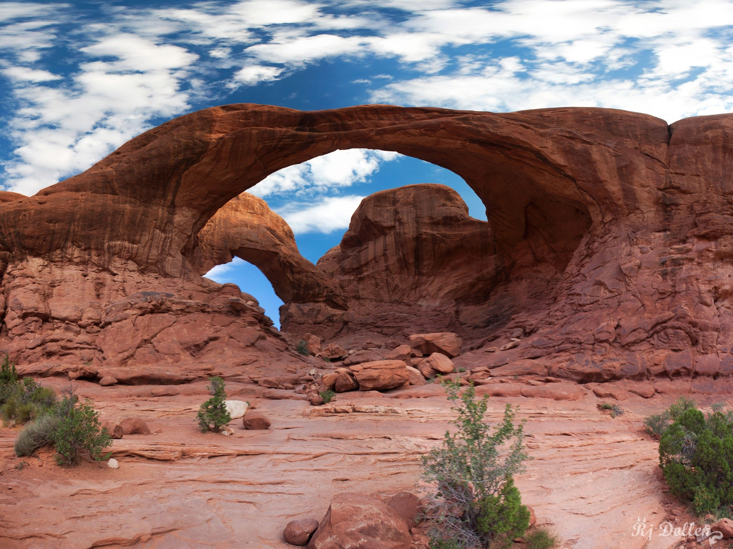
Desert

Slide 35
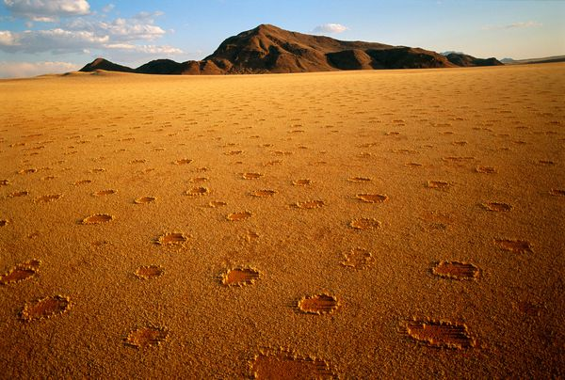
Grassless spots in Namibia

Slide 36
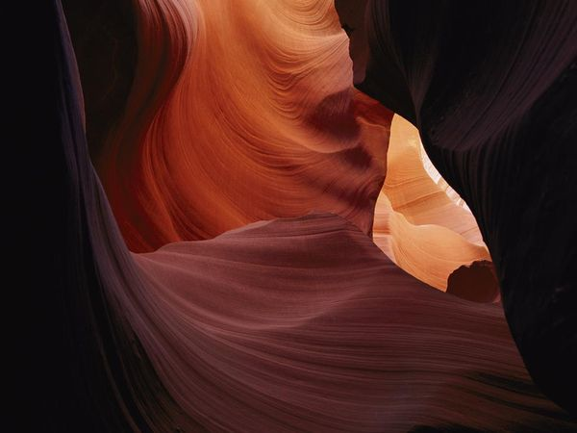
The Antelope Canyon - Arizona

Slide 37
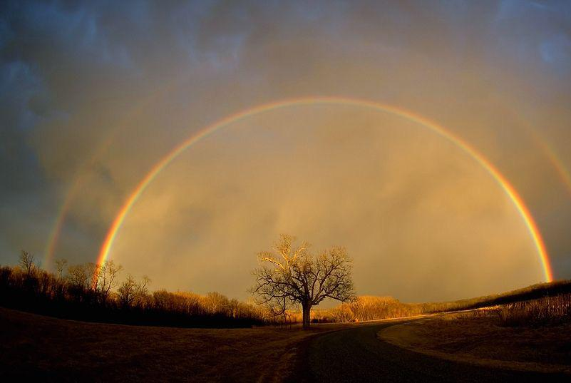
Rainbow

Slide 38
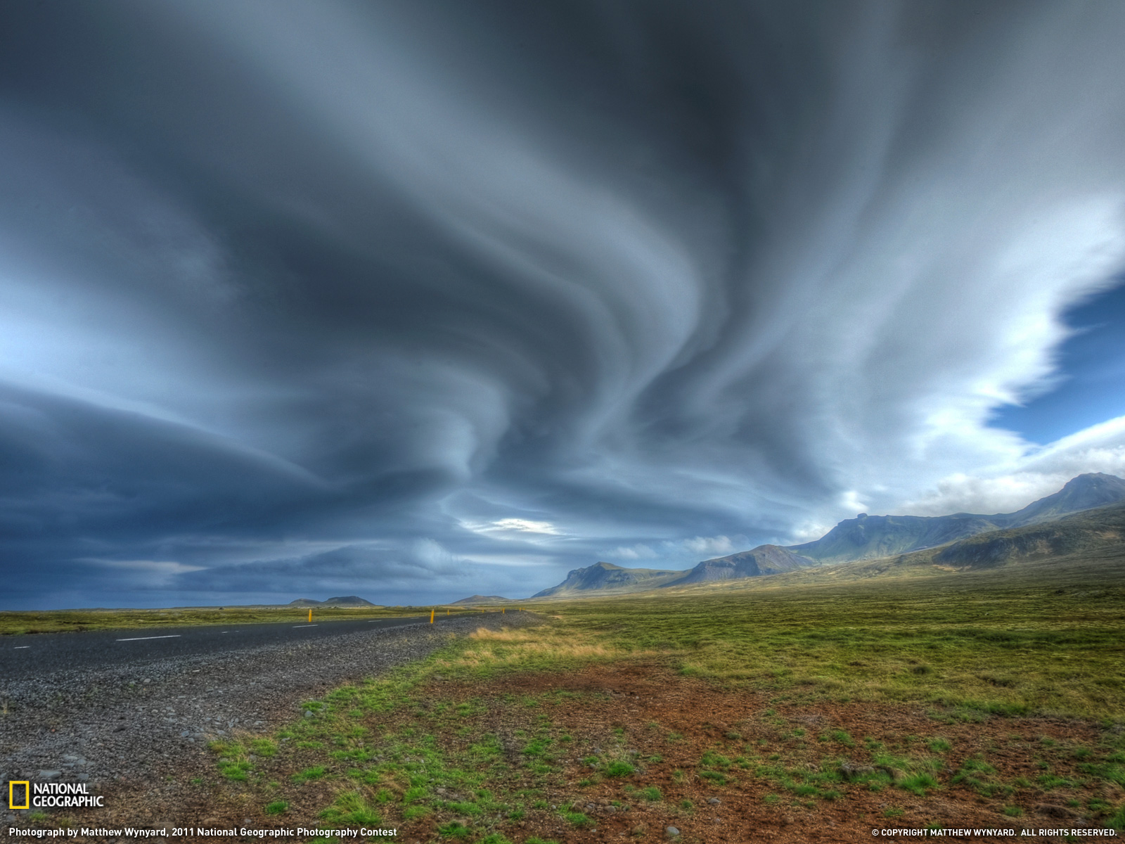
Strange shapes in the sky

Slide 39
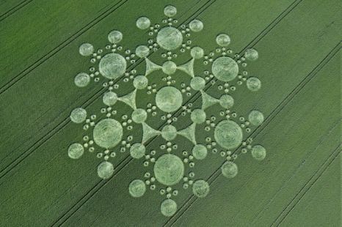
UFO signs in Britain

Slide 40
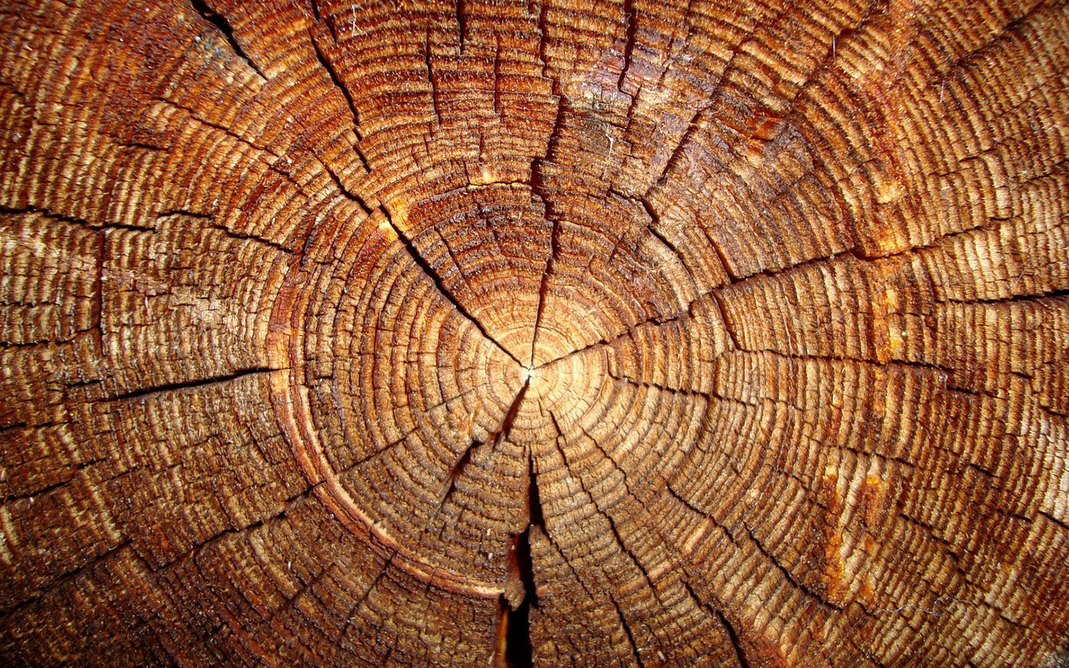
Tree rings

Slide 41

Agave

Slide 42

Romanesco Cauliflower

Slide 43

The black-eyed Susan

Slide 44

Fritillaria

Slide 45




Vegetable

Slide 46




Snakes

Slide 47

Beehives

Slide 48

The eye

Slide 49

This picture shows ideal human proportions → THE GOLDEN RATIO
The Vitruvian Men by Leonardo da Vinci

Slide 50

Geometry in Croatia
Red Lake, Imotski

Slide 51


Beach Golden Cape, island Brač

Slide 52

Dalmatians

Slide 53

SYMMETRY
Peacock

Slide 54

Apollo
SYMMETRY

Slide 55

SYMMETRY
Fire colored Beetles

Slide 56

NATURE LIKES BALANCE AND SYMMETRY, BUT PERFECT SYMMETRY IN NATURAL OBJECTS IS RARELY SEEN

Slide 57
By: Dora Matek
Lucija Ulaga
Paola Marinović
Mentors: Buga Mikšić
Marina Ninković
Music: Thomas Newman – American Beauty
Arsen Dedić – Jedrima oko svijeta
Zagreb, 2013.
XV. Gymnasium

Slide 58
Geometrical shapes in nature

Slide 59
pYTHAGOREANISM
THE SYSTEM OF BELIEFS HELD BY PYTHAGORAS AND HIS FOLLOWERS
FOR PYTHAGORA:
NUMBER WAS THE SUBSTANCE OF ALL THINGS

Slide 60
The Solar System

Slide 61
The Rings of Saturn

Slide 62
The Moon and
Boscovich crater

Slide 63
The Earth

Slide 64
Inside the Earth

Slide 65
Storm cloud

Slide 66
The Snowflake

Slide 67
The Ripple

Slide 68
The Blue Hole

Slide 69
The Whirlpool

Slide 70
Shapes in the Sand

Slide 71
Sea urchins

Slide 72
Sea animals

Slide 73
Medusa

Slide 74
The Pearl

Slide 75
Blue-ringed octopus

Slide 76
The Chambered Nautilus
Fibonacci Series

Slide 77
Fibonacci Series in Africa

Slide 78
Crystals

Slide 79
Which geometrical shapes can you see?
octagon
?
circle
triangle
kite

Slide 80
The Crystal Palace in Mexico

Slide 82
Crystal?
SOLID MATERIAL WHOSE ATOMS, MOLECULES OR IONS ARE ARRANGED IN AN ORDERED PATTERN
EXTENDS IN ALL THREE SPATIAL DIMENSIONS
aquamarine

Slide 83
diamond
graphite

Slide 84
Calcite [CaCO3]
CARBONATE MINERAL
MOST STABLE POLYMORPH OF CALCIUM CARBONATE

Slide 85
FINDING LOCATION? → island Pag

Slide 86
SILICON DIOXIDE AND ITS CRYSTALS

Slide 87
Litla Dimun

Slide 88
Pingualuit crater, Canada

Slide 89
Lake Kliuk, Canada

Slide 90
Volcano

Slide 91
Desert

Slide 92
Grassless spots in Namibia

Slide 93
The Antelope Canyon - Arizona

Slide 94
Rainbow

Slide 95
Strange shapes in the sky

Slide 96
UFO signs in Britain

Slide 97
Tree rings

Slide 98
Agave

Slide 99
Romanesco Cauliflower

Slide 100
The black-eyed Susan

Slide 101
Fritillaria

Slide 102
Vegetable

Slide 103
Snakes

Slide 104
Beehives

Slide 105
The eye

Slide 106
This picture shows ideal human proportions → THE GOLDEN RATIO
The Vitruvian Men by Leonardo da Vinci

Slide 107
Geometry in Croatia
Red Lake, Imotski

Slide 108
Beach Golden Cape, island Brač

Slide 109
Dalmatians

Slide 110
SYMMETRY
Peacock

Slide 111
Apollo
SYMMETRY

Slide 112
SYMMETRY
Fire colored Beetles

Slide 113
NATURE LIKES BALANCE AND SYMMETRY, BUT PERFECT SYMMETRY IN NATURAL OBJECTS IS RARELY SEEN

Slide 114
By: Dora Matek
Lucija Ulaga
Paola Marinović
Mentors: Buga Mikšić
Marina Ninković
Music: Thomas Newman – American Beauty
Arsen Dedić – Jedrima oko svijeta
Zagreb, 2013.
XV. Gymnasium

Slide 115
Geometrical shapes in nature

Slide 116
pYTHAGOREANISM
THE SYSTEM OF BELIEFS HELD BY PYTHAGORAS AND HIS FOLLOWERS
FOR PYTHAGORA:
NUMBER WAS THE SUBSTANCE OF ALL THINGS

Slide 117
The Solar System

Slide 118
The Rings of Saturn

Slide 119
The Moon and
Boscovich crater

Slide 120
The Earth

Slide 121
Inside the Earth

Slide 122
Storm cloud

Slide 123
The Snowflake

Slide 124
The Ripple

Slide 125
The Blue Hole

Slide 126
The Whirlpool

Slide 127
Shapes in the Sand

Slide 128
Sea urchins

Slide 129
Sea animals

Slide 130
Medusa

Slide 131
The Pearl

Slide 132
Blue-ringed octopus

Slide 133
The Chambered Nautilus
Fibonacci Series

Slide 134
Fibonacci Series in Africa

Slide 135
Crystals

Slide 136
Which geometrical shapes can you see?
octagon
?
circle
triangle
kite

Slide 137
The Crystal Palace in Mexico

Slide 139
Crystal?
SOLID MATERIAL WHOSE ATOMS, MOLECULES OR IONS ARE ARRANGED IN AN ORDERED PATTERN
EXTENDS IN ALL THREE SPATIAL DIMENSIONS
aquamarine

Slide 140
diamond
graphite

Slide 141
Calcite [CaCO3]
CARBONATE MINERAL
MOST STABLE POLYMORPH OF CALCIUM CARBONATE

Slide 142
FINDING LOCATION? → island Pag

Slide 143
SILICON DIOXIDE AND ITS CRYSTALS

Slide 144
Litla Dimun

Slide 145
Pingualuit crater, Canada

Slide 146
Lake Kliuk, Canada

Slide 147
Volcano

Slide 148
Desert

Slide 149
Grassless spots in Namibia

Slide 150
The Antelope Canyon - Arizona

Slide 151
Rainbow

Slide 152
Strange shapes in the sky

Slide 153
UFO signs in Britain

Slide 154
Tree rings

Slide 155
Agave

Slide 156
Romanesco Cauliflower

Slide 157
The black-eyed Susan

Slide 158
Fritillaria

Slide 159
Vegetable

Slide 160
Snakes

Slide 161
Beehives

Slide 162
The eye

Slide 163
This picture shows ideal human proportions → THE GOLDEN RATIO
The Vitruvian Men by Leonardo da Vinci

Slide 164
Geometry in Croatia
Red Lake, Imotski

Slide 165
Beach Golden Cape, island Brač

Slide 166
Dalmatians

Slide 167
SYMMETRY
Peacock

Slide 168
Apollo
SYMMETRY

Slide 169
SYMMETRY
Fire colored Beetles

Slide 170
NATURE LIKES BALANCE AND SYMMETRY, BUT PERFECT SYMMETRY IN NATURAL OBJECTS IS RARELY SEEN

Slide 171
By: Dora Matek
Lucija Ulaga
Paola Marinović
Mentors: Buga Mikšić
Marina Ninković
Music: Thomas Newman – American Beauty
Arsen Dedić – Jedrima oko svijeta
Zagreb, 2013.
XV. Gymnasium

Slide 172
Geometrical shapes in nature

Slide 173
pYTHAGOREANISM
THE SYSTEM OF BELIEFS HELD BY PYTHAGORAS AND HIS FOLLOWERS
FOR PYTHAGORA:
NUMBER WAS THE SUBSTANCE OF ALL THINGS

Slide 174
The Solar System

Slide 175
The Rings of Saturn

Slide 176
The Moon and
Boscovich crater

Slide 177
The Earth

Slide 178
Inside the Earth

Slide 179
Storm cloud

Slide 180
The Snowflake

Slide 181
The Ripple

Slide 182
The Blue Hole

Slide 183
The Whirlpool

Slide 184
Shapes in the Sand

Slide 185
Sea urchins

Slide 186
Sea animals

Slide 187
Medusa

Slide 188
The Pearl

Slide 189
Blue-ringed octopus

Slide 190
The Chambered Nautilus
Fibonacci Series

Slide 191
Fibonacci Series in Africa

Slide 192
Crystals

Slide 193
Which geometrical shapes can you see?
octagon
?
circle
triangle
kite

Slide 194
The Crystal Palace in Mexico

Slide 196
Crystal?
SOLID MATERIAL WHOSE ATOMS, MOLECULES OR IONS ARE ARRANGED IN AN ORDERED PATTERN
EXTENDS IN ALL THREE SPATIAL DIMENSIONS
aquamarine

Slide 197
diamond
graphite

Slide 198
Calcite [CaCO3]
CARBONATE MINERAL
MOST STABLE POLYMORPH OF CALCIUM CARBONATE

Slide 199
FINDING LOCATION? → island Pag

Slide 200
SILICON DIOXIDE AND ITS CRYSTALS

Slide 201
Litla Dimun

Slide 202
Pingualuit crater, Canada

Slide 203
Lake Kliuk, Canada

Slide 204
Volcano

Slide 205
Desert

Slide 206
Grassless spots in Namibia

Slide 207
The Antelope Canyon - Arizona

Slide 208
Rainbow

Slide 209
Strange shapes in the sky

Slide 210
UFO signs in Britain

Slide 211
Tree rings

Slide 212
Agave

Slide 213
Romanesco Cauliflower

Slide 214
The black-eyed Susan

Slide 215
Fritillaria

Slide 216
Vegetable

Slide 217
Snakes

Slide 218
Beehives

Slide 219
The eye

Slide 220
This picture shows ideal human proportions → THE GOLDEN RATIO
The Vitruvian Men by Leonardo da Vinci

Slide 221
Geometry in Croatia
Red Lake, Imotski

Slide 222
Beach Golden Cape, island Brač

Slide 223
Dalmatians

Slide 224
SYMMETRY
Peacock

Slide 225
Apollo
SYMMETRY

Slide 226
SYMMETRY
Fire colored Beetles

Slide 227
NATURE LIKES BALANCE AND SYMMETRY, BUT PERFECT SYMMETRY IN NATURAL OBJECTS IS RARELY SEEN

Slide 228
By: Dora Matek
Lucija Ulaga
Paola Marinović
Mentors: Buga Mikšić
Marina Ninković
Music: Thomas Newman – American Beauty
Arsen Dedić – Jedrima oko svijeta
Zagreb, 2013.
XV. Gymnasium

