Slide 1
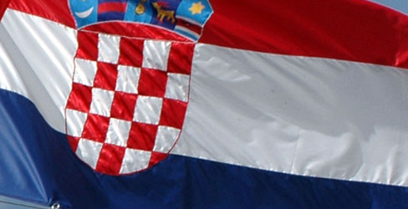
CROATIA

Slide 2
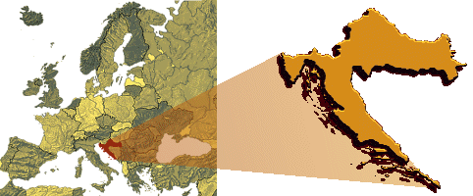
Location
At the crossroads of Central Europe, the Balkans, and the Mediterranean

Slide 3
Republic of Croatia
Area: 56,594 km2
Population: 4,489,409
Geographic coordinates:45°48′N 16°0′E
Currency: Kuna (HRK)
Form of Goverment: Parliamentary republic
Languages: Croatian
divided into 20 counties and the city of Zagreb (capital and largest)

Slide 4
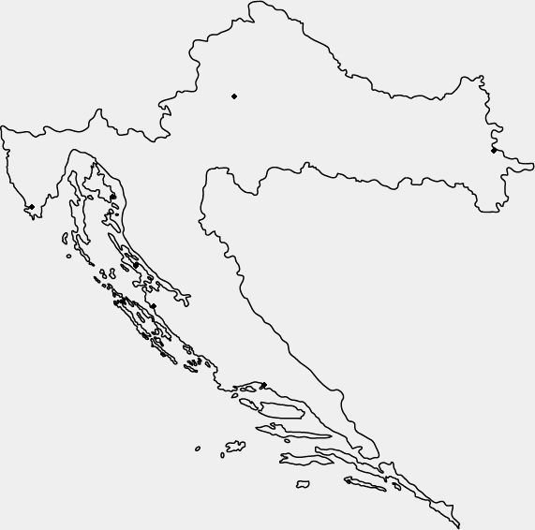
Zagreb

Slide 5
Zagreb
Capital of Croatia
Located on the Sava river, at the southern slopes od Medvednica mountain
The old Zagreb core is divided into two districts: the canonical settlement Kaptol developed north of Zagreb Cathedral and the fortified settlement Gradec on the neighbouring hill which date from the 11th century

Slide 6
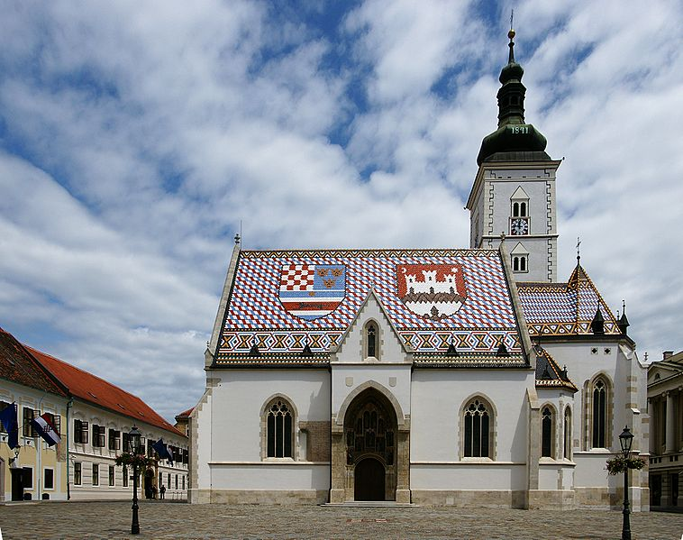
Zagreb – Church of St. Mark
Parish church of old Zagreb
Built in the 13th century but underwent a radical reconstruction in the second half of the 14th century
It was then turned into a late Gothic church
The oldest part is the south portal, considered to be the work of sculptors of the Parler family from Prague (end of the 14th century)

Slide 7
Vukovar

Slide 8
Vukovar
A city in eastern Croatia, and the biggest river port in Croatia located at the confluence of the Vuka river and the Danube
Vukovar was mentioned first in the 13th century
It’s nicknamed the Hero City for the bravery of Vukovar soldiers during the Croatian War of Independence

Slide 9
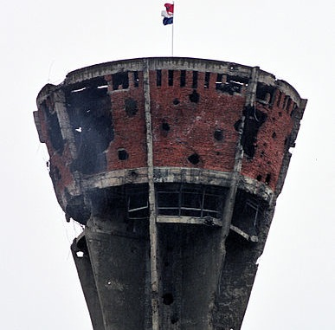
Vukovar water tower
It is one of the most famous symbols of Vukovar and the suffering of the city and the county in the Battle of Vukovar and the Croatian War of Independence
It was built in the late 1960s and destroyed in 1991 when it was hit more than 600 times
Today it is a symbol of victory and new life

Slide 10
Pula

Slide 11
Pula
Situated at the southern tip of the Istria
It was an important port in the Roman times and had the rank of a Roman colony
It is a known vacation destination because of the natural beauty of the countryside and sea along with the famous Brijuni national park

Slide 12
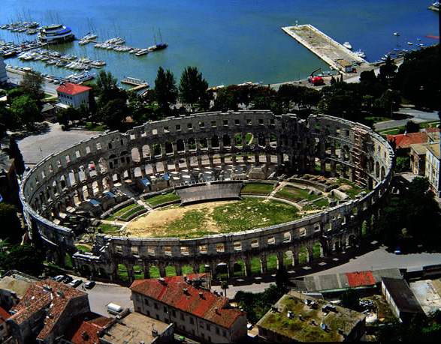
Pula Arena
It was constructed in 27 BC - 68 AD
It is among the six largest surviving Roman arenas in the world
Today it is used for many events, including concerts, festivals and recently even a hockey match

Slide 13
Baška

Slide 14
Baška [bâʃka]
Baška is a settlement on the island of Krk
Known for the early Christian archeological site from the 5th century and Baška tablet
It’s an attractive destination and is very tourist friendly

Slide 15
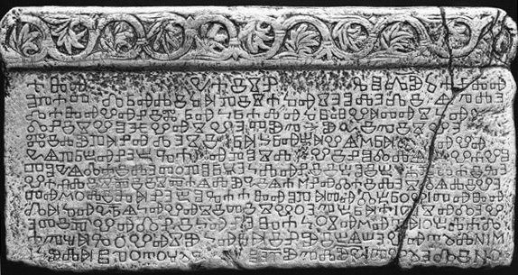
Baška tablet
One of the first monuments containing an inscription in the Croatian language
The inscribed stone slab records King Zvonimir's donation of a piece of land to a Benedictine abbey in the time of abbot Drzhiha
The tablet is considered to be the birth certificate of the Croats, as the name Croatia is mentioned here for the first time in Croatian

Slide 16
Pag

Slide 17
Island of Pag
Fifth-largest island of the Croatian coast
The first Croatian wind farm
Salt production
Most famous for its production of Paški sir
Reputation as a party destination which is centered on Zrće beach

Slide 18
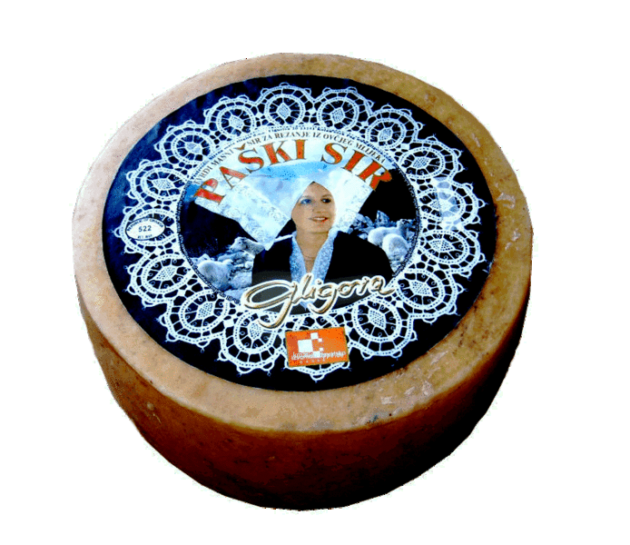
Paški sir (cheese from the island of Pag)
A perfect example of terroir and cheese
Distinctive cheese made from the milk of the island's autochthonous breed of sheep
In 2010 it won the prestigious Barber Award and was named the World’s Best New Cheese

Slide 19
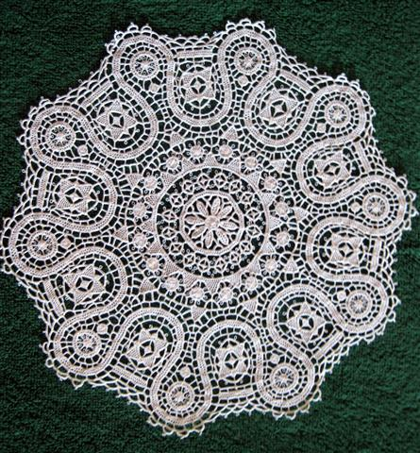
Pag Lace
The ''white gold'' of the town od Pag
The lacemaking school in the town of Pag was founded in 1906. and still works today
The Pag lace travelled to various parts of the world and is declared as a Croatian cultural heritage

Slide 20
Zadar

Slide 21
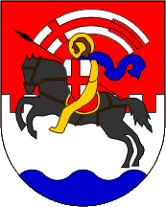
Zadar
Town on Adriatic sea, center of Zadar County
Sea Organ - architectural object which plays music by way of sea waves and tubes located underneath a set of large marble steps

Slide 22
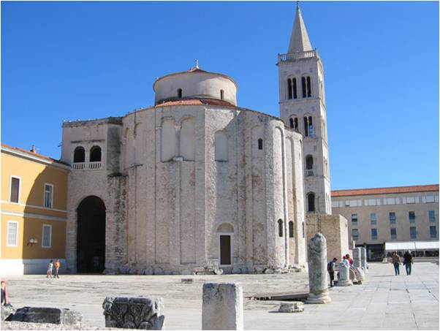
Church of St Donat
Built in the 9th Century
Built on top of the old Roman forum
Originally named the Church of the Holy Trinity
Later changed and named for Bishop Donat

Slide 23
Split

Slide 24
Split
Economic and administrative center of Middle Dalmatia
International airport, regular ferry services
Many of Split's historical and cultural buildings can be found within the walls of Diocletian's Palace

Slide 25
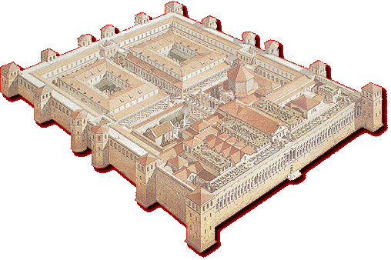
Diocletian palace
At the end of the third century the Roman Emperor Diocletian built his palace
One of the most famous and integral architectural and cultural constructs on the Croatian Adriatic coast
Combines qualities of a luxurious villa with those of a military camp

