Slide 1
Prostitution
By Timmy Bendiš

Slide 2
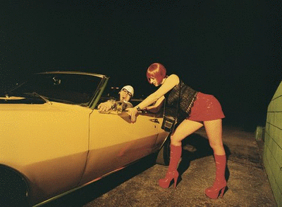
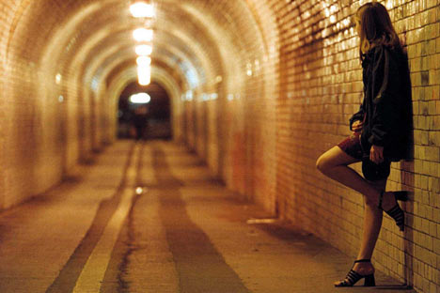
Introduction
History/Basic facts
Medically
Politically
Religiously
Morally
Economically
Guiding Questions

Slide 3
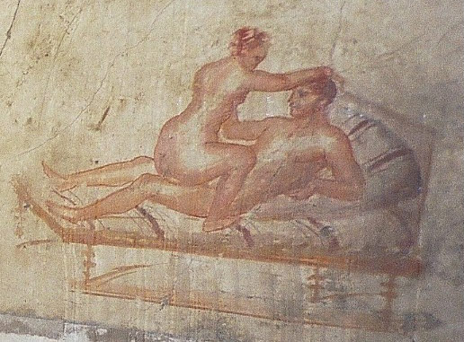
History
“The world’s oldest profession”
Best known legalized prostitution areas are The Red Light District of Amsterdam and The Reeperbahn of St. Pauli.
Only in the 15th century was prostitution thought badly upon
In the 18th century, prostitutes first used condoms
Only since the mid 20th century has prostitution been widely banned and discouraged
It is illegal to be involved in prostitution if you are HIV positive. It is considered a felony in most countries instead of a misdemeanour

Slide 4
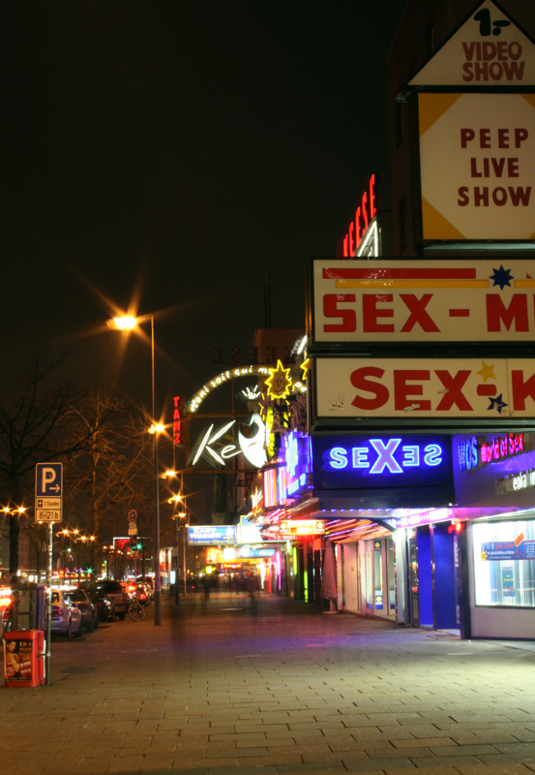
Economics of Prostitution
Reeperbahn
On Reeperbahn in St. Pauli (the street where prostitution and brothels are permitted in Hamburg) the businesses is actually declining due to cheap bars and clubs that attract teenagers. Teenagers are not normally allowed on the Reeperbahn.
Because the sex shops on Reeperbahn pay taxes, the government actually loses money, as the cheap bars make less than the Brothels.

Slide 5
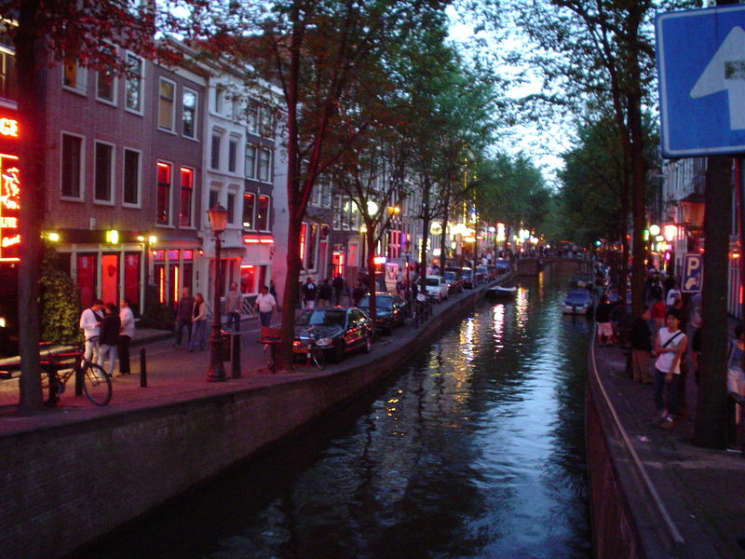
Economics of Prostitution (cont.)
De Wallen
The main street of Amsterdam’s Red Light District
Because of the local government trying to shut down sex shops, the rest of the Red Light district is becoming more desirable.
Government is spending millions of euros trying to buy out the brothels of De Wallen without much success
However, like in Germany, brothels pay significant taxes to the government, and it actually makes them money
Northern Germany and Holland are prime examples for prostitution because prostitution is legalized by the city. However in both of these places, street prostitution is banned, because the government makes no money from it.

Slide 6
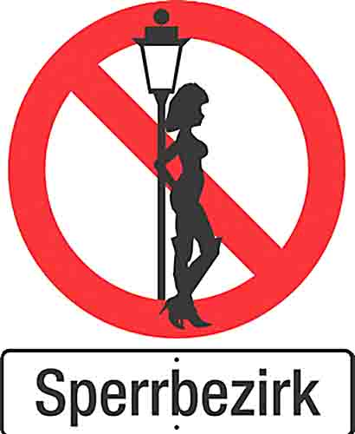
Ideal Legal system
Legal
Many politicians argue that the abusive activities operate on the black market
Many prostitutes cannot register because it is illegal, however, in legal countries, prostitutes can register as do other employees
Illegal
Argue that the situtation would only get worse with legalization.
Link between crime and prostitution is apparant
Pimps still operate, legal or illegal
Many brothel owners are criminals themselves

Slide 7
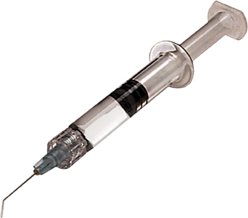
Medically
In places where prostitution is socially accepted, prostitutes regularly submit themseleves to STD and overall health testing.
It is still not entirely safe, because, in the month between check-ups, an average prostitute has sex with more than 50 people, all of who may have a sexual disease. Which in turn can be transferred to the next customer.
However, in places where prostitution is illegal, there is no testing spots for prostitution.

Slide 8
Moral and Religious Issues
Married men might hire a prostitute for one reason or another. This involves issues of cheating in marriage, especially religious marriage.
The 7th commandment specifically forbids prostitution, using the word “adultery”.
However, in The Decameron by friars frequently “found” wenches or prostitutes to enjoy. Friars practise celebacy
Why follow rules of people who cannot follow their own rules?

Slide 9
Organized Religion vs. Prostitution. Productivity?
Prostitution:
Fulfills man’s primal urges: sex
Prostitutes make a good living
Everyone benefits
Religion
Clouds reason
Sells something of no use to consumer
Historically, reason is the cause for human’s achievements and religion the cause for dark ages.

Slide 10
Feminist Issues of Prostitution
Feminists say that prostitution ruins existing relationships.
Prostitutes say that they don’t ruin relationships, but their customers do.
Feminists believe that prostitutes make a bad name for women, disgrace the gender and provide nothing to society

Slide 11
Bibliograpy
Works Cited Boccacio, Giovanni. The Decameron. Print.
Bromberg, Sarah. "Feminist Issues In Prostitution." Feminist Issues in Prostitution. 1997. Web. 23 Sept. 2009. <http://www.feministissues.com/>.
David. "Prostitution vs. Organized Religion |." Truth, Justice, and the American Way. 13 Aug. 2003. Web. 23 Sept. 2009. <http://www.rationalmind.net/2003/08/13/prostitution-vs-organized-religion/>.
"File:Pompeii-wall painting.jpg -." Wikipedia, the free encyclopedia. Web. 23 Sept. 2009. <http://en.wikipedia.org/wiki/File:Pompeii-wall_painting.jpg>.
"Google rezultati pretra." Google Images. Web. 23 Sept. 2009. <http://images.google.com/imgres?imgurl=http://www.ananova.com/images/web/463644.jpg&imgrefurl=http://www.ananova.com/news/story/sm_1653451.html&usg=__ySK3ESKNloApSzCEuKvTJcKRjGg=&h=500&w=410&sz=40&hl=hr&start=4&um=1&tbnid=8E3O-zlSyXrPnM:&tbnh=130&tbnw=107&prev=/images%3Fq%3DLegality%2Bof%2BProstitution%2Bsign%26hl%3Dhr%26client%3Dsafari%26rls%3Dhr-hr%26sa%3DG%26um%3D1>.
Noer, Michael. "The Economics Of Prostitution - Forbes.com." Forbes.com - Business News, Financial News, Stock Market Analysis, Technology & Global Headline News. Forbes, 14 Feb. 2006. Web. 23 Sept. 2009. <http://www.forbes.com/2006/02/11/economics-prostitution-marriage_cx_mn_money06_0214prostitution.html>. Web.

Slide 12
Leading Questions
Should prostitution be legalized.
Should prostitution be treated as a regular career
And, if prostitution is not legal, should escorts be banned as well

