Slide 1
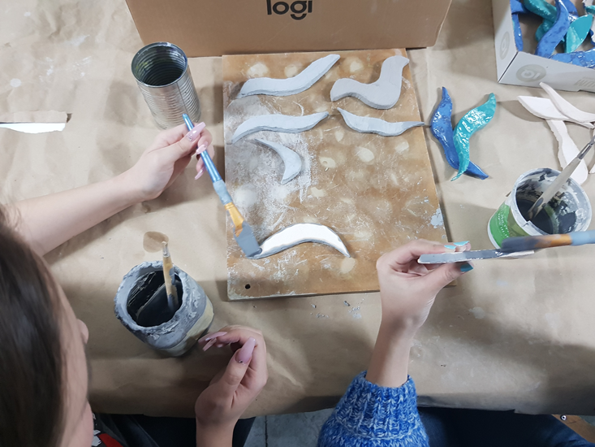
Ceramics group
Lead by Diana Sokolić

Slide 2
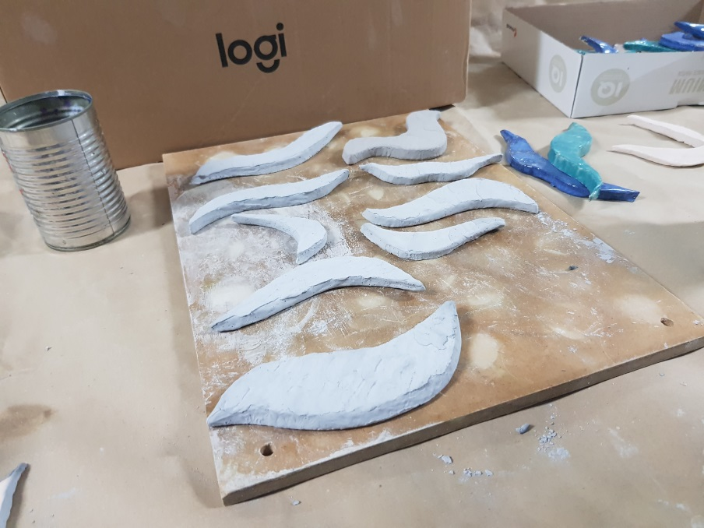
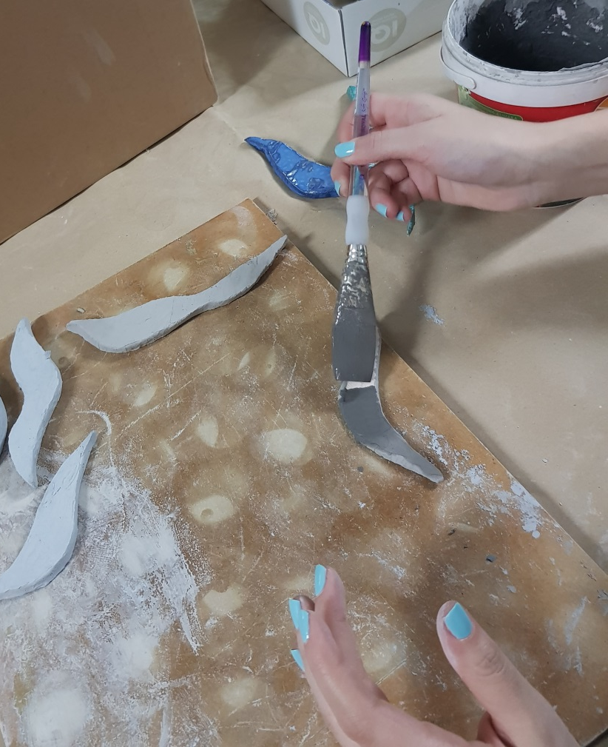
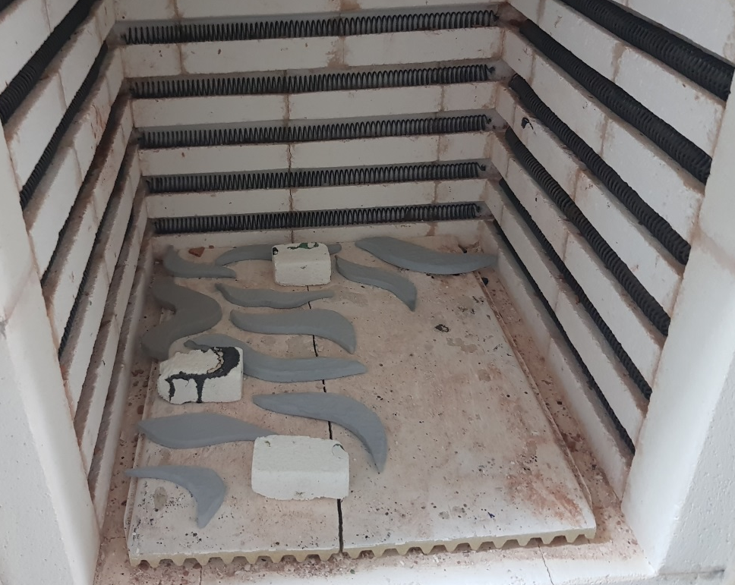
1. Slap clay against the table in order for air to get out
2. Make it thinner with the help of rolling pin
3. Make any shapes you want! (Be careful: choose wisely☺)
4. The object has to be put into ceramics oven
5. When it completely cools down you can start with glazing which is adding color to your handmade and unique ceramics

Slide 3
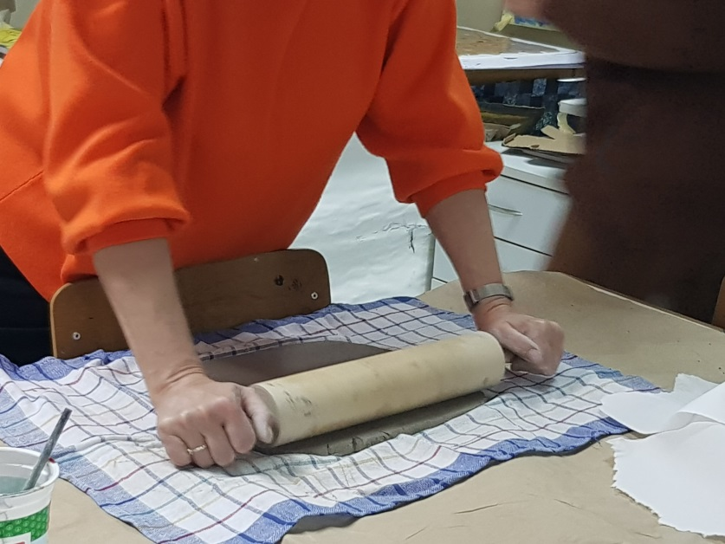
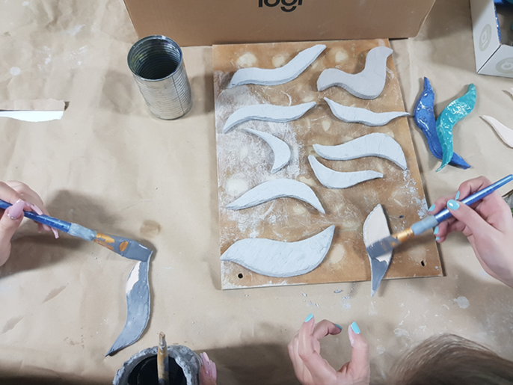
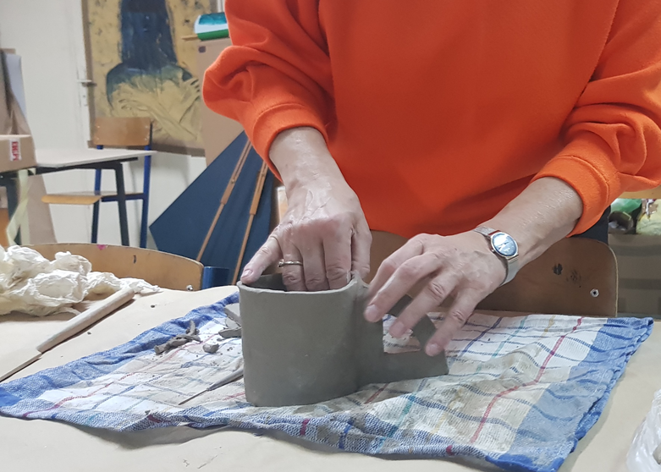
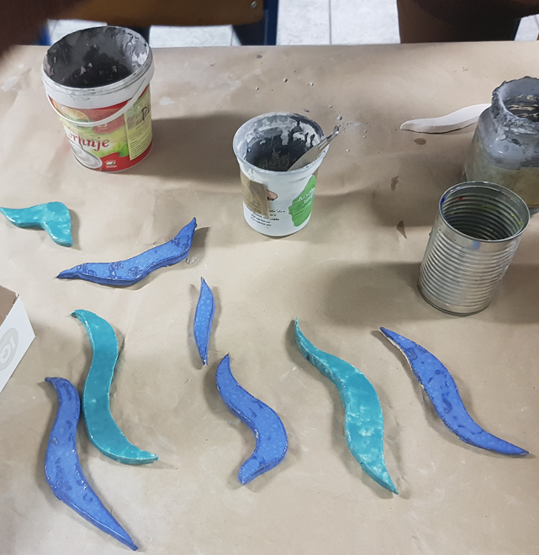
It takes a lot of hard work to make objects, but it is definitely worth to try
PROCCESS OF WORKING WITH CLAY

