Slide 1
GEOMETRY IN CASTLE ARCHITECTURE
Nikola Ćulumović

Slide 2
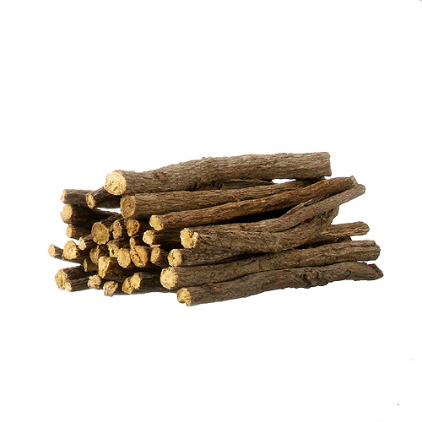
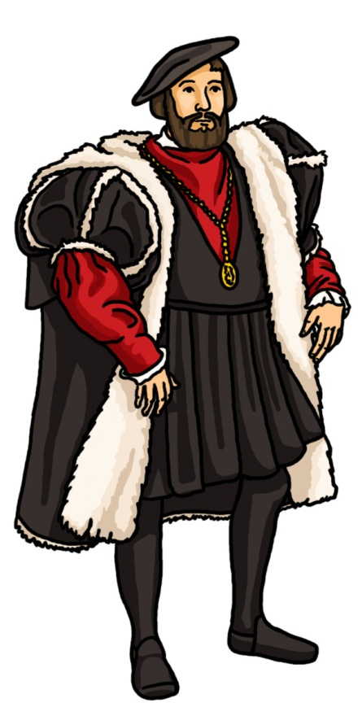
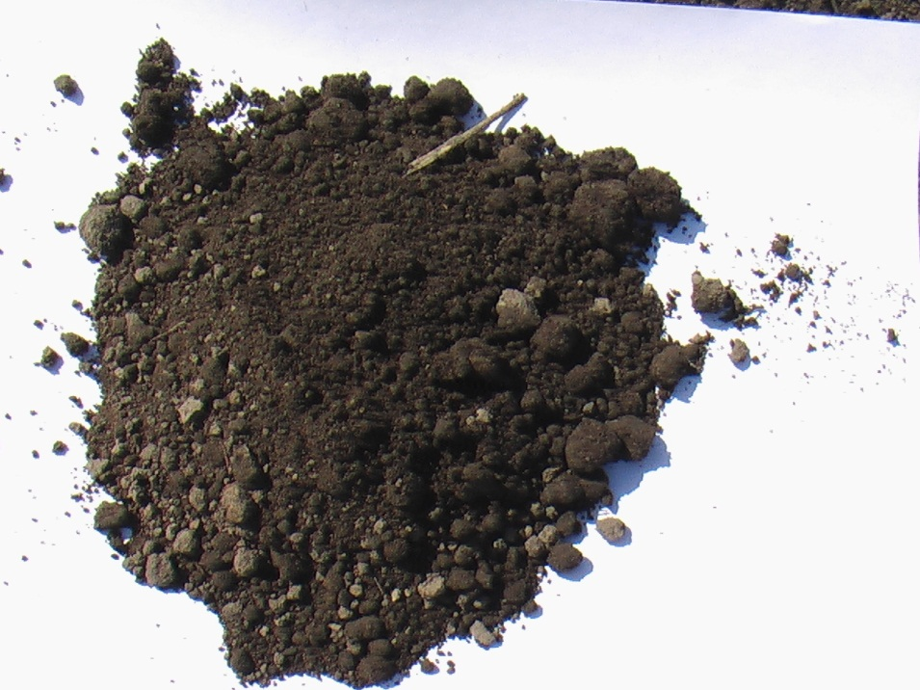
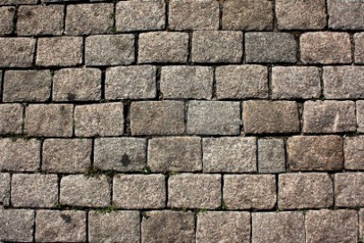
CASTLE?
Notes:
Sure, we’ve all used that word we all know what it means. But do we really know what it means? A castle is a fortified structure built in europe and the middle east during the Middle ages, by members of the nobility
They were a European „invention” that saw a major boom after the fall of the Carolingian empire
Although first castles were built from earth, mud and sticks with the introduction of stone math got it’s fingers into the design of castles

Slide 3
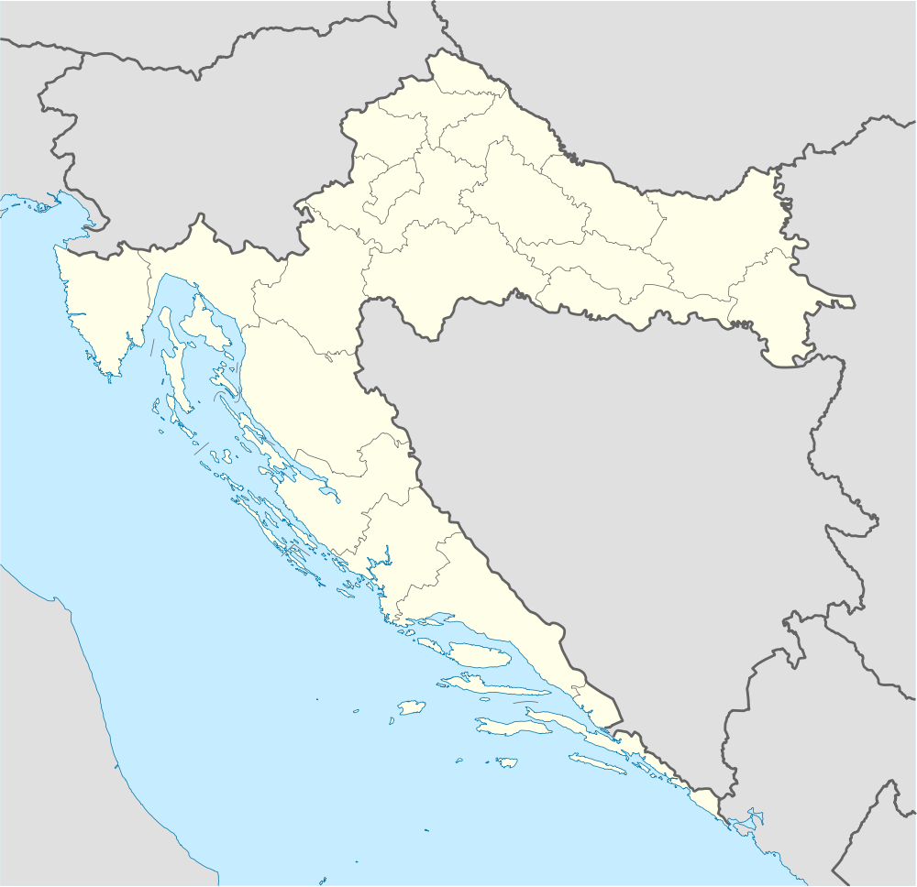
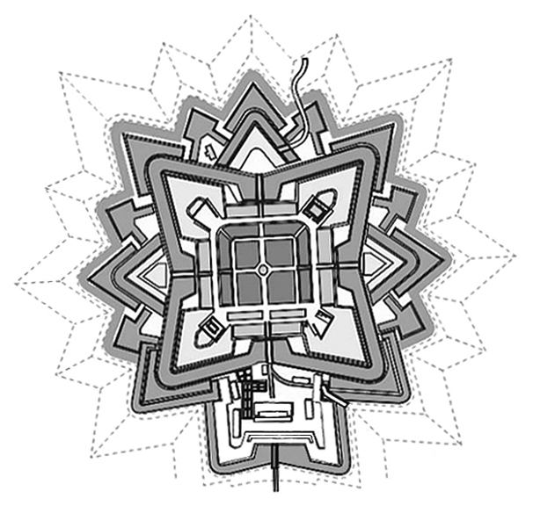
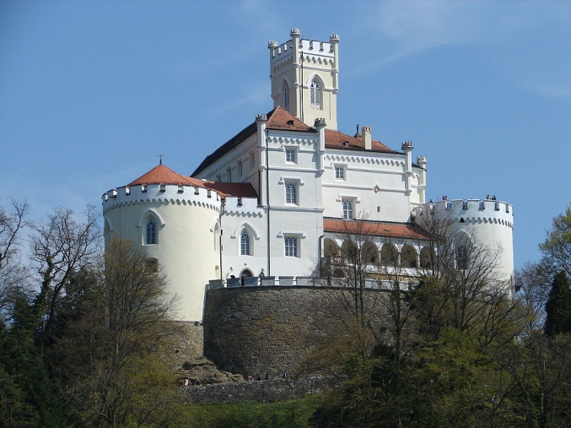
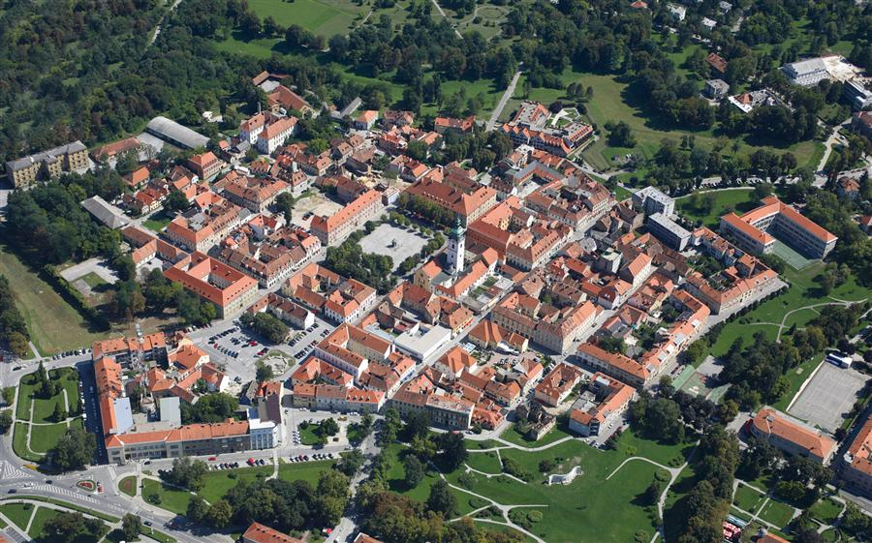
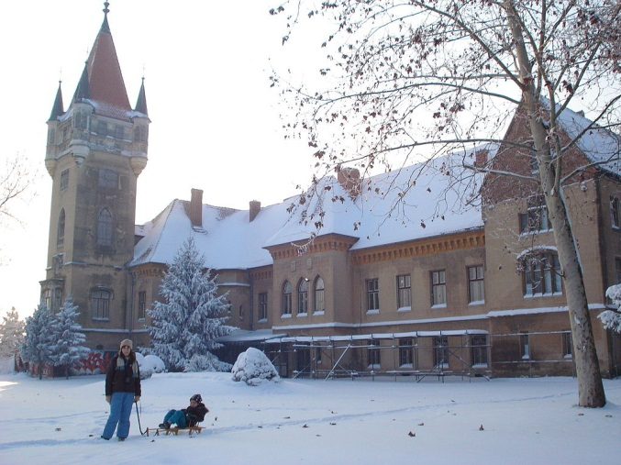
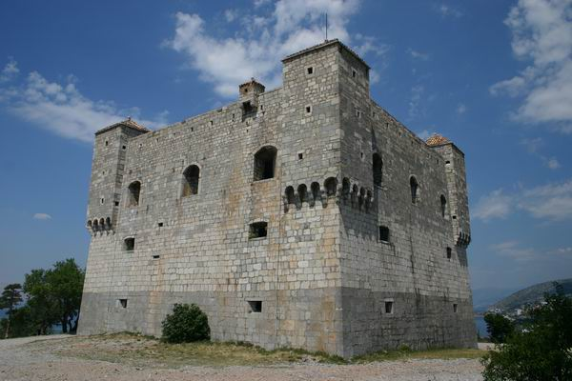
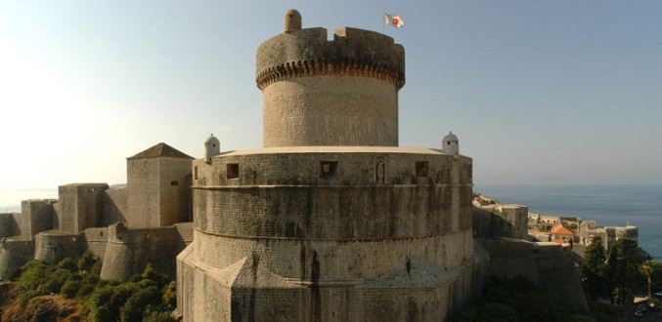
CASTLES & FORTS IN CROATIA
Notes:
Fort nehaj built in the 16th century, had a rectangular base

Slide 4
FORT MINCETA
DUBROVNIK
STRONG MERCHANT TIES WITH BIZANTINE EMPIRE
ORIGINALLY BUILT WITH A RECTANGULAR BASE IN THE 1300.
OTTOMAN EMPIRE
1500. PLAN WAS SET IN MOTION TO CONVERT IT INTO A ROUND FORT

Slide 5
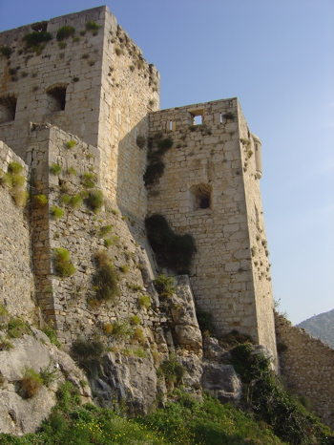
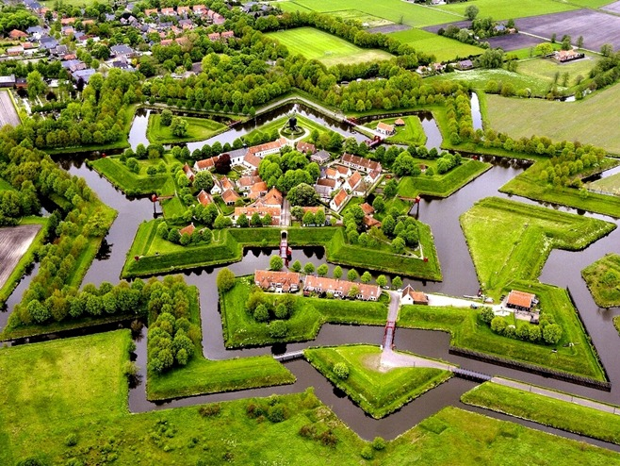
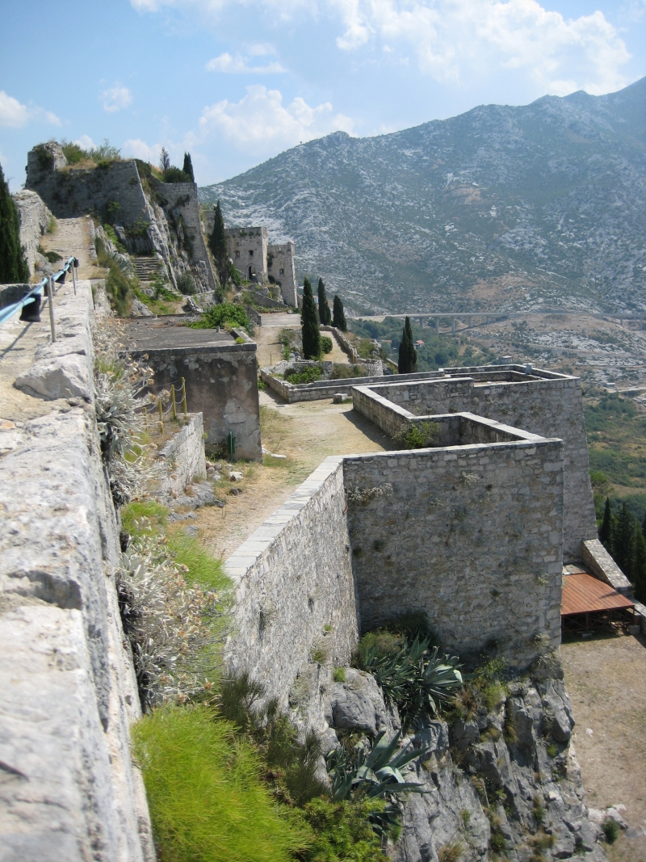
MORE EXAMPLES

Slide 6
WHY?
DEFENSIVE STRUCTURES
EFFECTIVE RANGE OF 150m
INCREASE IN THE NUMBER OF SIDES CORELATES TO AN INCREASE OF OVERLAPING AREAS OF FIRE

Slide 7
COMPARISON
$$P_{sector}=\frac{r^{2}∗π∗β}{360°}$$
$$β=\frac{\left(n−2\right)∗180°}{n}$$
OVERLAPPING AREA OF FIRE OF A RECTANGULAR FORT IS
$P=\frac{{(150 m)}^{2}∗π∗\left(4−2\right)}{2}={70686m}^{2}$
AND THE OVERLAPPING AREA OF FIRE OF A HEXAGONAL FORT IS
$P=\frac{{(150 m)}^{2}∗π∗\left(4−2\right)}{2}={141372m}^{2}$
$$P=\frac{r^{2}∗π∗\left(n−2\right)}{2}$$
$$P=P_{sector}∗n$$

